Slide 1
Analysis Resource Overview
tools.iedb.org
Presented by: Bjoern Peters, Professor

Slide 2
IEDB Analysis Resource tools.iedb.org
T cell tools
B cell tools
Analysis tools
MHC binding prediction
Linear epitope prediction
Population coverage of epitope set
MHC I binding prediction
MHC II binding prediction
TepiTool
BepiPred
Other methods
Population coverage tool
Degree of conservation
MHC processing prediction
Discontinuous epitope prediction
Conservancy analysis tool
NetChop/NetCTL/NetCTLpan
MHC-NP, MHCII-NP
DiscoTope
ElliPro
Group peptides based on sequence identity
Immunogenicity prediction
Cluster 2.0
CD4 & CD8 T cell immunogenicity prediction tools
Antibody and TCR structure prediction
LYRA
SCEptRe
Infer restriction in HLA typed subjects
RATE
Remove epitopes from therapeutic proteins
Aggregate heterogeneous immune response
Deimmunization tool
Immunome-browser

Slide 3
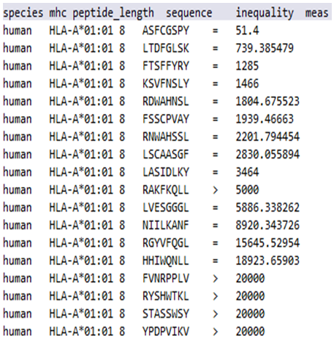
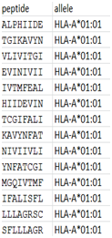
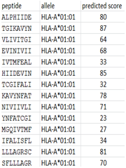
Development of prediction tools
Epitope prediction tools
Vaccine, cancer neoantigen studies
Based on machine learning techniques
Experimentally derived data
E.g. MHC binding data, Eluted ligand data, T cell assay data
Training data
Peptide data for prediction
Prediction method/model
Prediction results

Slide 4
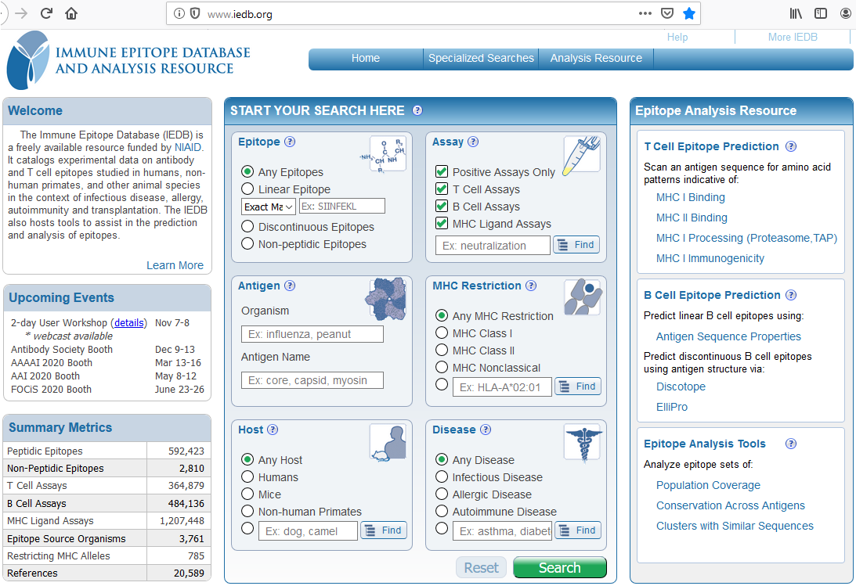
Accessing the Analysis Resource
tools.iedb.org
iedb.org

Slide 5
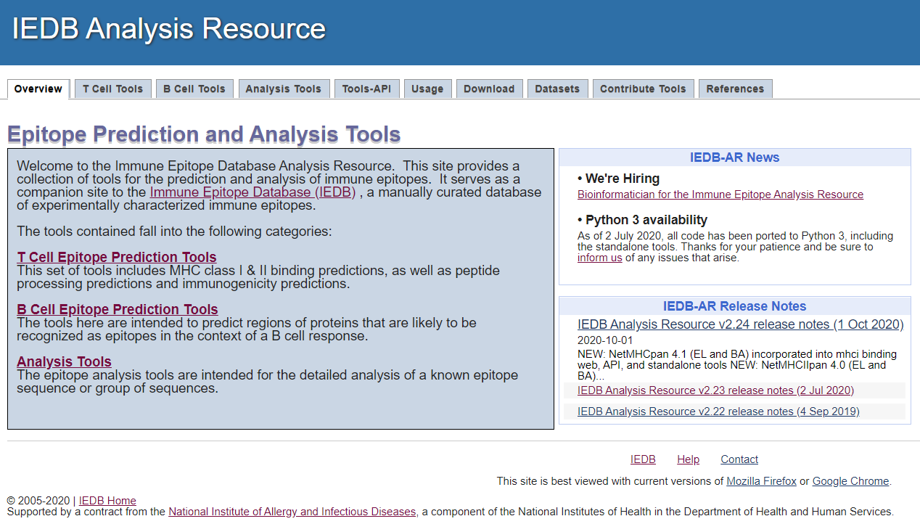
Available Resources
API/RESTful interface
Standalone/Local
Solutions Center:
Tutorials, Q&A
help@iedb.org

Slide 6
T Cell Tools
tools.iedb.org/main/tcell/

Slide 7
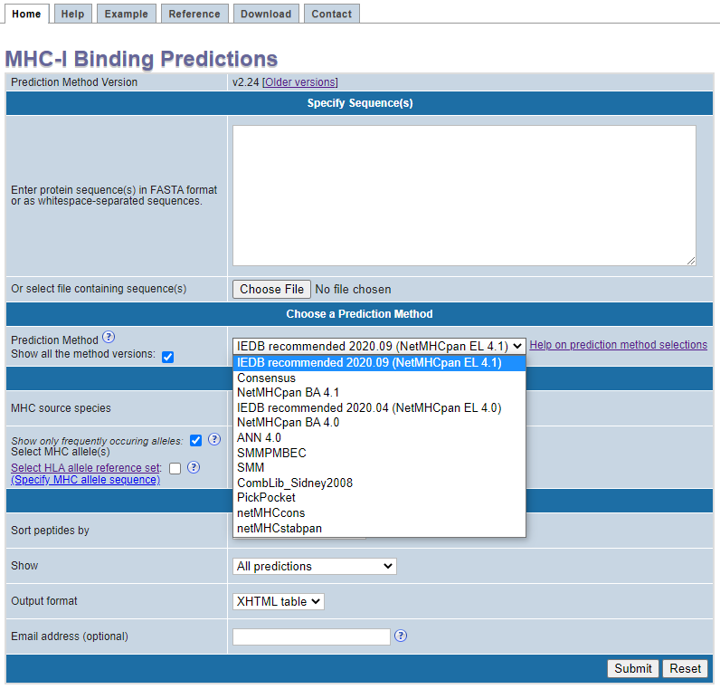
MHC I binding prediction
tools.iedb.org/mhci/
>LCMV Armstrong, Protein GP
MGQIVTMFEALPHIIDEVINIVIIVLIVITGIKAVYNFATCGIFALISFLLLAGRSCGM
YGLKGPDIYKGVYQFKSVEFDMSHLNLTMPNACSANNSHHYISMGTSGLELTFTNDSII
SHNFCNLTSAFNKKTFDHTLMSIVSSLHLSIRGNSNYKAVSCDFNNGITIQYNLTFSDA
QSAQSQCRTFRGRVLDMFRTAFGGKYMRSGWGWTGSDGKTTWCSQTSYQYLIIQNRTWE
NHCTYAGPFGMSRILLSQEKTKFFTRRLAGTFTWTLSDSSGVENPGGYCLTKWMILAAE
LKCFGNTAVAKCNVNHDAEFCDMLRLIDYNKAALSKFKEDVESALHLFKTTVNSLISDQ
LLMRNHLRDLMGVPYCNYSKFWYLEHAKTGETSVPKCWLVTNGSYLNETHFSDQIEQEA
DNMITEMLRKDYIKRQGSTPLALMDLLMFSTSAYLVSIFLHLVKIPTHRHIKGGSCPKP
HRLTNKGICSCGAFKVPGVKTVWKRR
Sequence
Prediction method

Slide 8
MHC I binding prediction methods - benchmarking

Slide 9
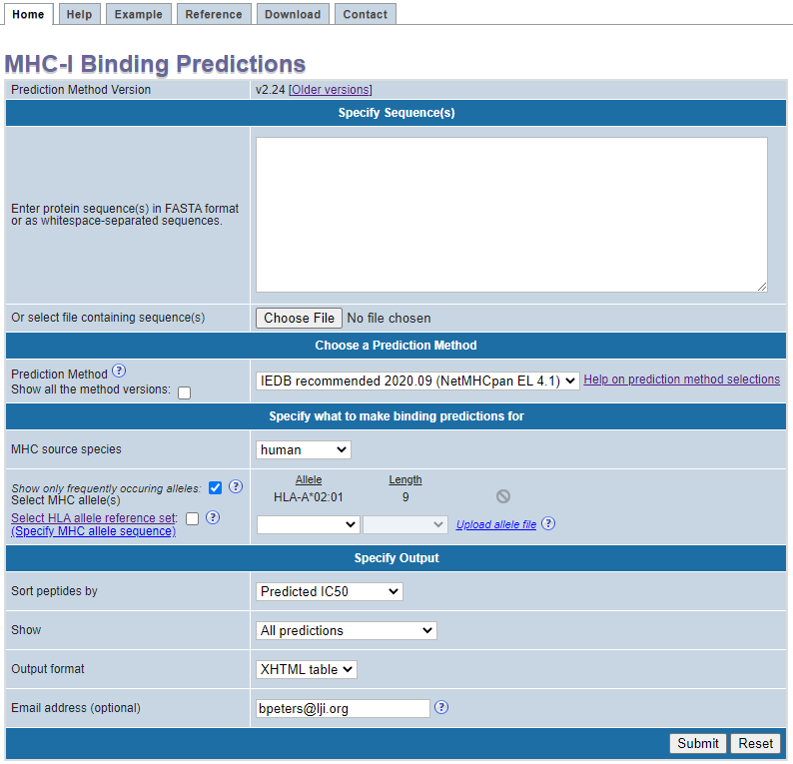
MHC I binding prediction
tools.iedb.org/mhci/
>LCMV Armstrong, Protein GP
MGQIVTMFEALPHIIDEVINIVIIVLIVITGIKAVYNFATCGIFALISFLLLAGRSCGM
YGLKGPDIYKGVYQFKSVEFDMSHLNLTMPNACSANNSHHYISMGTSGLELTFTNDSII
SHNFCNLTSAFNKKTFDHTLMSIVSSLHLSIRGNSNYKAVSCDFNNGITIQYNLTFSDA
QSAQSQCRTFRGRVLDMFRTAFGGKYMRSGWGWTGSDGKTTWCSQTSYQYLIIQNRTWE
NHCTYAGPFGMSRILLSQEKTKFFTRRLAGTFTWTLSDSSGVENPGGYCLTKWMILAAE
LKCFGNTAVAKCNVNHDAEFCDMLRLIDYNKAALSKFKEDVESALHLFKTTVNSLISDQ
LLMRNHLRDLMGVPYCNYSKFWYLEHAKTGETSVPKCWLVTNGSYLNETHFSDQIEQEA
DNMITEMLRKDYIKRQGSTPLALMDLLMFSTSAYLVSIFLHLVKIPTHRHIKGGSCPKP
HRLTNKGICSCGAFKVPGVKTVWKRR
Prediction method
Allele & length
Email ID

Slide 10
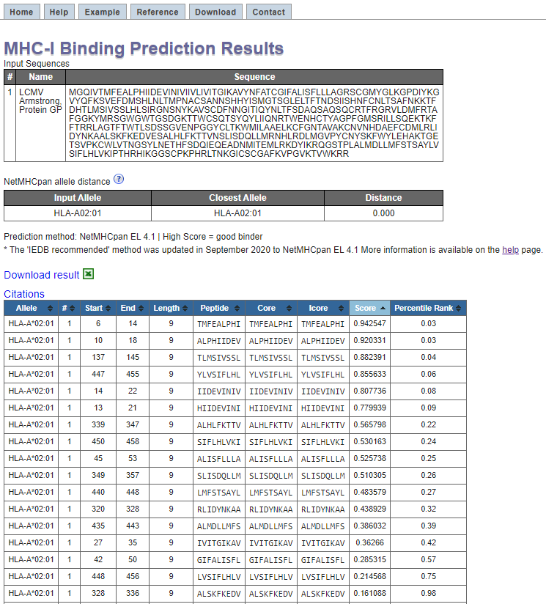
MHC I binding prediction - result
tools.iedb.org/mhci/

Slide 11
MHC II binding prediction
tools.iedb.org/mhcii/
>West Nile virus envelope glycoprotein
FNCLGMSNRDFLEGVSGATWVDLVLEGDSCVTIMSKDKPTIDVKMMNMEAANLAEVRSYCYLATVSDLST
KAACPTMGEAHNDKRADPAFVCRQGVVDRGWGNGCGLFGKGSIDTCAKFACSTKAIGRTILKENIKYEVA
IFVHGPTTVESHGNYSTQVGATQAGRFSITPAAPSYTLKLGEYGEVTVDCEPRSGIDTNAYYVMTVGTKT
FLVHREWFMDLNLPWSSAGSTVWRNRETLMEFEEPHATKQSVIALGSQEGALHQALAGAIPVEFSSNTVK
LTSGHLKCRVKMEKLQLKGTTYGVCSKAFKFLGTPADTGHGTVVLELQYTGTDGPCKVPISSVASLNDLT
PVGRLVTVNPFVSVATANAKVLIELEPPFGDSYIVVGRGEQQINHHWHKSGSSIGKAFTTTLKGAQRLAA
LGDTAWDFGSVGGVFTSVGKAVHQVFGGAFRSLFGGMSWITQGLLGALLLWMGINARDRSIALTFLAVGGVLLFLSVNVHA

Slide 12
TepiTool – MHC I and II binding prediction
tools.iedb.org/tepitool/
>LCMV Armstrong, Protein GP
MGQIVTMFEALPHIIDEVINIVIIVLIVITGIKAVYNFATCGIFALISF

Slide 13
TepiTool – MHC I and II binding prediction
tools.iedb.org/tepitool/

Slide 14
TepiTool – MHC I and II binding prediction
tools.iedb.org/tepitool/

Slide 15
B Cell Tools

Slide 16
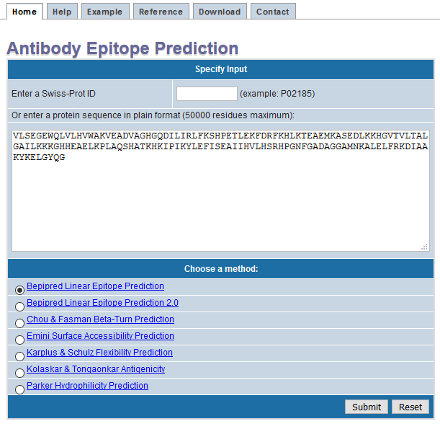
B Cell epitope prediction – sequence based
tools.iedb.org/bcell/
VLSEGEWQLVLHVWAKVEADVAGHGQDILIRLFKSHPETLEKFDRFKHLKTEAEMKASEDLKKHGVTVLTALGAILKKKGHHEAELKPLAQSHATKHKIPIKYLEFISEAIIHVLHSRHPGNFGADAGGAMNKALELFRKDIAAKYKELGYQG

Slide 17
B Cell epitope prediction – sequence based
tools.iedb.org/bcell/

Slide 18
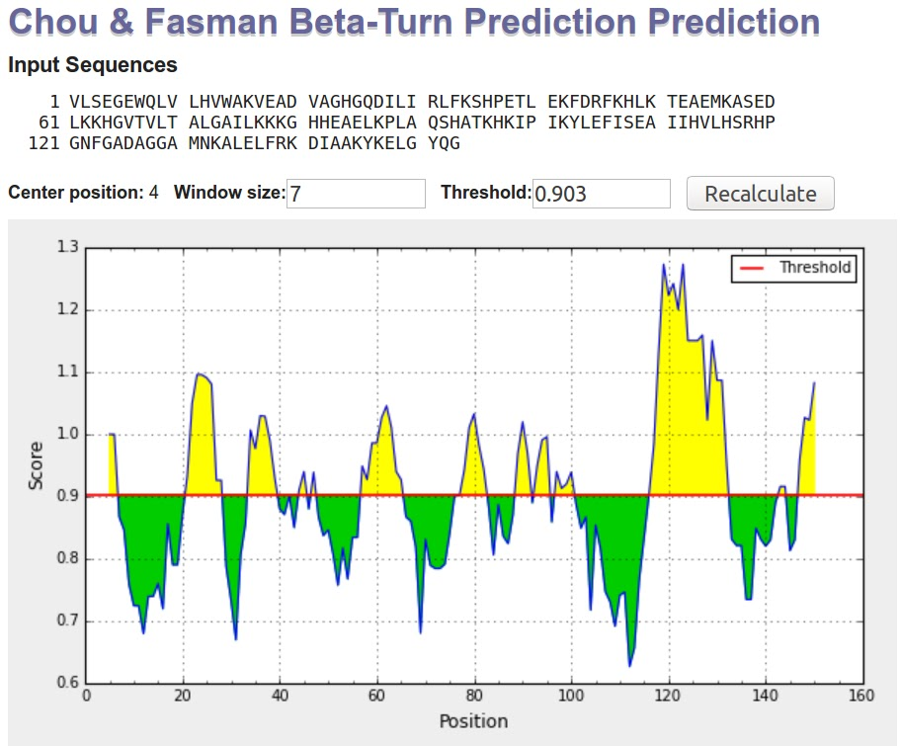
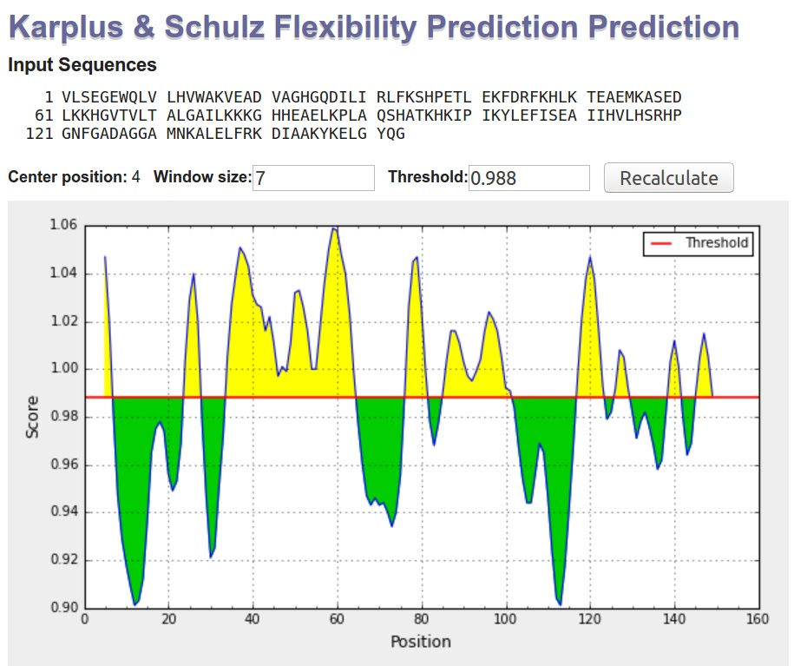
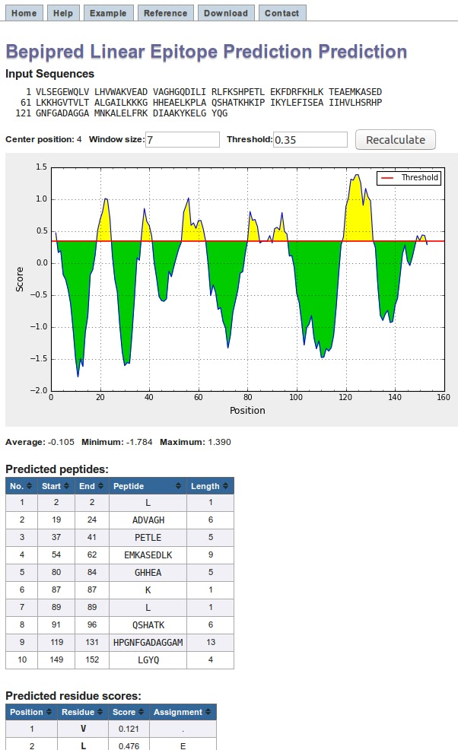
Using a consensus of different methods may be better.

Slide 19
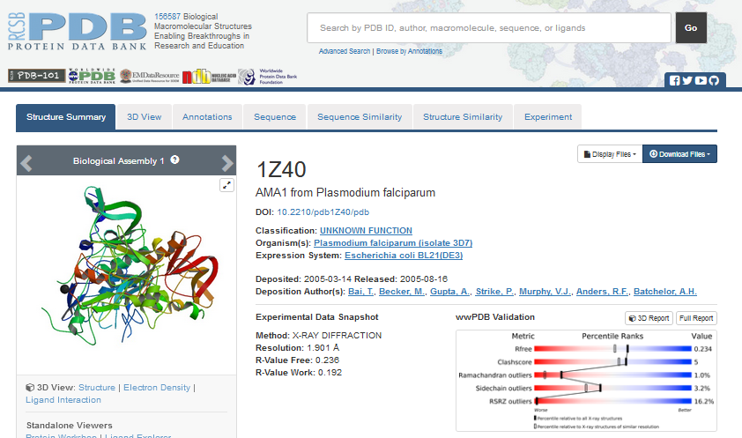
B cell epitope prediction – structure based
tools.iedb.org/discotope/

Slide 20
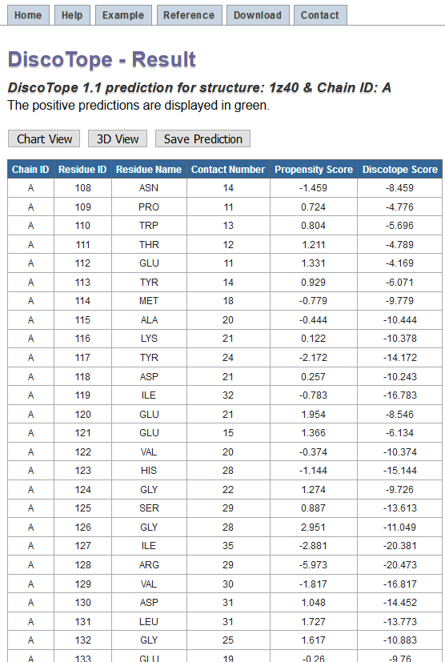
B cell epitope prediction – structure based

Slide 21
B cell epitope prediction – structure based

Slide 22
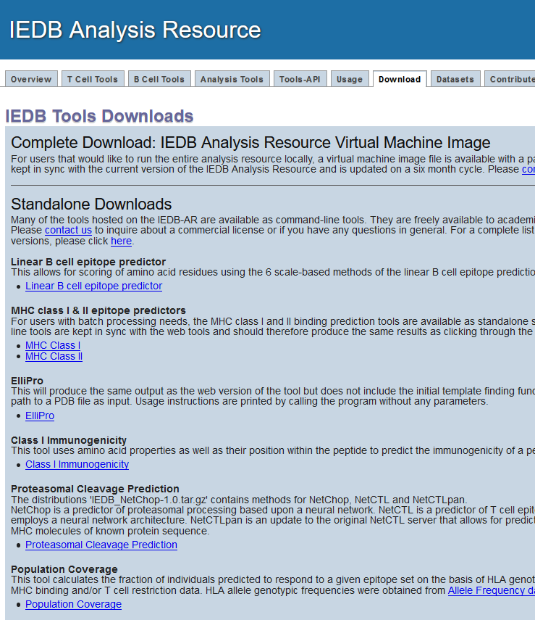
Standalone (local) version
tools.iedb.org/main/download/
Run programs on your local machine
Advantages:
No internet needed
Very helpful in case of large data sets
Free for non-profit & academia
Available for industry at a nominal fee
license@iedb.org

Slide 23
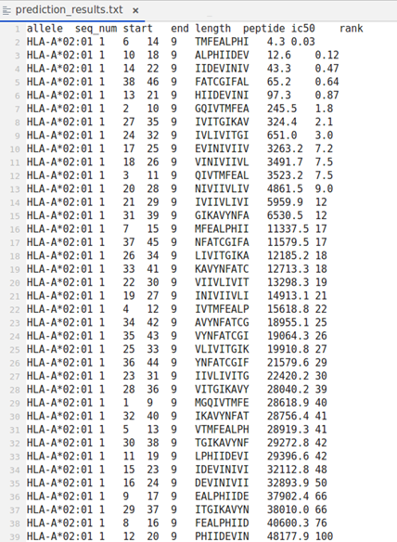
Standalone (local) version - example

Slide 24
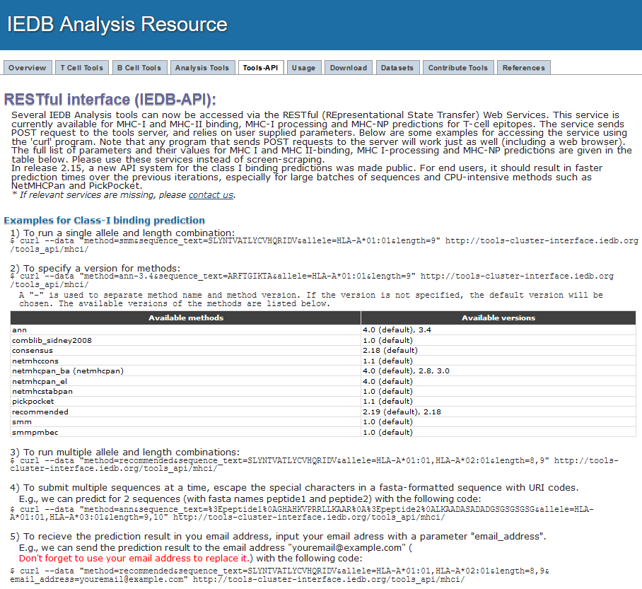
API version (RESTful interface)
tools.iedb.org/main/tools-api/
Sends prediction request to the tools server at LJI
No need to install tools on your machine
Freely available to all users
Can be incorporated in prediction pipelines
Automatic update without reinstalling

Slide 25
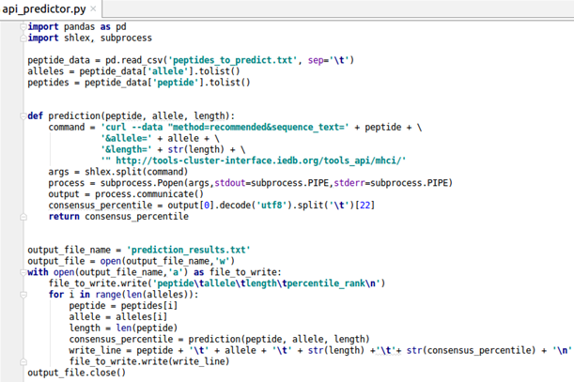
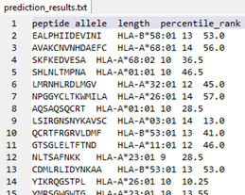
API version (RESTful interface) - example

Slide 26
Versions of IEDB Analysis Resource tools
Web
Standalone
API
http://tools.iedb.org
Client uses browsers to submit data
Predictions run on IEDB tools server
Can be run on Windows/Mac/Linux
Internet is needed
May not be suitable for very very large data sets
Automatically updated
http://tools.iedb.org/main/download
Uses command line interface
Downloaded from IEDB website
Installed and run on local machine
Runs on Linux only (can use virtual machines to run Linux on other OS)
Internet not needed once installed
Better for very large data sets
Need to update for every release
Free to academia/non-profit; License fee for industry
http://tools.iedb.org/main/tools-api
Uses command line interface
Predictions run on IEDB server
Clients send parameters to IEDB server using commands or scripts
Internet is needed
Can be used to make custom scripts for use with large data sets
Automatically updated
Free to all

Slide 27
Points to remember
First stop is IEDB database
Epitope prediction tools extrapolate from existing data to identify new candidate epitopes
‘Machine learning’ approaches identify patterns
ROC curves / AUC values as preferred performance metrics
Prediction is a screening step, not confirmatory
Predicted peptides should be experimentally verified
Analysis tools help to examine existing sets of epitopes and gain new knowledge
No single metric of performance
Broad array of applications

