Slide 1
Analysis Tools
tools.iedb.org
Presented by: Alessandro Sette, IEDB Principal Investigator

Slide 2
Analysis tools with broad applications
http://tools.iedb.org/main/analysis-tools/

Slide 3
Population Coverage
http://tools.iedb.org/population/
Calculates the fraction of individuals projected to bind and/or respond to a given set of epitopes with defined reactivity
Based on
Epitope known HLA binding/restrictions
HLA genotypic frequencies
HLA genotypic frequencies vary in different ethnicities
http://allelefrequencies.net

Slide 4
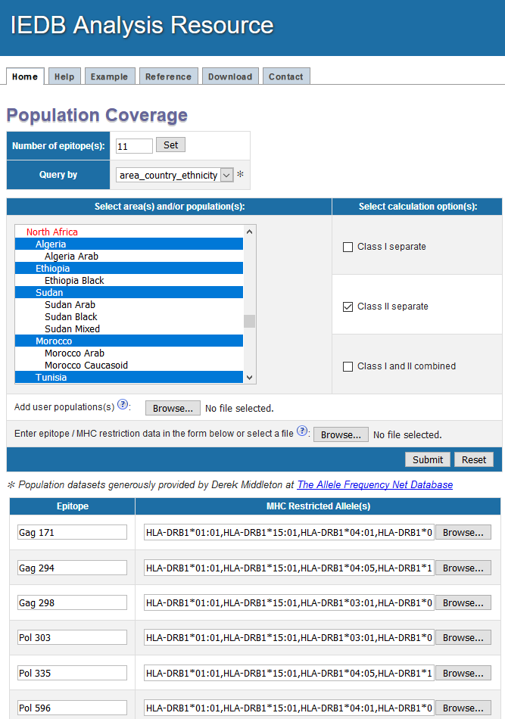
Population Coverage – example
http://tools.iedb.org/population/
For a set of 11 MHC class II restricted epitopes with promiscuous HLA binding, what is the population coverage in different North African populations?

Slide 5
Population Coverage – example
http://tools.iedb.org/population/
Results:
Summarized in table format
Plotted per population

Slide 6
Epitope Conservancy Analysis
Calculates the degrees of conservancy of one or more epitopes, within a given set of protein sequences
Adjustable sequence identity threshold
“Degree of conservation” = the fraction of protein sequences containing the epitope at a given identity level

Slide 7
Epitope Conservancy – example
http://tools.iedb.org/conservancy/
Known epitopes
Protein sequences

Slide 8
Epitope Conservancy – example
http://tools.iedb.org/conservancy/

Slide 9
Epitope Conservancy – example
http://tools.iedb.org/conservancy/

Slide 10
Epitope Cluster Analysis Tool
Analyzes how many epitopes in a set have significant sequence homology
Groups epitopes into clusters based on having sequence identity greater than a specified threshold
Three different clustering approaches are implemented
Enables diverse applications such as generating epitope pools, and understanding cross-reactivity

Slide 11
Clustering approaches
1. All connected peptides in a cluster
All peptides homologous to specified threshold are clustered together (for example, 70%)
Drawback: members of the cluster might be related by levels of homology lower than threshold (for example, 70%)
2. Fully interconnected clusters (cliques)
All peptides in a cluster share homology higher than the given threshold
Drawback: One peptide can be a part of multiple cliques
3. Cluster-break method (recommended method)
An extension of first approach
A cluster is broken down into subclusters based on consensus sequence computations

Slide 12
Here is a set of sequences...as an example
TRAPPER
CLAPPER
SNAPPER
RAPPERTIME
DAYTIME
ANYTIME
PERTIME
TIMELESS
TIMER
TWICE
NICEDAY
ICE
CEDAR
HAPPYDAYS
HIPPY
PAYDAY
CALAMARI
AMA
ISQAVHAAHAEINEAGR

Slide 13
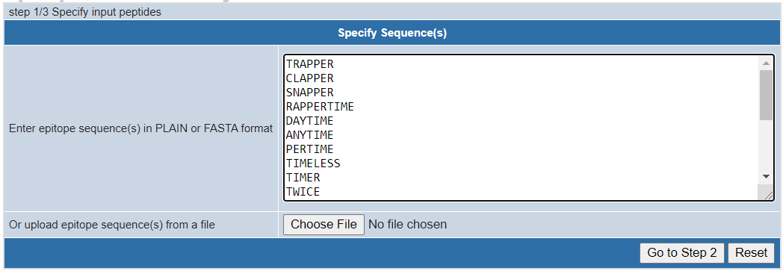
Epitope Clustering – example
http://tools.iedb.org/cluster/
Step 1:
Enter epitope sequences
Step 2:
Specify parameters
Step 3:
Select algorithm

Slide 14
Epitope Clustering – example
http://tools.iedb.org/cluster/
TRAPPER and TIMELESS do not have 80% homology but are in the same cluster because each have 80% homology to other members of the cluster

Slide 15
Epitope Clustering – example
http://tools.iedb.org/cluster/
Step 1:
Enter epitope sequences
Step 2:
Specify parameters
Step 3:
Select algorithm

Slide 16
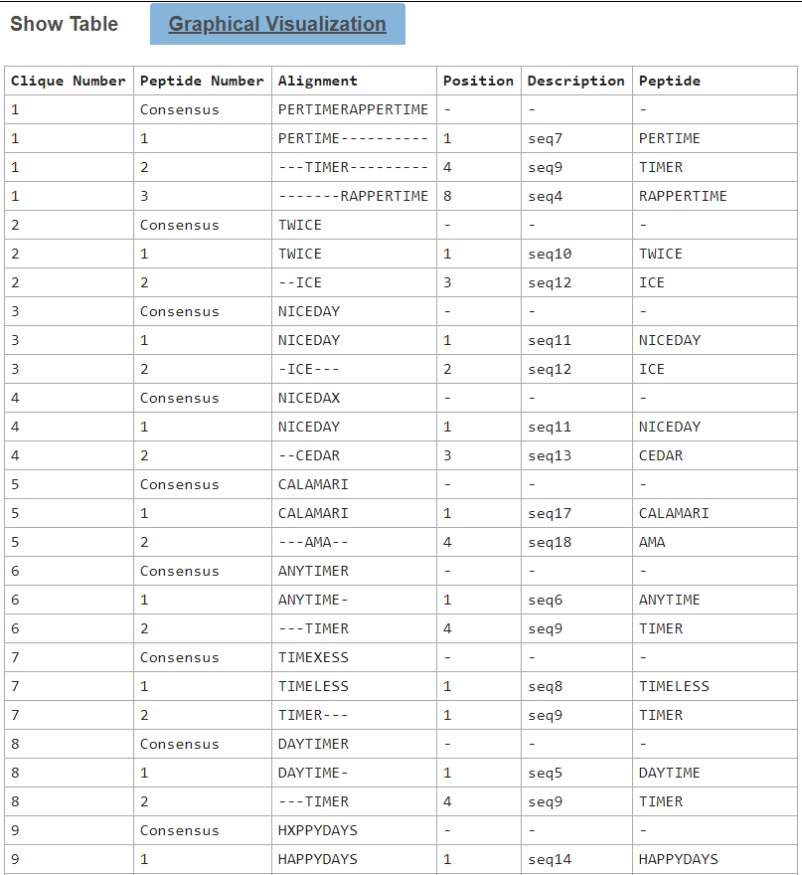
Epitope Clustering – example
http://tools.iedb.org/cluster/
TIMER (and several others) appear in multiple clusters because they have the specified level of homology to the other members of the clique

Slide 17
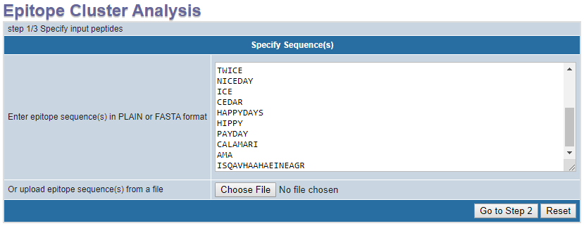
Cluster-break method is the recommended method
http://tools.iedb.org/cluster/
Step 1:
Enter epitope sequences
Step 2:
Specify parameters
Step 3:
Select algorithm

Slide 18
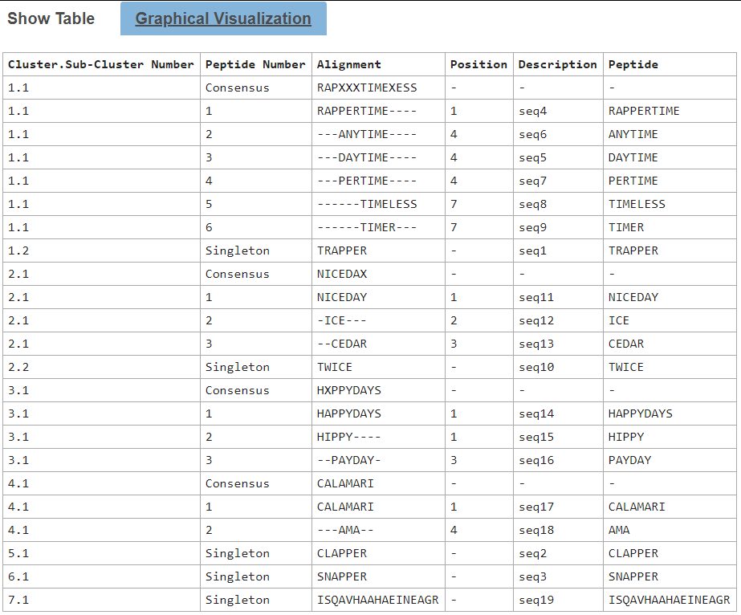
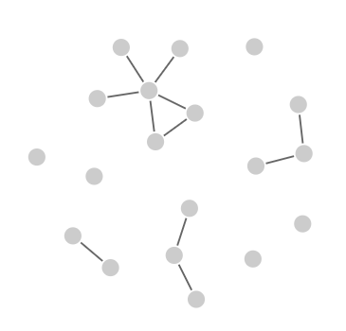
Epitope Clustering – example
http://tools.iedb.org/cluster/

Slide 19
Restrictor Analysis Tool for Epitopes (RATE)
Automated method to infer HLA restriction of a given epitope set, from immune response data of HLA typed subjects
The method is based on computing the frequency of all alleles expressed in the population studied in donors who had an immune response to each given epitope
Compare those frequencies in donors that did not have a response to the same epitope

Slide 20
RATE
http://tools.iedb.org/rate/
Labs designation
Two data input files need to be provided

Slide 21
RATE – Input: Allele data
Data format = tab separated in plain text file
Sample data shown here – 12 class II alleles of 6 loci for each donor are listed in separate columns

Slide 22
RATE – Input: Response data
Data format = tab separated in plain text file
The response data (here SFC values) for each epitope in each of the donors are provided

Slide 23
RATE – how it works
Restrictions are determined based on
“Odds Ratio” and significance estimated using Fisher's exact test.
“Relative Frequency”, a parameter estimated by the tool based on the frequency of alleles and donors responded

Slide 24
RATE – example

Slide 25
RATE – example
All buttons download as .csv files

Slide 26
RATE – results (complete report)
All epitopes

Slide 27
RATE – results (selected HLA restrictions)
Epitope-allele combinations with RF ≥ 1.3 and p-value < 0.01 are reported (not Bonferroni corrected)

Slide 28
Deimmunization

Slide 29
Deimmunization – background
Wild type and engineered proteins are widely used as drugs
Immunogenicity of protein drugs is associated with serious potency and safety issues
A potential approach to reducing immunogenicity is based on removal of T cell epitopes (de-immunization)

Slide 30
Deimmunization – approach
Generate overlapping peptides from protein sequence
Predict HLA class II binding binding regions
APPRLICDSRVLERY | 1-15 | 38.89
ICDSRVLERYLLEAK | 6-20 | 60.39
VLERYLLEAKEAENI | 11-25 | 23.46
LLEAKEAENITTGCA | 16-30 | 21.76
. . .
DTFRKLFRVYSNFLR | 136-150 | 6.08
Suggest amino acid substitutions that are predicted to decrease binding
Also consider the effect of substitutions on neighboring peptides

Slide 31
Deimmunization – example
http://tools.iedb.org/deimmunization/
>sp|P01588|EPO_HUMAN Erythropoietin OS=Homo sapiens GN=EPO PE=1 SV=1
APPRLICDSRVLERYLLEAKEAENITTGCAEHC
SLNENITVPDTKVNFYAWKRMEVGQQAVEVWQGLALLSEAVLRGQALLVNSSQPWEPLQLHVDKAVSGLRSLTTLLRALGAQKEAISPPDAASAAPLRTITADTFRKLFRVYSNFLRGKL
KLYTGEACRTGDR
Epitope
sequence
Threshold

Slide 32
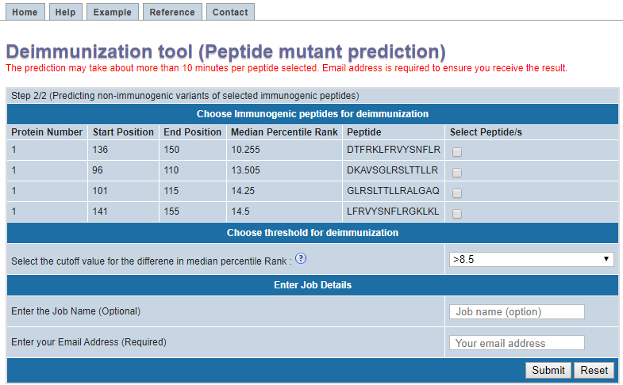
Deimmunization – example
http://tools.iedb.org/deimmunization/

Slide 33
Deimmunization Score
Immunogenicity for Neighboring peptide (1) | Immunogenicity for Neighboring peptide (2) | Score
Absent | Absent | 1
Reduced | Absent | 2
Reduced | Reduced | 3
Neutral | Absent | 4
Reduced | Neutral | 5
Neutral | Neutral | 6
Increased | Absent | 7
Reduced | Increased | 8
Increased | Neutral | 9
Increased | Increased | 10

Slide 34
Deimmunization – example

Slide 35
Analysis tools recap
Help to examine existing sets of epitopes and gain new knowledge across a broad array of applications
Population Coverage
Analyze T cell epitopes with known HLA restriction that are recognized in a population based on HLA frequencies
Conservancy
Investigate epitope conservancy across different protein sequences.
Cluster
Cluster epitopes on the basis of homology
RATE
(Restrictor Analysis)
Infer HLA restrictions for epitopes of T cell response frequency in HLA typed subjects
Deimmunization
Identify immunodominant regions in a given protein, and suggest amino-acid substitutions that create non-immunogenic versions of the protein.

