Slide 1


Using the IEDB and Analysis Resource for
Identifying Candidates in SARS-CoV-2
Alba Grifoni, PhD
Instructor in Sette lab
La Jolla Institute for Immunology

Slide 2
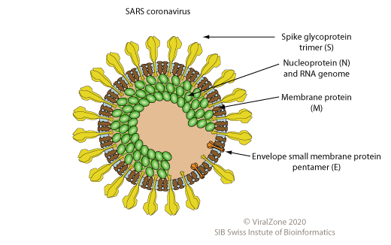
2019-nCoV has high degree of similarity with SARS-CoV
2019-nCoV
Bat-SL-CoV
SARS-CoV
MERS-CoV
2019-nCoV
Bat-SL-CoV
SARS-CoV
MERS-CoV
Can we identified SARS-CoV-2 immunodominant regions based on SARS-CoV data?

Slide 3
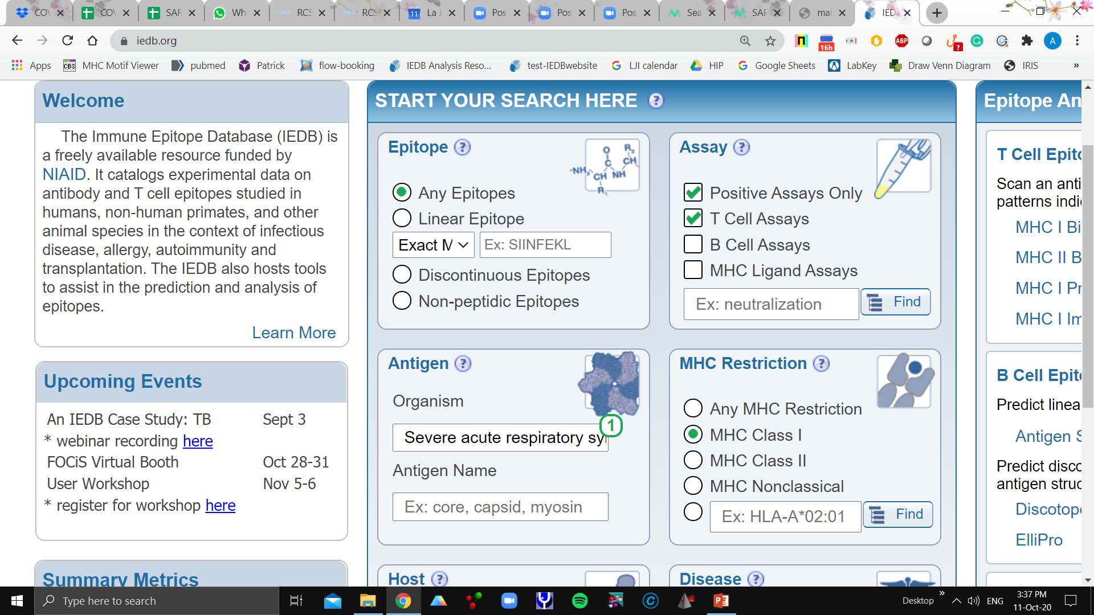
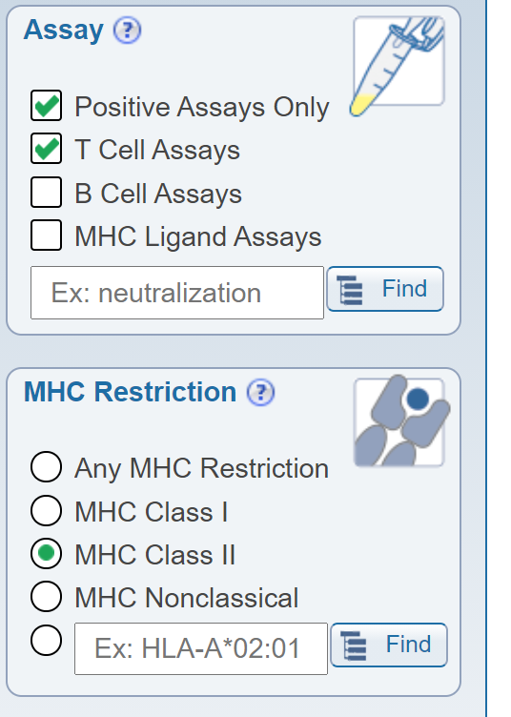
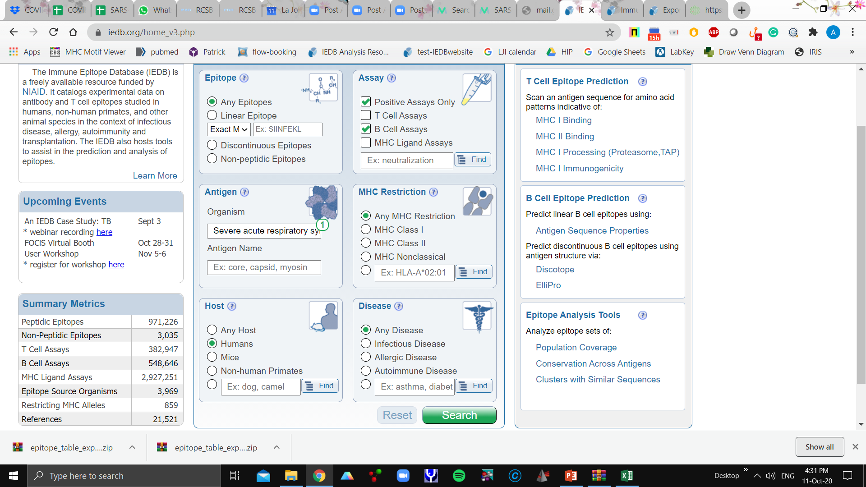
Searching T and B cell epitopes for SARS-CoV
CD8 T cell
epitopes
CD4 T cell
epitopes
B cell
epitopes
STEP 1
Select the organism
STEP 2
Specify the
Type Epitopes
STEP 3
Specify the
Host and Disease

Slide 4
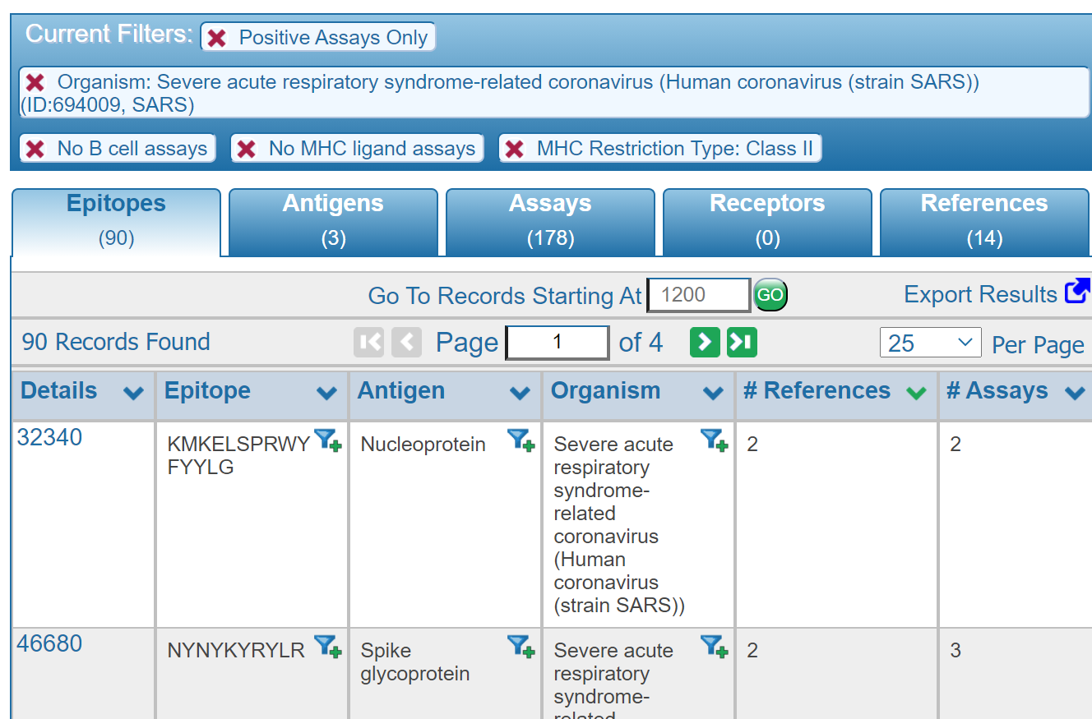
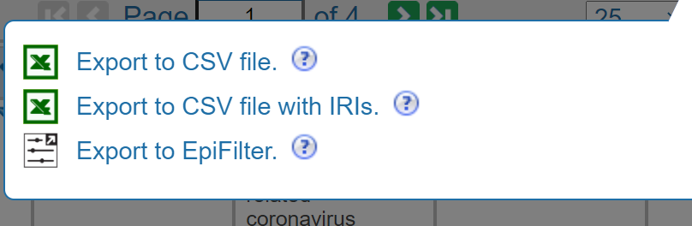
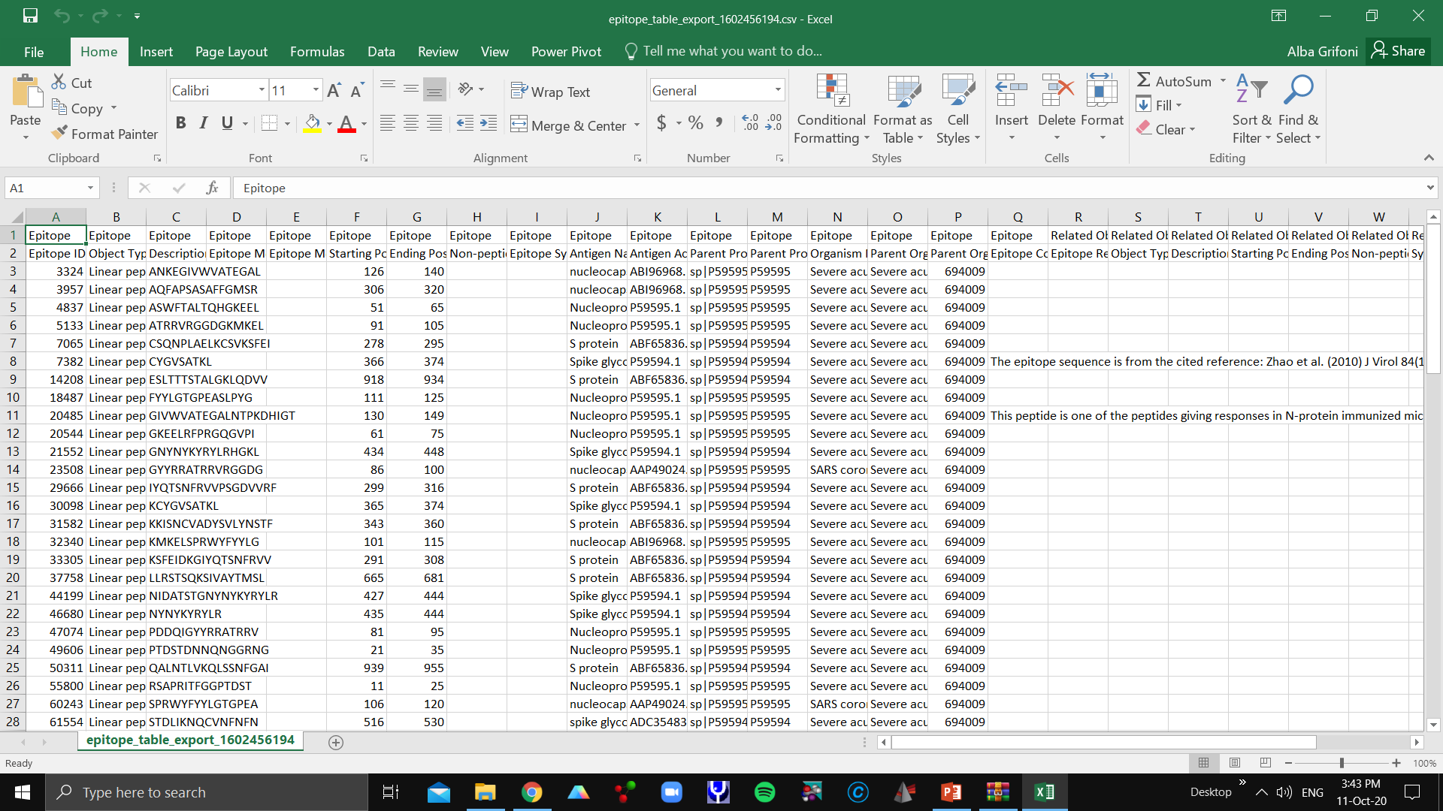
Results of CD4T cell epitopes query for SARS-Cov

Slide 5
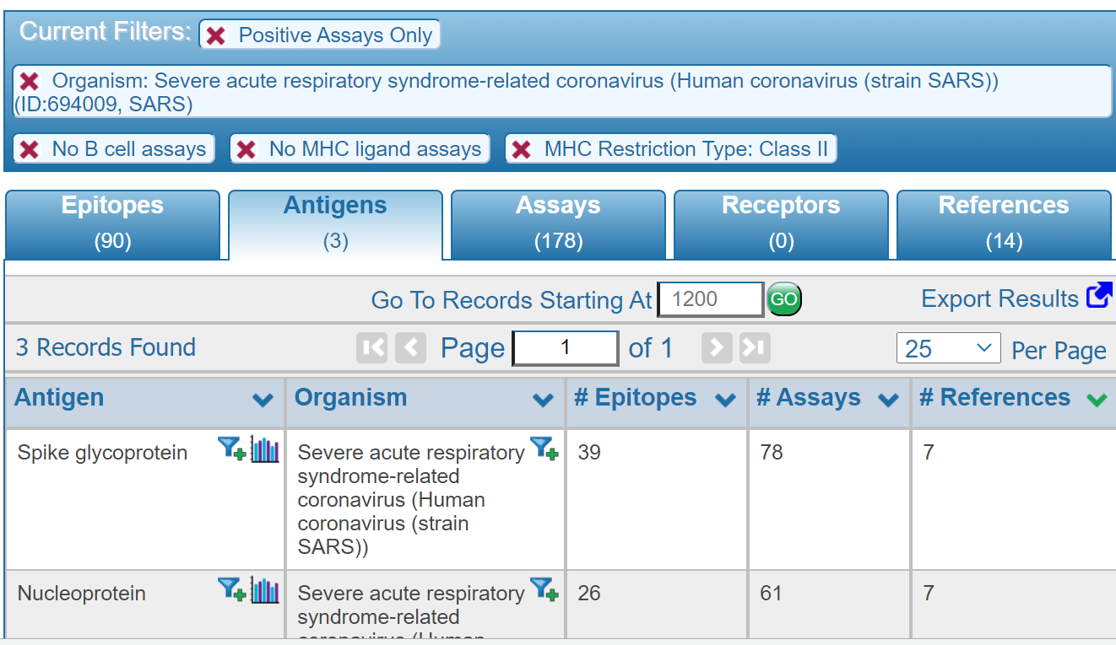
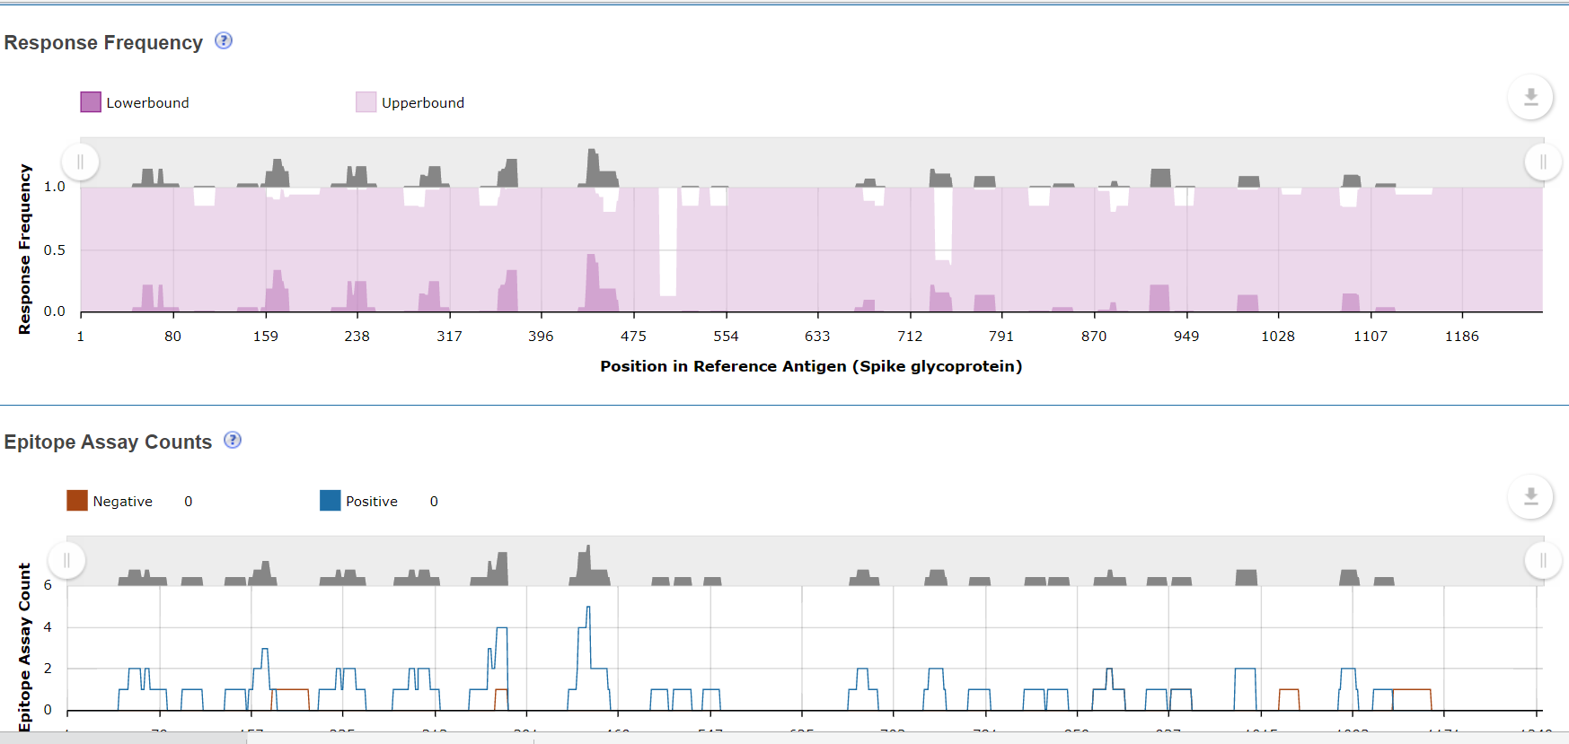
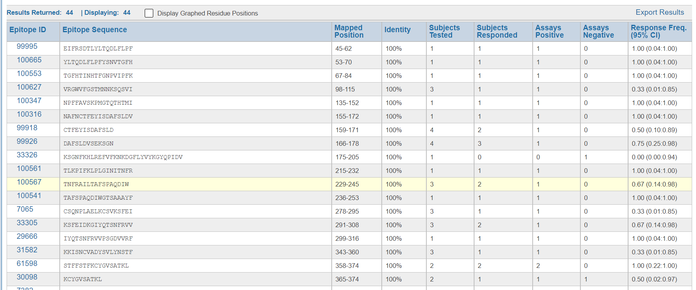
Mapping epitopes to the different SARS-CoV proteins
You can always export your queries and analyses in IEDB!

Slide 6
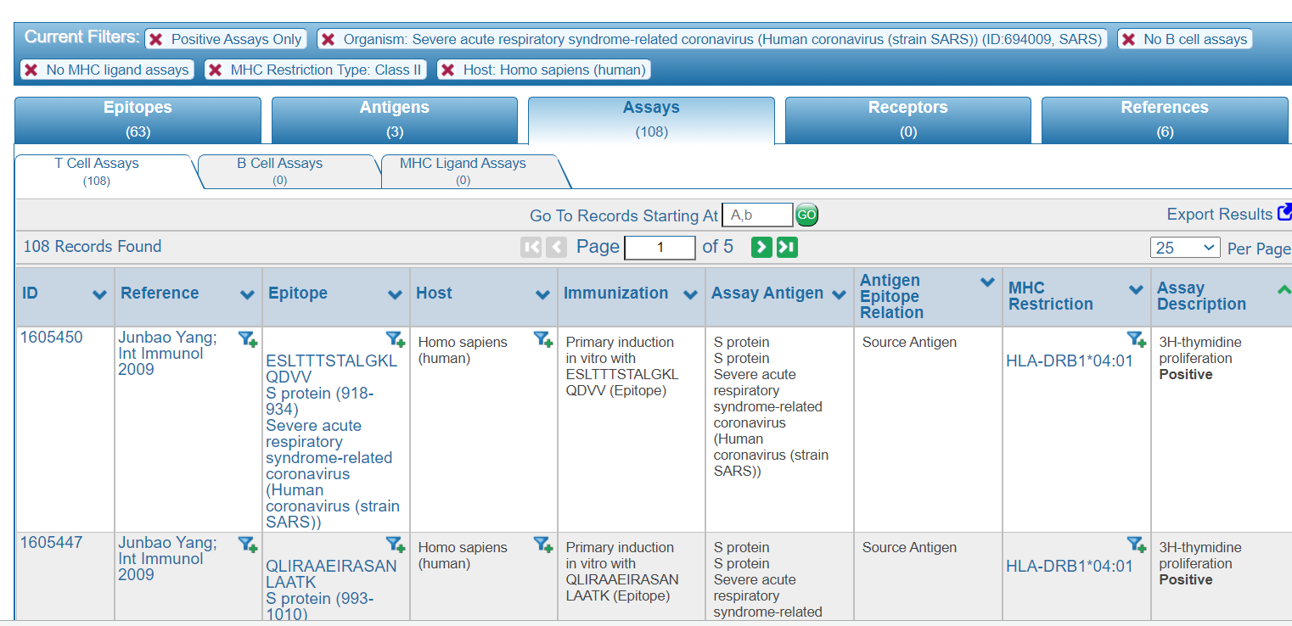
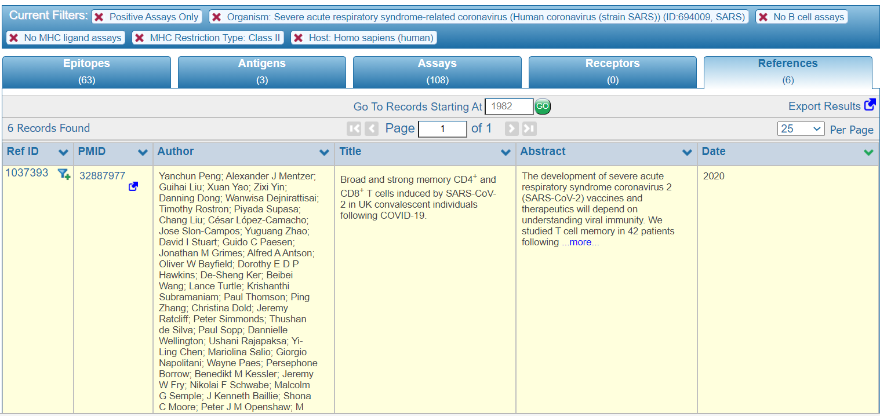
Additional informations that could be extracted from an IEDB query
Experimental Assay utilized for determination
Peer-reviewed papers referring to the identified epitopes
Specify the assay used to identify the epitope
Links directly to Pubmed

Slide 7
The majority of epitopes available in the IEDB derive from SARS-CoV
 |  | Coronavirus
 |  | Alpha | Beta |  |  | Gamma
Epitope set | Type |  | SARS-CoV | MERS-CoV | Other |  | Total
B cell | conformational | 18 | 27 | 23 | 2 | 11 | 81
 | linear | 81 | 405 | 5 | 60 | 30 | 581
T cell |  | 61 | 164 | 25 | 54 | 16 | 320
SARS-CoV protein | B cell | T cell
Spike glycoprotein | 279 | 48
Nucleoprotein | 113 | 33
Membrane protein | 20 | 4
Replicase polyprotein 1ab | 8 | 9
Protein 3a | 2 | 7
Envelope | 2 | 0
Non-structural protein 3b | 2 | 0
Protein 7a | 2 | 0
Protein 9b | 2 | 0
Non-structural protein 6 | 1 | 0
Protein non-structural 8a | 1 | 0
 |  | Coronavirus
 |  | Alpha | Beta |  |  | Gamma
Epitope set | Host |  | SARS-CoV | MERS-CoV | Other |  | Total
B cell* | Humans | 0 | 306 | 16 | 0 | 0 | 322
 | Mice | 62 | 154 | 0 | 67 | 20 | 303
 | Other | 42 | 142 | 0 | 11 | 23 | 218
 | Tg mice | 0 | 0 | 0 | 0 | 0 | 0
T cell | Humans | 2 | 92 | 0 | 1 | 0 | 95
 | Mice | 16 | 99 | 0 | 78 | 1 | 194
 | Other | 46 | 1 | 0 | 0 | 15 | 62
 | Tg mice | 0 | 29 | 0 | 0 | 0 | 29

Slide 8
Conclusion (i)
B and T cell epitope data are available for SARS-CoV in IEDB:
      The majority are B cells epitopes targeting Spike glycoprotein, Nucleoprotein and Membrane protein
      Less data are available for T cells
Hence, immunodominant regions within the SARS-CoV proteins can be used to infer potential targets of immune responses to the novel CoV

Slide 9
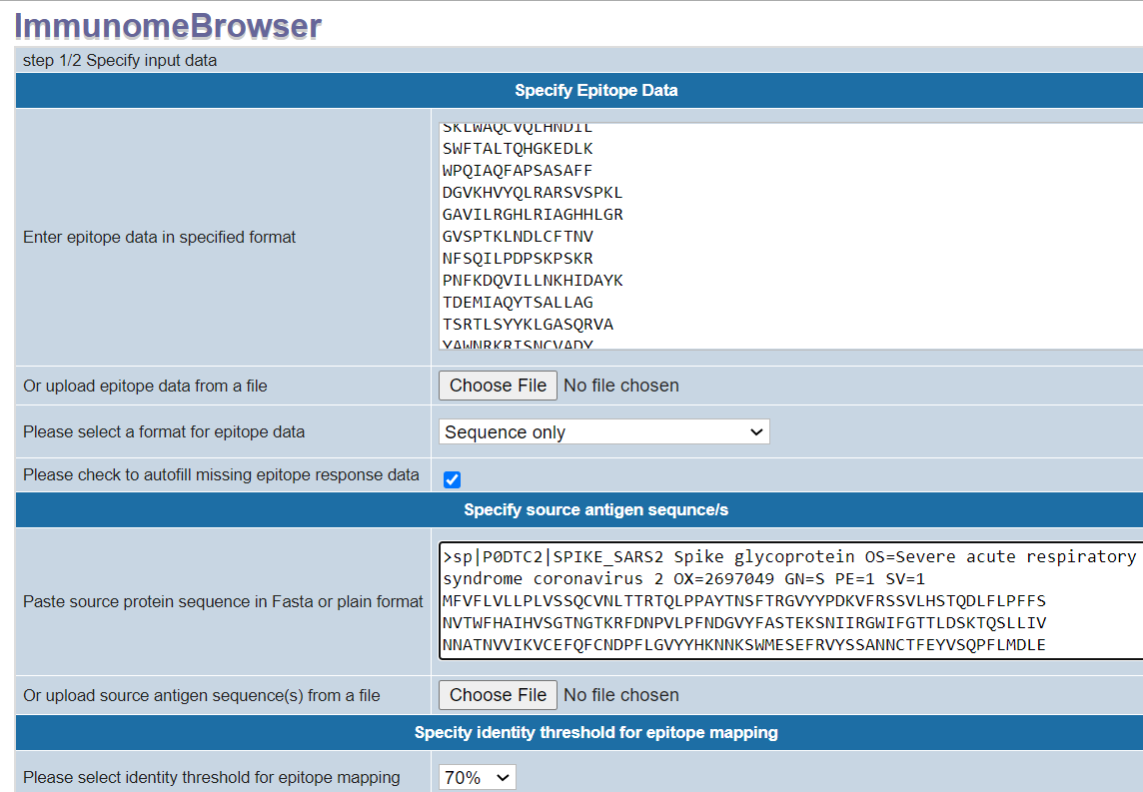
Immunobrowser analysis tool to map epitopes on SARS-CoV-2 sequence
Epitopes derived from IEDB query
SARS-CoV-2 Fasta sequence of the protein of interest

Slide 10
Defining B cell immunodominant regions within the SARS-CoV
SARS-CoV |  | SARS-CoV-2
Sequence | Max RF | Sequence | Protein | Mapped Start-End | Identity (%)
DAVDCSQNPLAELKCSVKSFEIDKGIYQTSNF | 0.504 | DAVDCALDPLSETKCTLKSFTVEKGIYQTSNF | S | 287-319 | 69
VCGPKLSTDLIKNQCVNFNFNGLTGTGVLTPSSKRFQPFQQFGRDVSDFTDSVRDPKTSEILDISPCSFGGVSVIT | 0.745 | VCGPKKSTNLVKNKCVNFNFNGLTGTGVLTESNKKFLPFQQFGRDIADTTDAVRDPQTLEILDITPCSFGGVSVIT | S | 524-600 | 80
GTNASSEVAVLYQDVNCTDVSTAIHADQLTPAWRIYSTGNN | 0.709 | GTNTSNQVAVLYQDVNCTEVPVAIHADQLTPTWRVYSTGSN | S | 601-642 | 78
FSQILPDPLKPTKRSFIED | 0.365 | FSQILPDPSKPSKRSFIED | S | 802-821 | 89
FGAGAALQIPFAMQMAYRFNGIG | 0.367 | FGAGAALQIPFAMQMAYRFNGIG | S | 888-911 | 100
MADNGTITVEELKQLLEQWNLVIG | 0.460 | MADSNGTITVEELKKLLEQWNLVI | M | 1-25 | 92
PLMESELVIGAVIIRGHLRMA | 0.457 | PLLESELVIGAVILRGHLRIA | M | 132-153 | 90
PQGLPNNTASWFTALTQHGKEE | 0.537 | PQGLPNNTASWFTALTQHGKED | N | 42-64 | 95
NNAATVLQLPQGTTLPKGFYA | 0.543 | NNAAIVLQLPQGTTLPKGFYA | N | 153-174 | 95
KHIDAYKTFPPTEPKKDKKKKTDEAQPLPQRQKKQPTVTLLPAADMDD | 0.82 | KHIDAYKTFPPTEPKKDKKKKADETQALPQRQKKQQTVTLLPAADLDD | N | 355-403 | 90

Slide 11
Conclusion (ii)
We identified ten B cell immunodominant regions within the SARS-CoV S, M and N proteins that could be use to infer potential targets of immune responses.
Can we use T and B cell epitope prediction as alternative strategy?

Slide 12
IEDB Analysis Resource for prediction analyses tools.iedb.org
B cell tools
Linear prediction
Linear epitope prediction
Bebipred 2.0
(Jurtz et al., 2017)
Cutoff 0.55
BepiPred
Other methods
Discontinuous epitope prediction
SARS-CoV-2 proteins analyzed:
-Surface glycoprotein (S)
-Membrane protein (M)
-Nucleoprotein (N)
DiscoTope
ElliPro
Structure-based prediction
Antibody and TCR structure prediction
Discotope 2.0
(Kringelum et al., 2017)
Cutoff -2.5
LYRA

Slide 13
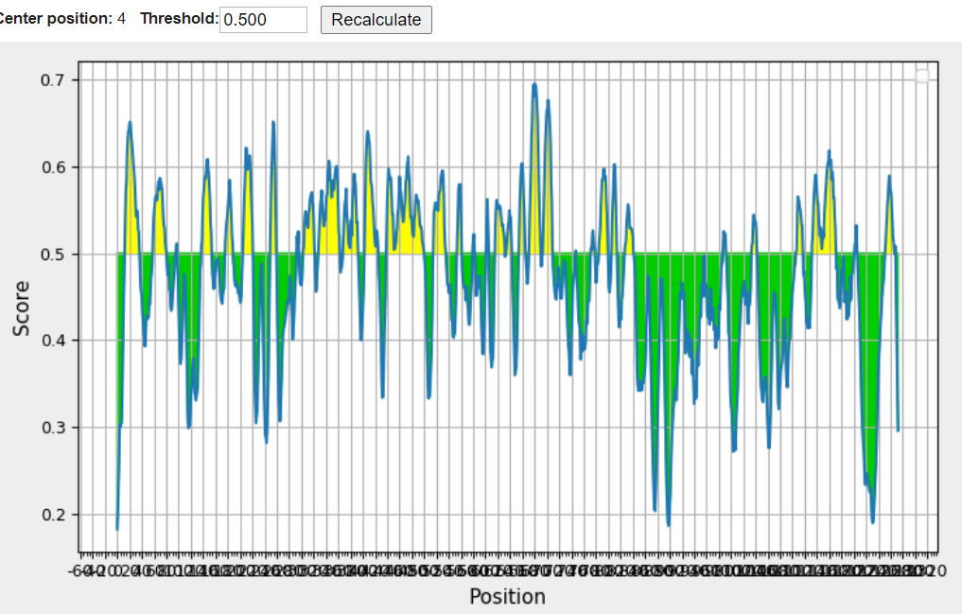
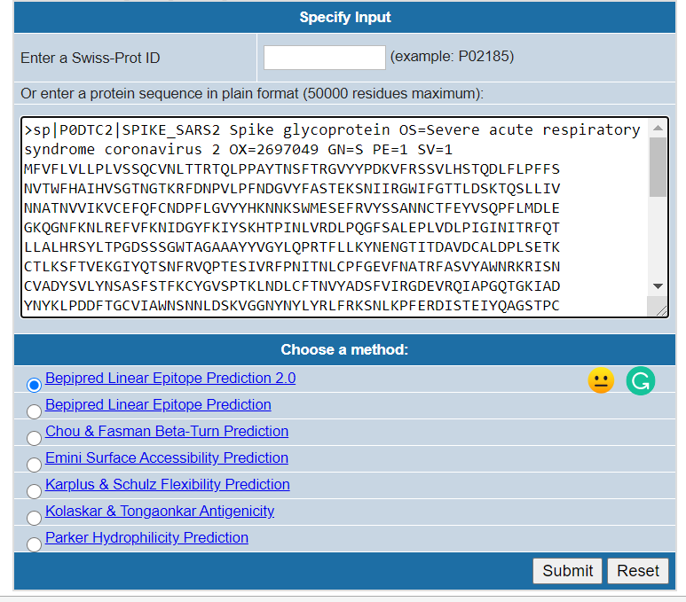
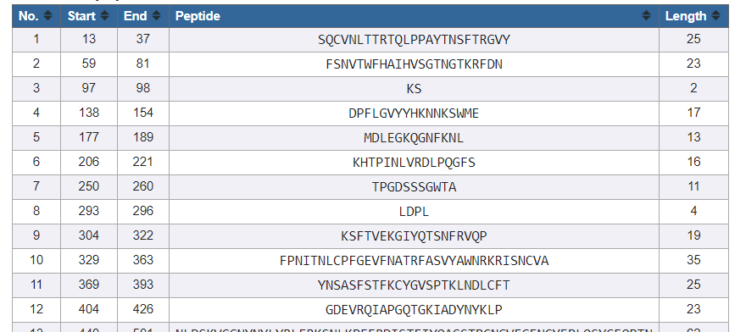
Linear B cell epitope prediction
Step1: insert FASTA sequence
Step2: Results of the prediction
Threshold can be modified
Bepipred 2.0
Jurtz et al., 2017

Slide 14
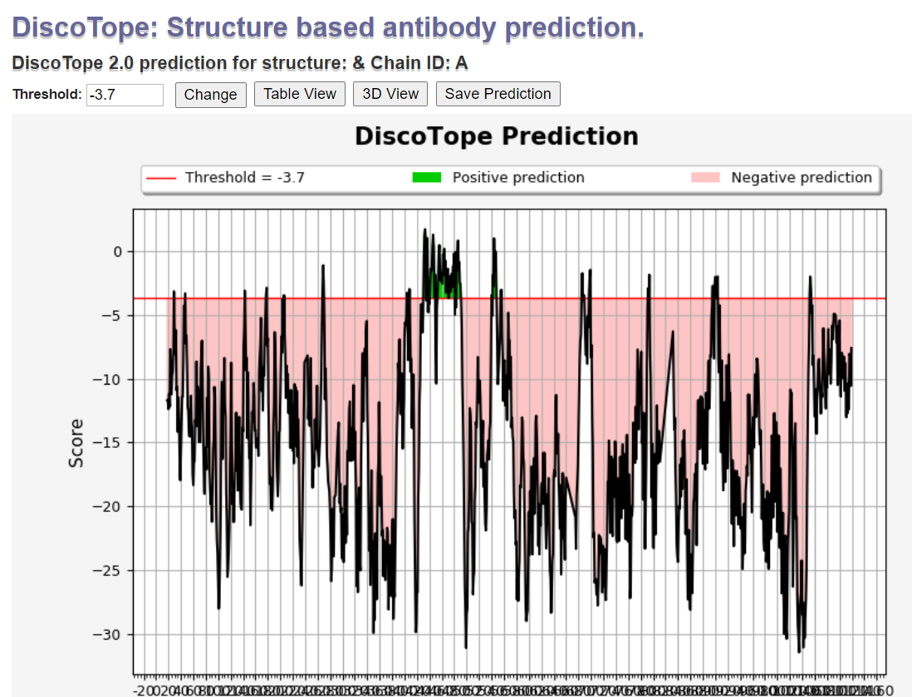
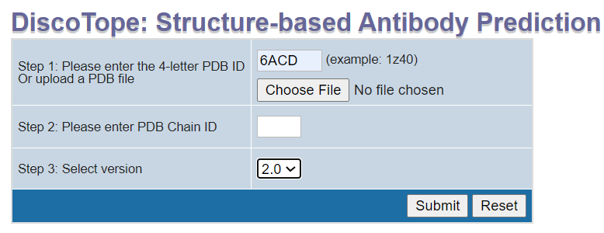
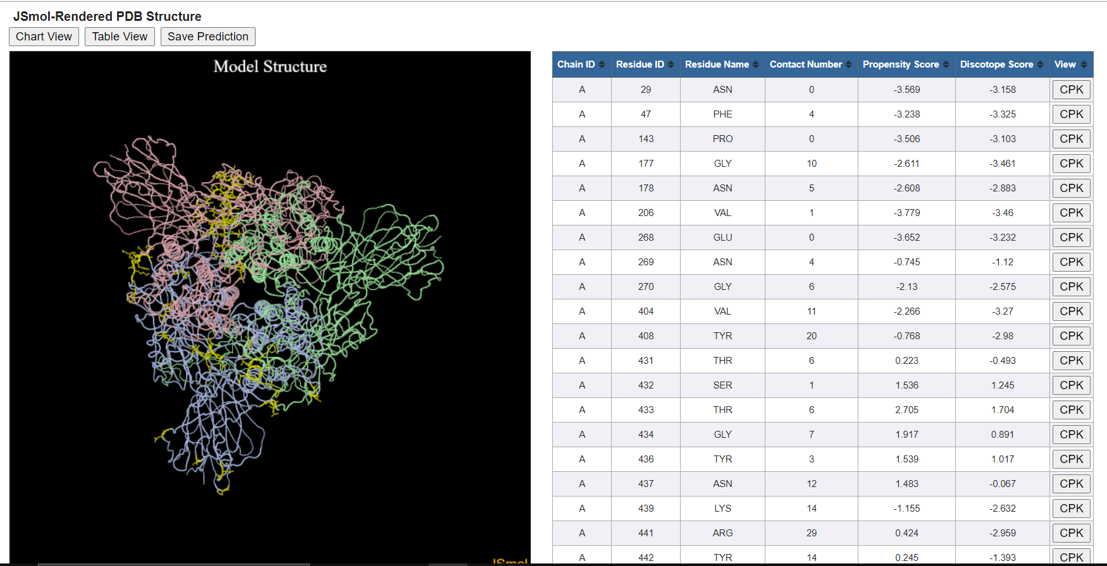
Structure-based prediction
Step1: insert PDB code or PDB file/ predicted structure
Step2: Results of the prediction
Epitope

Slide 15
B cell epitope predictions for surface glycoprotein
Linear Prediction
Structure-based prediction

Slide 16
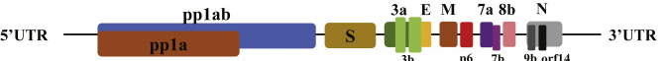
IEDB Analysis Resource for prediction analyses tools.iedb.org
T cell tools
CD4 T cell prediction
MHC binding prediction
overlapping 15-mers by 10 amino acids
7-allele method, Median percentile ≤20
(Paul et al., 2015 JI)
MHC I binding prediction
MHC II binding prediction
TepiTool
MHC processing prediction
SARS-CoV-2 protein sequences
NetChop/NetCTL/NetCTLpan
MHCNP, MHCIINP
Immunogenicity prediction
CD8 T cell prediction
CD4 & CD8 T cell immunogenicity prediction tools
Top common HLA alleles with frequency ≥6
NetMHCpan 4.0 EL algorithm
(includes peptide size correction).
Selected the top 1% epitopes
ranked based on prediction score and clustered
Remove epitopes from therapeutic proteins
Deimmunization tool

Slide 17
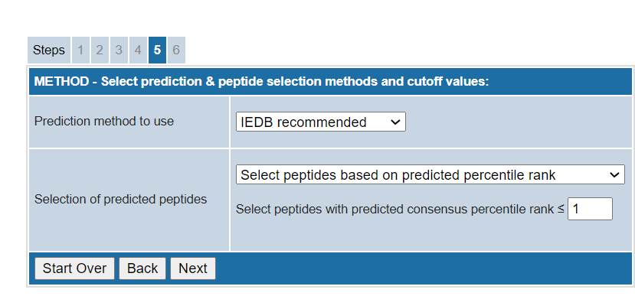
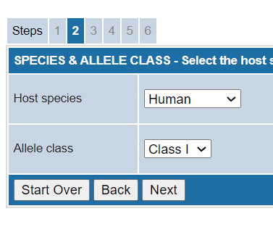
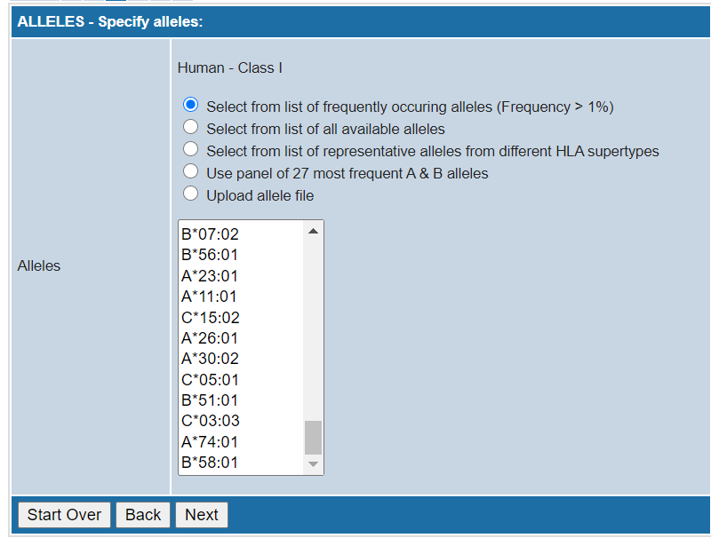
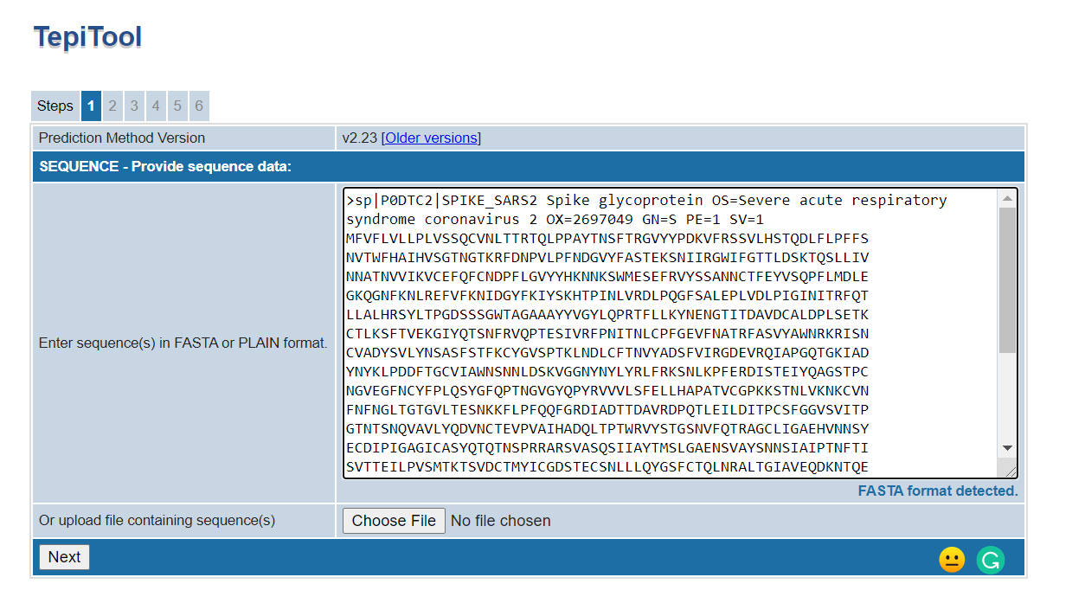

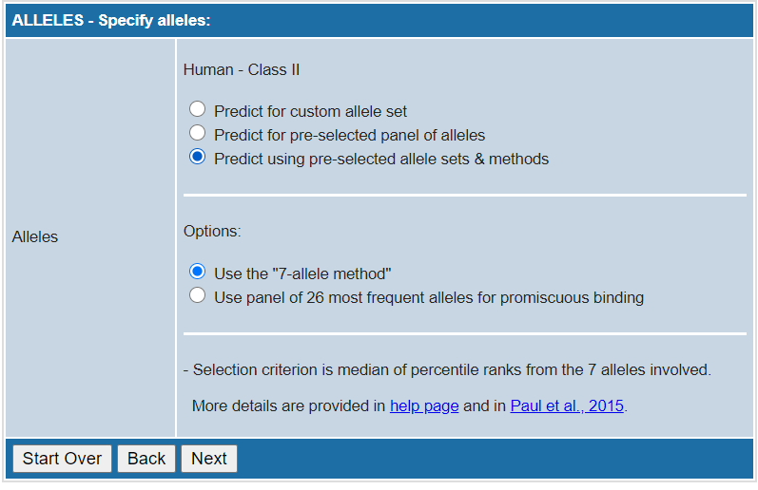
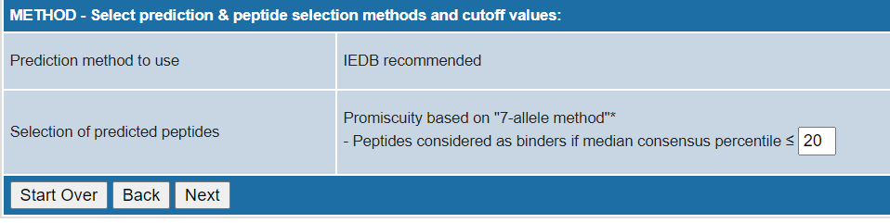
Tepitool to perform T cell prediction
Step 1: add the FASTA sequences
Step 2: Select CD4 or CD8 predicition
Step 3: Select type of prediction
Steps 4-5: Select peptides and prediction method
CD8 prediction
CD4 prediction

Slide 18
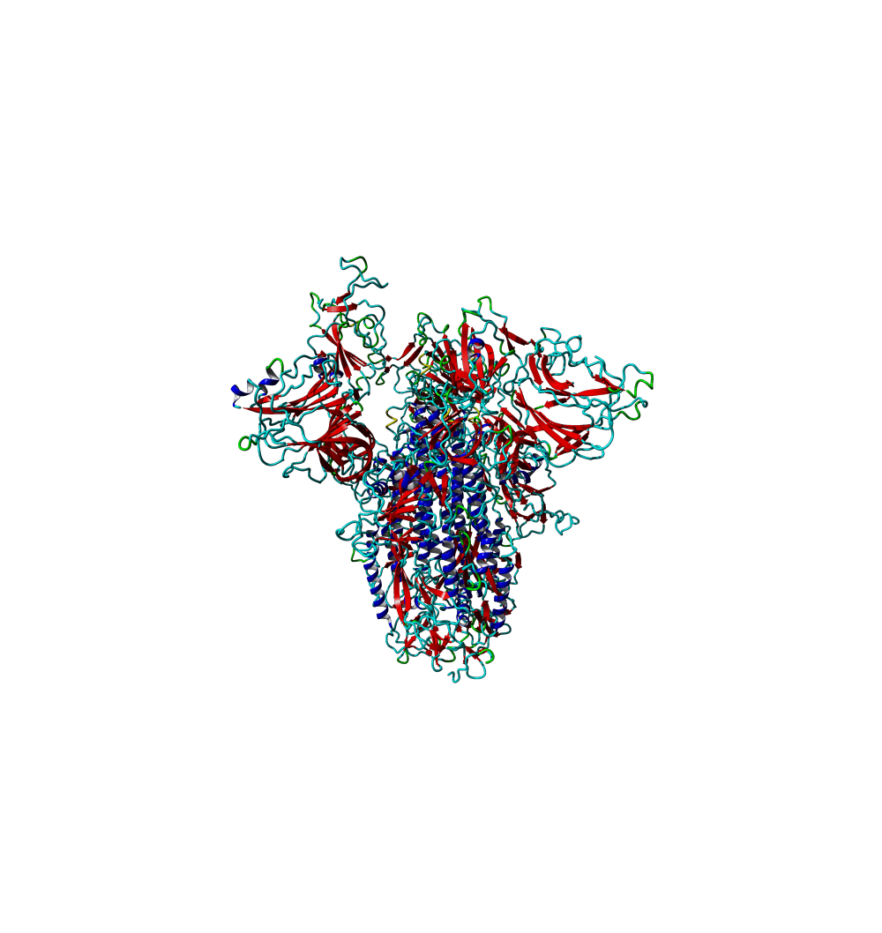
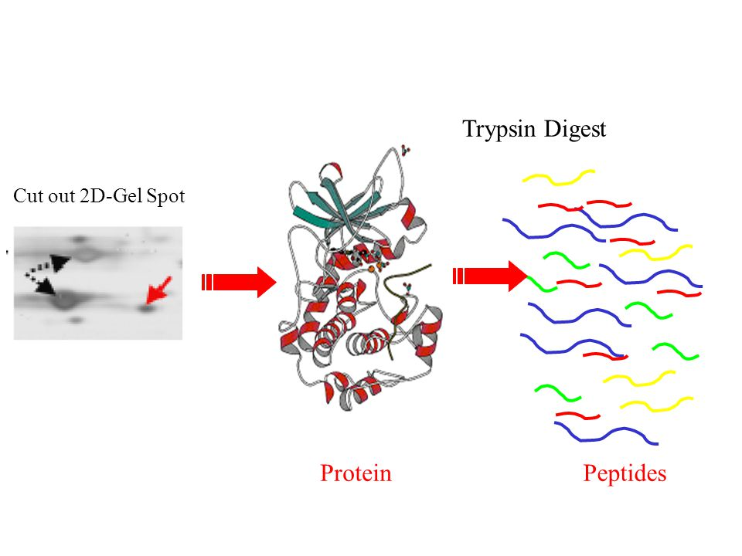
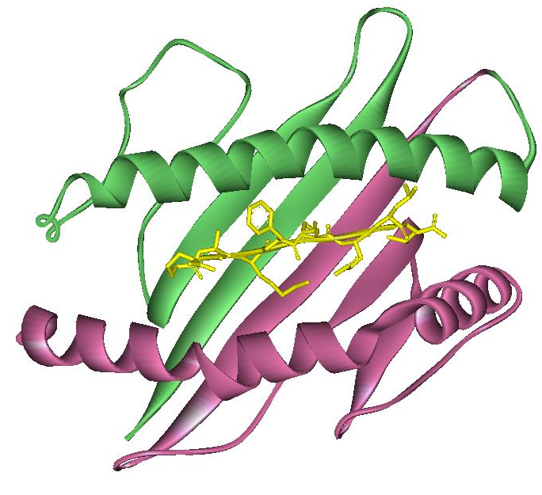
Applications for T cell epitopes: the Megapool (MP) approach
Sequential Lyophilization
predicted or
experimentally defined
epitopes
HLA alleles
Covering worldwide population
possible peptides
Pathogens are composed by multiple proteins
Megapool
Why use a Megapool?
200-300 peptides
Synergistic effect of the epitopes
Good HLA and protein coverage
Minimized DMSO toxicity
Can be used with small biological samples
Carrasco Pro 2015 J. Immunol Res

Slide 19
Experimental validation of T cell prediction
The megapool has been designed to capture 50% or more of the T cell responses.
The SARS-CoV-2 predicted Megapool
strongly correlates with the pool per protein responses.
CD8
Prediction with top 12 most
Frequent HLA class I alleles
CD4
7-allele prediction
All proteome but spike

Slide 20
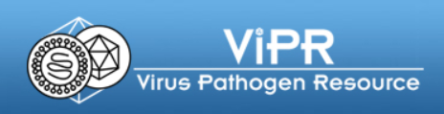
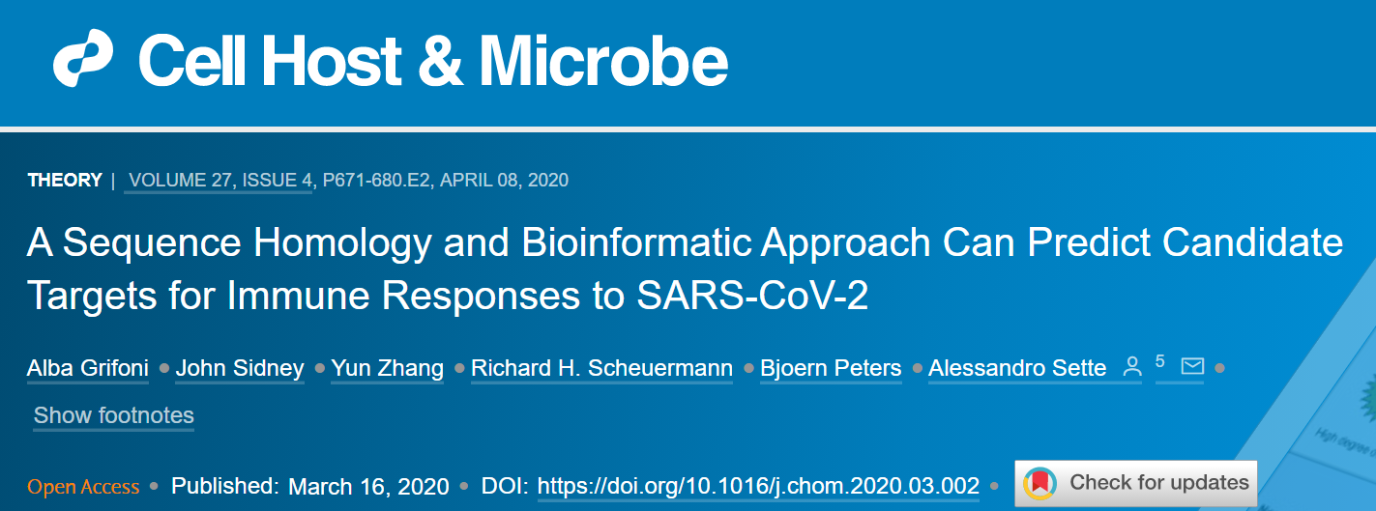
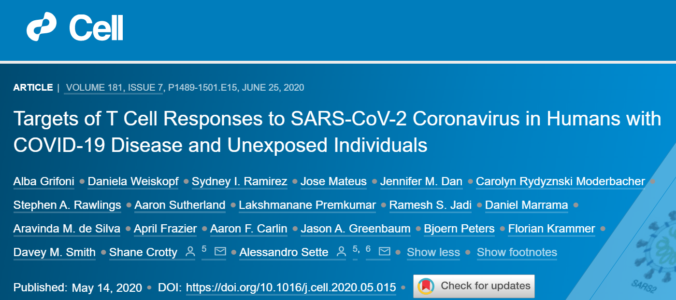
Acknowledgements
John Sidney
Jason Greenbaum
Bjoern Peters
Alessandro Sette
Yun Zhang
Richard Scheuermann
Daniela Weiskopf
Shane Crotty
Prediction analyses
Experimental validation

