Slide 1
T Cell processing & immunogenicity predictions
tools.iedb.org
Presented by:
Bjoern Peters, PI
Austin Crinklaw, Research Tech

Slide 2
CD8+ T cell epitopes in viral infection
Mouse
Virus
MHC-I
APC

Slide 3
CD8+ T cell epitopes in viral infection
Mouse
Virus
T
Proliferation
T
T
Cytokine Release
TCR
CD8
Cytotoxicity
MHC-I
APC

Slide 4
MHC I - Antigen processing and presentation pathway
T Cell Receptor
50% - Immunogenicity
2.5% - MHC binding
Golgi
ER
MHC-I
TAP
15% - processing
Protein
Proteasome
Peters et al, J Mol Biol 2002, Bioinformatics 2003, J Immunol. 2003; CMLS 2005; Assarson, J Immunol 2007

Slide 5
Class I Processing + immunogenicity tools available in the IEDB
http://tools.iedb.org/main/tcell/

Slide 6
Class I ‘combined predictor’
http://tools.iedb.org/processing/
Combines predictions for:
proteasomal cleavage
TAP transport
Trained on specific in vitro datasets

Slide 7
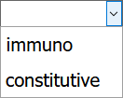
Proteasomal cleavage
http://tools.iedb.org/processing/
Proteasomes create the C-terminal end of peptides
Prediction looks for sequence motive up and downstream of potential cleavage site
Cleavage sequence motif determined based on in vitro protein digests by proteasomes

Slide 8
TAP Transport
http://tools.iedb.org/processing/
TAP transport efficiency of peptides is sequence dependent; motif derived based on in vitro assays
Overall TAP transport efficiency of a presented MHC ligand can be result of a collection of precursors
Unless paper specifically read and details about the precursor length distribution are known, keep parameters unchanged

Slide 9
Class I ‘combined predictor’ - example
http://tools.iedb.org/processing/

Slide 10
Class I ‘combined predictor’ - example
http://tools.iedb.org/processing/

Slide 11
Class I ‘combined predictor’ - example
http://tools.iedb.org/processing/
Higher scores = higher efficiency for MHC-I presentation
MHC binding score = –log10(IC50) (sign change)
Combined scores are additive
Processing = proteasome + TAP
Total = proteasome + TAP + MHC
Different variance in scores reflects different selectivity

Slide 12
Caveats / performance of processing predictions
Processing predictions beat MHC binding predictions when predicting eluted peptides
No clear evidence that processing predictions are better at predicting epitopes
Eluted peptides may over represent ‘best possible’ ligands, and the difference in processing may not be relevant in practice
Co-evolution of MHC molecules to bind peptides with motifs that are generated by proteasome and TAP means that most high affinity MHC binders are also efficiently processed
Recommendation: Use MHC binding predictions alone by default
If resources require limiting the number of peptides considered, use total score of processing predictions as additional filter

Slide 13
Class I Processing + immunogenicity tools available in the IEDB
http://tools.iedb.org/main/tcell/

Slide 14
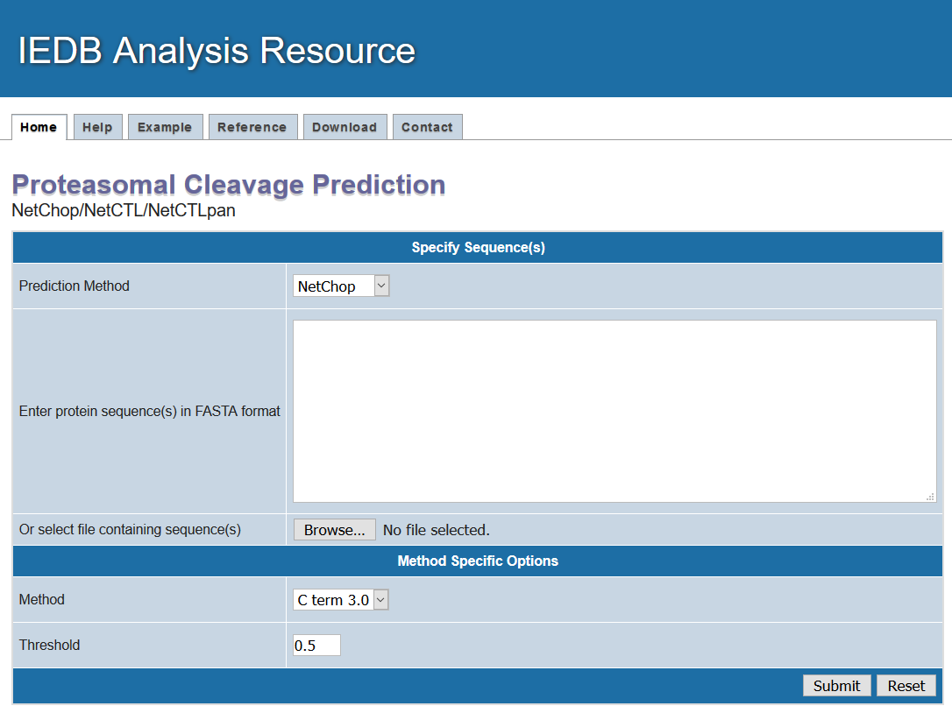
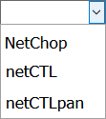
Neural Network based predictors
http://tools.iedb.org/netchop/
NetChop: proteasomal cleavage
NetCTL: combines NetChop, TAP transport, NetMHC
NetCTLpan: combines NetChop, TAP transport, NetMHCpan
Key difference is the use of NetChop

Slide 15
NetChop -example
http://tools.iedb.org/netchop/
Predicts C-terminal cleavage based on two approaches
C-term 3.0: C-terminal residues found for MHC ligands
20S 3.0: Cleavage sites based on in vitro protein digests
C-term 3.0 is not truly a proteasome predictor but performs better
NetCTL and NetCTLPan use C-term 3.0 by default

Slide 16
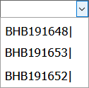
NetChop -example
http://tools.iedb.org/netchop/
Adjustable threshold
Download as CSV
View each sequence

Slide 17
NetChop -example
http://tools.iedb.org/netchop/

Slide 18
References
Peters et al, JMB 2002 (proteasome)
Peters et al, J Immunol 2003 (TAP)
Tenzer et al, CMLS, 2005 (combined)
Nielsen, Immunogenetics, 2005 (NetChop)
Larsen, BMC Bioinformatics, 2007 (NetCTL)
Stranzl, Immunogenetics, 2010 (NetCTLPan)

Slide 19
Class I Processing + immunogenicity tools available in the IEDB
http://tools.iedb.org/main/tcell/

Slide 20
MHC-NP: Prediction of peptides naturally processed by the MHC
http://tools.iedb.org/mhcnp/
Pan-predictions trained on both binding + eluted ligand data now available!

Slide 21
Class I Processing + immunogenicity tools available in the IEDB
http://tools.iedb.org/main/tcell/

Slide 22
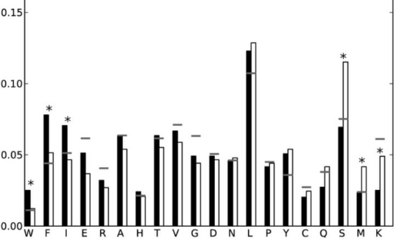
Class I immunogenicity prediction
Approach: Assemble two datasets of peptides with similar MHC binding affinity, that are (i) recognized or (ii) not recognized by T cells
Enrichment of W,F,I and depletion of S,M,K in immunogenic peptides
Use enrichments to calculate propensity scores
immunogenic
non-immunogenic

Slide 23
Class I immunogenicity prediction -example
http://tools.iedb.org/immunogenicity/
Mask positions that are MHC anchors

Slide 24
Class I immunogenicity prediction -example
http://tools.iedb.org/immunogenicity/
Scores are sums of propensity scores at all unmasked positions
High scores = peptide is more likely to be immunogenic

Slide 25
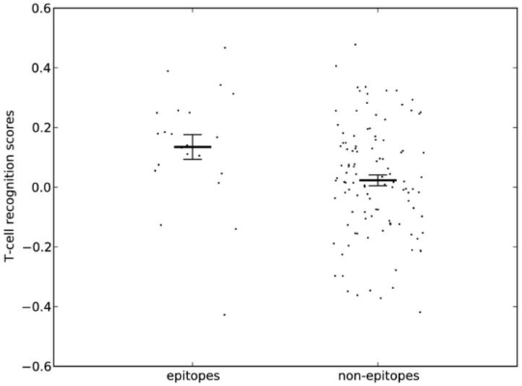
Class I immunogenicity prediction caveats / performance
Experimentally, many MHC binding peptides can be immunogenic (~50%)
Cross validation gave AUC values ~ 0.65. Test on independent blind set gave AUC = 0.69
Recommendation: Use as filter (cutoff 0) if high specificity is desired. Suggested cutoff is 0

Slide 26
Class I Summary
Processing predictions are better at identifying naturally processed ligands, but have not been shown to be superior in identifying epitopes compared to MHC binding predictions
Specific processing and immunogenicity predictions are good additional filters if the only goal is to select high likelihood T cell epitopes
NetMHCPan 4.0 EL scores, which are trained on both MHC binding and ligand elution data are a straightforward replacement of MHC binding predictions, and show some enhanced performance 🡪 Use these, and consider pairing with immunogenicity scores, when predicting epitope candidates

Slide 27
CD4 T cell epitopes (MHC class II)

Slide 28
Class II Processing + immunogenicity tools available in the IEDB
http://tools.iedb.org/main/tcell/

Slide 29
MHCII-NP
Predicting the naturally processed peptides for MHC class II
Based on
Cleavage motif analysis at C and N terminal of peptides
Ligand elution data derived from IEDB
Ligand predictions is improved markedly when combining the binding and cleavage motifs
T cell epitope prediction is not significantly improved

Slide 30
MHCII-NP - example
http://tools.iedb.org/mhciinp/

Slide 31
MHCII-NP -example
http://tools.iedb.org/mhciinp/

Slide 32
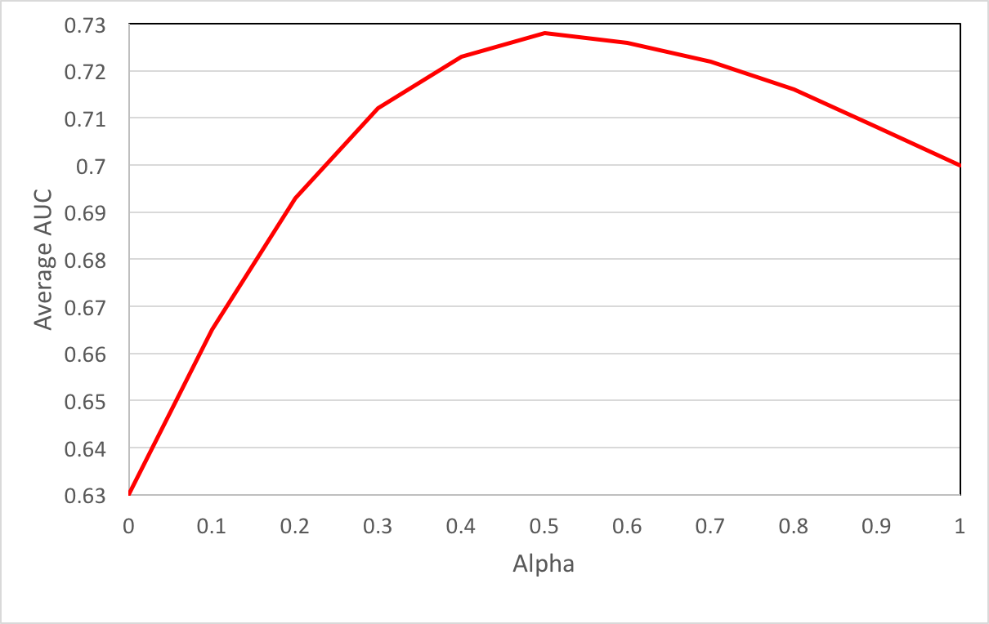
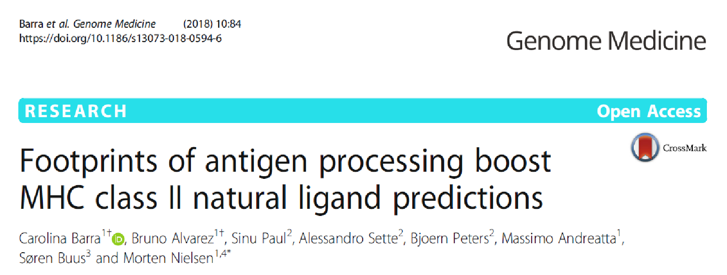
MHCII-NP scores
Cleavage Score: Derived from the cleavage motif analysis in ligand elution data
Binding Score: Derived from HLA binding affinity using 7-allele method (Paul et. al. 2015).
Cleavage Score
Binding Score

Slide 33
Class II Processing + immunogenicity tools available in the IEDB
http://tools.iedb.org/main/tcell/

Slide 34
MHC-II restricted immunogenicity prediction
Extracted datasets of proteins from the IEDB for which overlapping peptides were tested for immunogenicity
Utilized these datasets to train a Neural Network to learn ‘motifs’ associated with immunogenicity independent of specific MHC alleles expressed
Resulting score can be combined with ‘7 allele method’ quantifying MHC binding across alleles to predict overall immunogenicity

Slide 35
Class II immunogenicity prediction
Based on Neural network model trained on
In house dataset for different antigens tested on different population cohorts
Tetramer dataset- derived from IEDB
Validated on 57 independent studies from different groups across the world
Implemented three approaches
7-allele method (Paul et. al. 2015)
Immunogenicity predictions
Hybrid approach

Slide 36
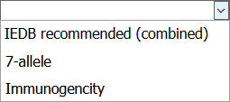
Class II immunogenicity prediction -example
http://tools.iedb.org/CD4episcore/

Slide 37
Class II immunogenicity prediction - example
http://tools.iedb.org/CD4episcore/

Slide 38
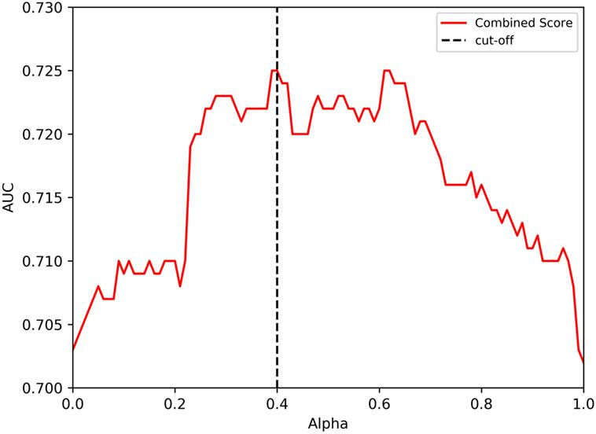
Class II immunogenicity prediction scores
Immunogenicity Score: Derived from the neural network model trained on Immunogenicity data
HLA Score: Derived from HLA binding affinity using 7-allele method (Paul et. al. 2015).

Slide 39
Class II Summary
Similar to MHC class I, enhancement of epitope prediction efficacy is minor compared to using MHC binding predictions alone
Prediction of naturally eluted ligands is greatly improved with processing predictions
As of now, recommendation is to stick to allele specific MHC binding predictions (NetMHCPanII), or the 7-allele method for broad populations
🡪 Both class I and II epitope predictions are constantly being re-evaluated, and these recommendations are subject to change

