Slide 1

TCRMatch
Presented by:
Will Chronister, Bioinformatics Postdoc
2020 IEDB User Workshop

Slide 2
TCRMatch
Manuscript in progress
  TCRMatch: Predicting T-cell receptor specificity based on sequence similarity to previously characterized receptors
Tool not yet public, but will be available on IEDB-AR, on VDJServer, and as a stand-alone download
2020 IEDB User Workshop
2

Slide 3
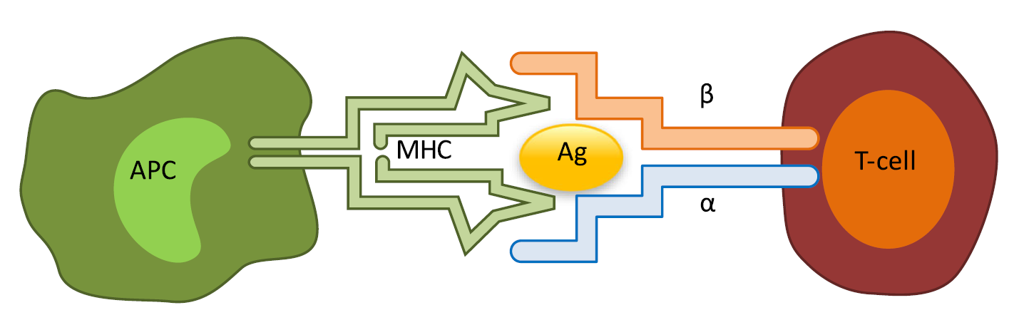
Background
MHC molecules present antigens (Ag) for recognition by T cells
Rosati et al. 2017
2020 IEDB User Workshop
3

Slide 4
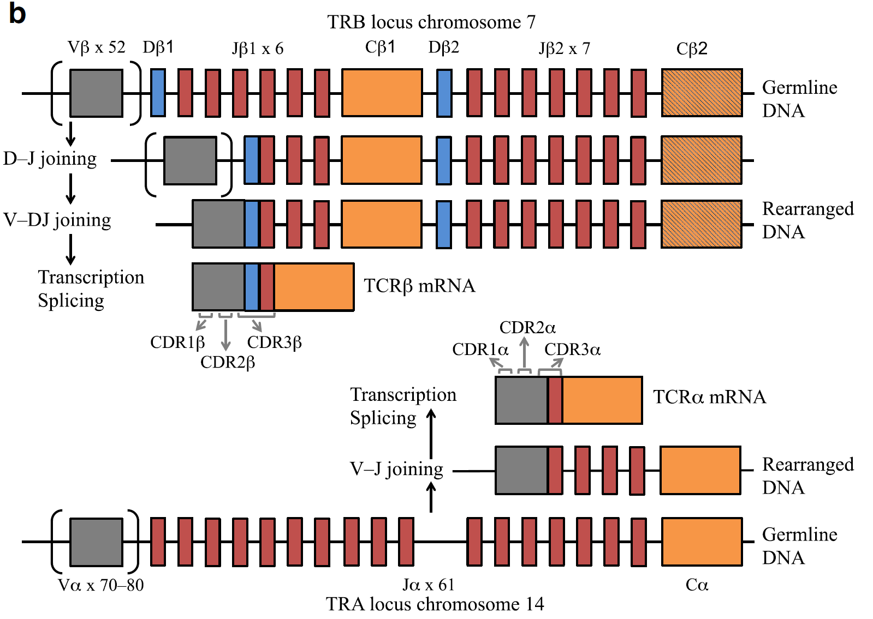
Background
V D J C
V J C
Rosati et al., 2017
V(D)J recombination generates a vast diversity of TCRs
Each chain features 3 complementarity determining regions (CDRs)
  CDR1, CDR2, CDR3
2020 IEDB User Workshop
4

Slide 5
Background
Repertoire sequencing yields TCR chain sequences
CDR3β region is extremely important:
  Interacts with epitope
  Most variable
V D J C
Repertoire sequencing
…CASSIRSSYEQYF…
…CASSLEGYTEAFF…
…CASSSANYGYTF…
…CASSIRAAETQYF…
…CASSIRSSTEAFF…
…CASSSRSSYEQYF…
Rosati et al. 2017
2020 IEDB User Workshop
5

Slide 6
Background
Repertoire sequencing yields TCR chain sequences
CDR3β region is extremely important:
  Interacts with epitope
  Most variable
V D J C
TCR sequencing does not directly reveal the epitope recognized by a given CDR3β.
Repertoire sequencing
…CASSIRSSYEQYF…
…CASSLEGYTEAFF…
…CASSSANYGYTF…
…CASSIRAAETQYF…
…CASSIRSSTEAFF…
…CASSSRSSYEQYF…
Rosati et al. 2017
2020 IEDB User Workshop
6

Slide 7
Background
Repertoire sequencing yields TCR chain sequences
CDR3β region is extremely important:
  Interacts with epitope
  Most variable
V D J C
TCR sequencing does not directly reveal the epitope recognized by a given CDR3β.
Repertoire sequencing
…CASSIRSSYEQYF…
…CASSLEGYTEAFF…
…CASSSANYGYTF…
…CASSIRAAETQYF…
…CASSIRSSTEAFF…
…CASSSRSSYEQYF…
But:
We can use known CDR3β-epitope pairs to make educated epitope predictions for CDR3βs.
Rosati et al. 2017
2020 IEDB User Workshop
7

Slide 8
TCRMatch
Goal: Build a tool that searches input CDR3βs against IEDB for similar sequences (“matches”) with known epitope specificity
  Underlying principle: Similar CDR3β seqs often recognize the same epitope
Dataset: 24,678 CDR3β sequences and corresponding epitopes (IEDB)
Similarity algorithms tested:
  1-4. Alignment-based methods
  5. Levenshtein distance (edit distance)
  6. TCRMatch (Shen et al., 2012; Wong et al., 2019)
2020 IEDB User Workshop
8

Slide 9
TCRMatch algorithm
Uses a modified BLOSUM62 substitution matrix to calculate similarity scores between sequences
2020 IEDB User Workshop
9

Slide 10
TCRMatch algorithm
Compares two sequences using all possible k-mers
2020 IEDB User Workshop
10

Slide 11
TCRMatch algorithm
Compares two sequences using all possible k-mers
  ASSSANYGYT
  ASSIRAAETQY
2020 IEDB User Workshop
11

Slide 12
TCRMatch algorithm
Compares two sequences using all possible k-mers
  ASSSANYGYT
  ASSIRAAETQY
2020 IEDB User Workshop
12

Slide 13
TCRMatch algorithm
Compares two sequences using all possible k-mers
  ASSSANYGYT
  ASSIRAAETQY
2020 IEDB User Workshop
13

Slide 14
TCRMatch algorithm
Compares two sequences using all possible k-mers
  ASSSANYGYT
  ASSIRAAETQY
2020 IEDB User Workshop
14

Slide 15
TCRMatch algorithm
Compares two sequences using all possible k-mers
  ASSSANYGYT
  ASSIRAAETQY
2020 IEDB User Workshop
15

Slide 16
TCRMatch algorithm
Compares two sequences using all possible k-mers
  ASSSANYGYT
  ASSIRAAETQY
  (and so on for k=1)
2020 IEDB User Workshop
16

Slide 17
TCRMatch algorithm
Compares two sequences using all possible k-mers
  ASSSANYGYT
  ASSIRAAETQY
2020 IEDB User Workshop
17

Slide 18
TCRMatch algorithm
Compares two sequences using all possible k-mers
  ASSSANYGYT
  ASSIRAAETQY
2020 IEDB User Workshop
18

Slide 19
TCRMatch algorithm
Compares two sequences using all possible k-mers
  ASSSANYGYT
  ASSIRAAETQY
2020 IEDB User Workshop
19

Slide 20
TCRMatch algorithm
Compares two sequences using all possible k-mers
  ASSSANYGYT
  ASSIRAAETQY
2020 IEDB User Workshop
20

Slide 21
TCRMatch algorithm
Compares two sequences using all possible k-mers
  ASSSANYGYT
  ASSIRAAETQY
2020 IEDB User Workshop
21

Slide 22
TCRMatch algorithm
Compares two sequences using all possible k-mers
  ASSSANYGYT
  ASSIRAAETQY
2020 IEDB User Workshop
22

Slide 23
TCRMatch algorithm
Compares two sequences using all possible k-mers
  ASSSANYGYT
  ASSIRAAETQY
2020 IEDB User Workshop
23

Slide 24
TCRMatch algorithm
Compares two sequences using all possible k-mers
  ASSSANYGYT
  ASSIRAAETQY
2020 IEDB User Workshop
24

Slide 25
TCRMatch algorithm
Compares two sequences using all possible k-mers
  ASSSANYGYT
  ASSIRAAETQY
2020 IEDB User Workshop
25

Slide 26
TCRMatch algorithm
Compares two sequences using all possible k-mers
  ASSSANYGYT
  ASSIRAAETQY
  (and so on for k=2)
2020 IEDB User Workshop
26

Slide 27
TCRMatch algorithm
Compares two sequences using all possible k-mers
  ASSSANYGYT
  ASSIRAAETQY
  (and so on for k=2)
  (and so on for k=3 → k=10)
2020 IEDB User Workshop
27

Slide 28
TCRMatch algorithm
Compares two sequences using all possible k-mers
  ASSSANYGYT
  ASSIRAAETQY
  (and so on for k=2)
  (and so on for k=3 → k=10)
Ultimately, a score between 0 and 1 is computed
  Perfect match = 1
2020 IEDB User Workshop
28

Slide 29
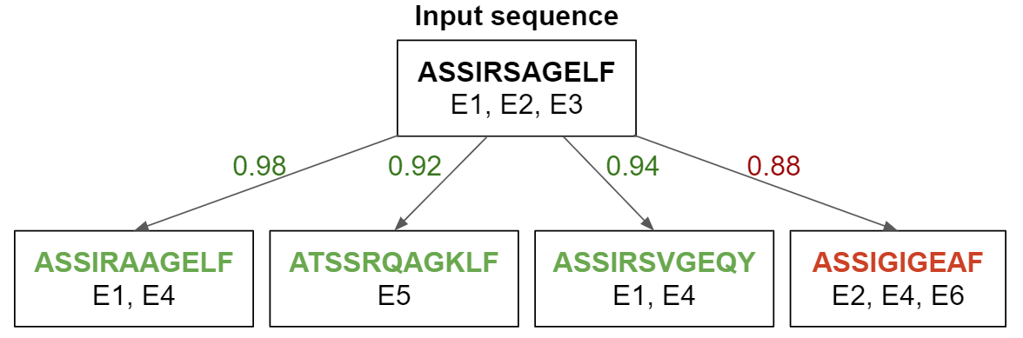
Evaluating performance of TCRMatch
Threshold for match: 0.90 or above
2020 IEDB User Workshop
29

Slide 30
Evaluating performance of TCRMatch
Threshold for match: 0.90 or above
2020 IEDB User Workshop
30

Slide 31
Evaluating performance of TCRMatch
Threshold for match: 0.90 or above
2020 IEDB User Workshop
31

Slide 32
Evaluating performance of TCRMatch
Threshold for match: 0.90 or above
2020 IEDB User Workshop
32

Slide 33
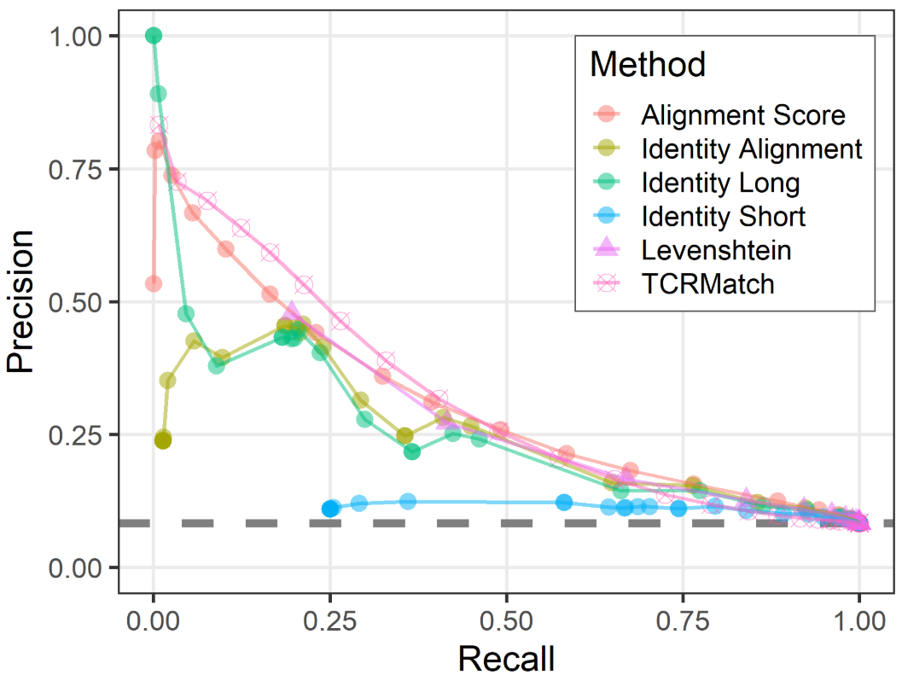
Evaluating performance of similarity metrics
TCRMatch score is the top performing metric for predicting epitopes
All metrics outperform random model
Average performance using randomized dataset
2020 IEDB User Workshop
33

Slide 34
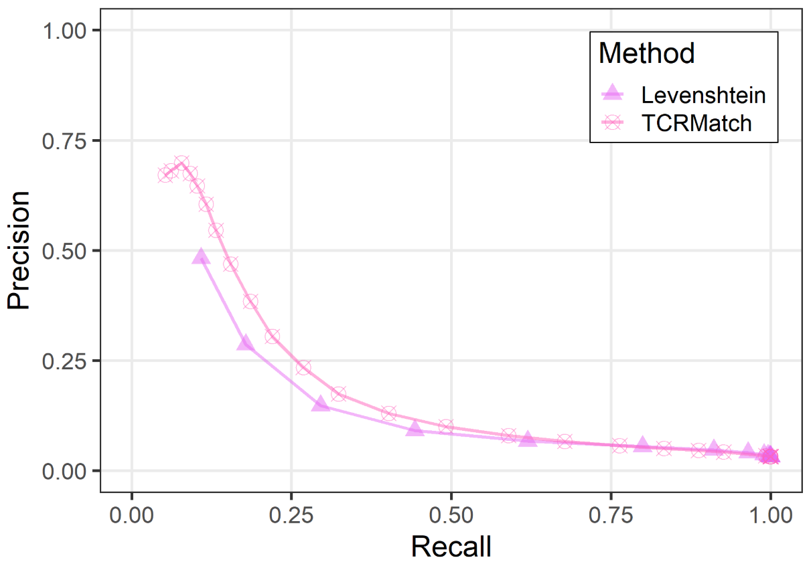
Testing performance on independent dataset
Dataset published by 10x Genomics
  3,218 CDR3β seqs
  18 epitopes
232 CDR3βs had exact matches in the IEDB
  171 recognized same epitope (73.7%)
2020 IEDB User Workshop
34

Slide 35
TCRMatch demonstration
2020 IEDB User Workshop
35

Slide 36
Summary
TCRMatch is an efficient way to find similar TCR sequences curated in the IEDB with known specificity
It can be used in tandem with TCR clustering tools (e.g., GLIPH2) to determine likely epitopes for TCR repertoire sequences
It is not trained on specific epitopes, making it unbiased and generalizable
2020 IEDB User Workshop
36

Slide 37
Future Directions
TCRMatch will improve in utility as IEDB continues to gather high quality TCR-epitope data
Possible improvements:
  Replace BLOSUM62 with one or more CDR3β-derived matrices
  Evaluate performance with integration of:
    CDR3α sequences
    CDR1α and CDR1β seqs
    CDR2α and CDR2β seqs
    MHC information
2020 IEDB User Workshop
37

Slide 38
Acknowledgments
Austin Crinklaw
Swapnil Mahajan
Randi Vita
Zeynep Kosaloglu-Yalcin
Zhen Yan
Jason Greenbaum
Leon Jessen (DTU)
Morten Nielsen (DTU)
Scott Christley (UTSW)
Lindsay Cowell (UTSW)
Nina Blazeska
Alessandro Sette
Bjoern Peters
2020 IEDB User Workshop
38

Slide 39
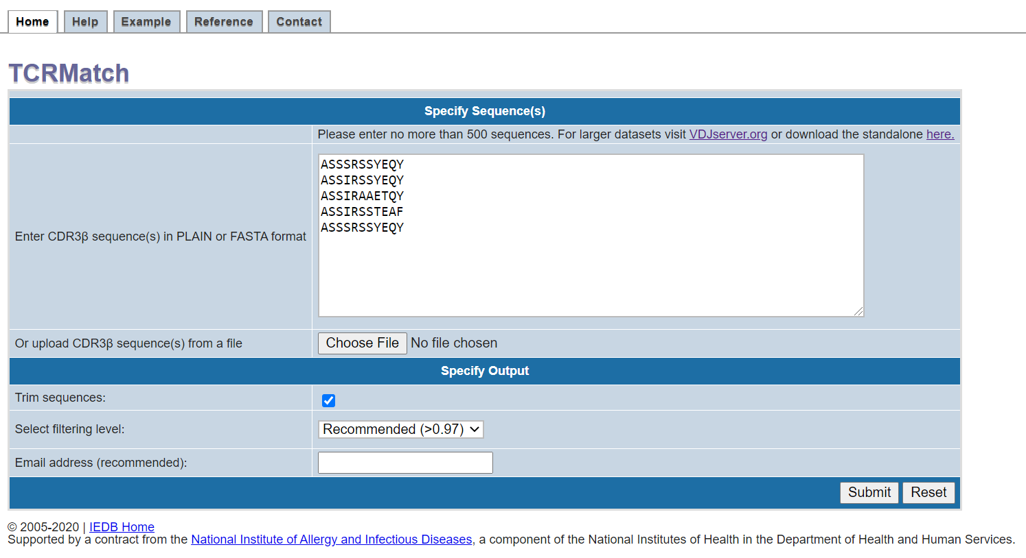
2020 IEDB User Workshop
39

Slide 40
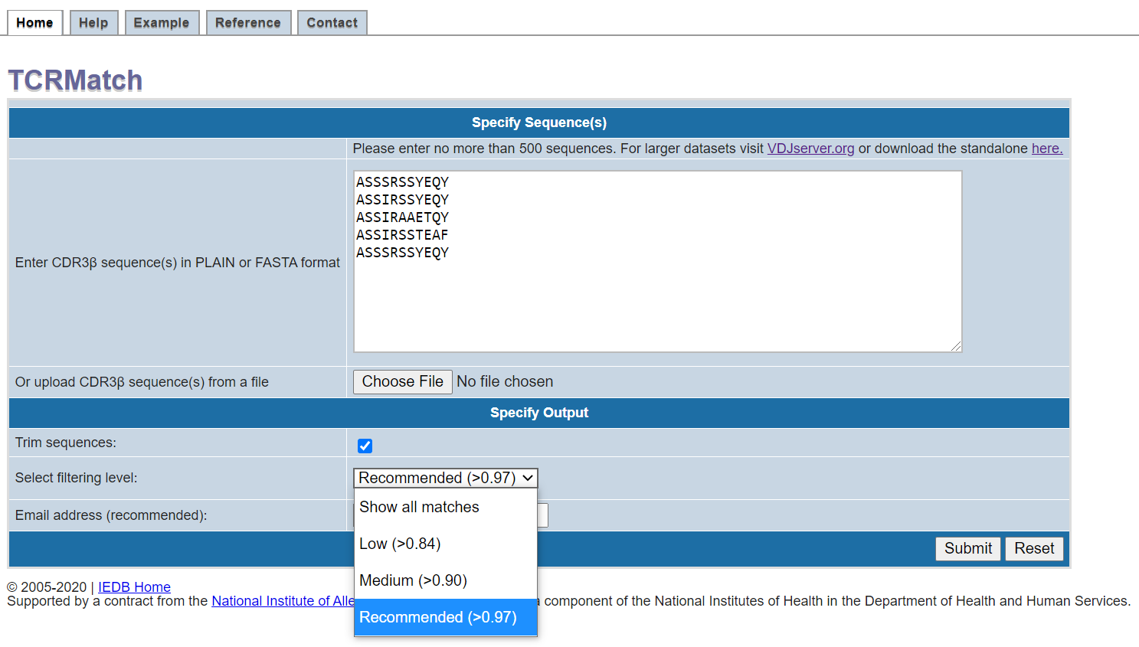
2020 IEDB User Workshop
40

Slide 41
2020 IEDB User Workshop
41

Slide 42
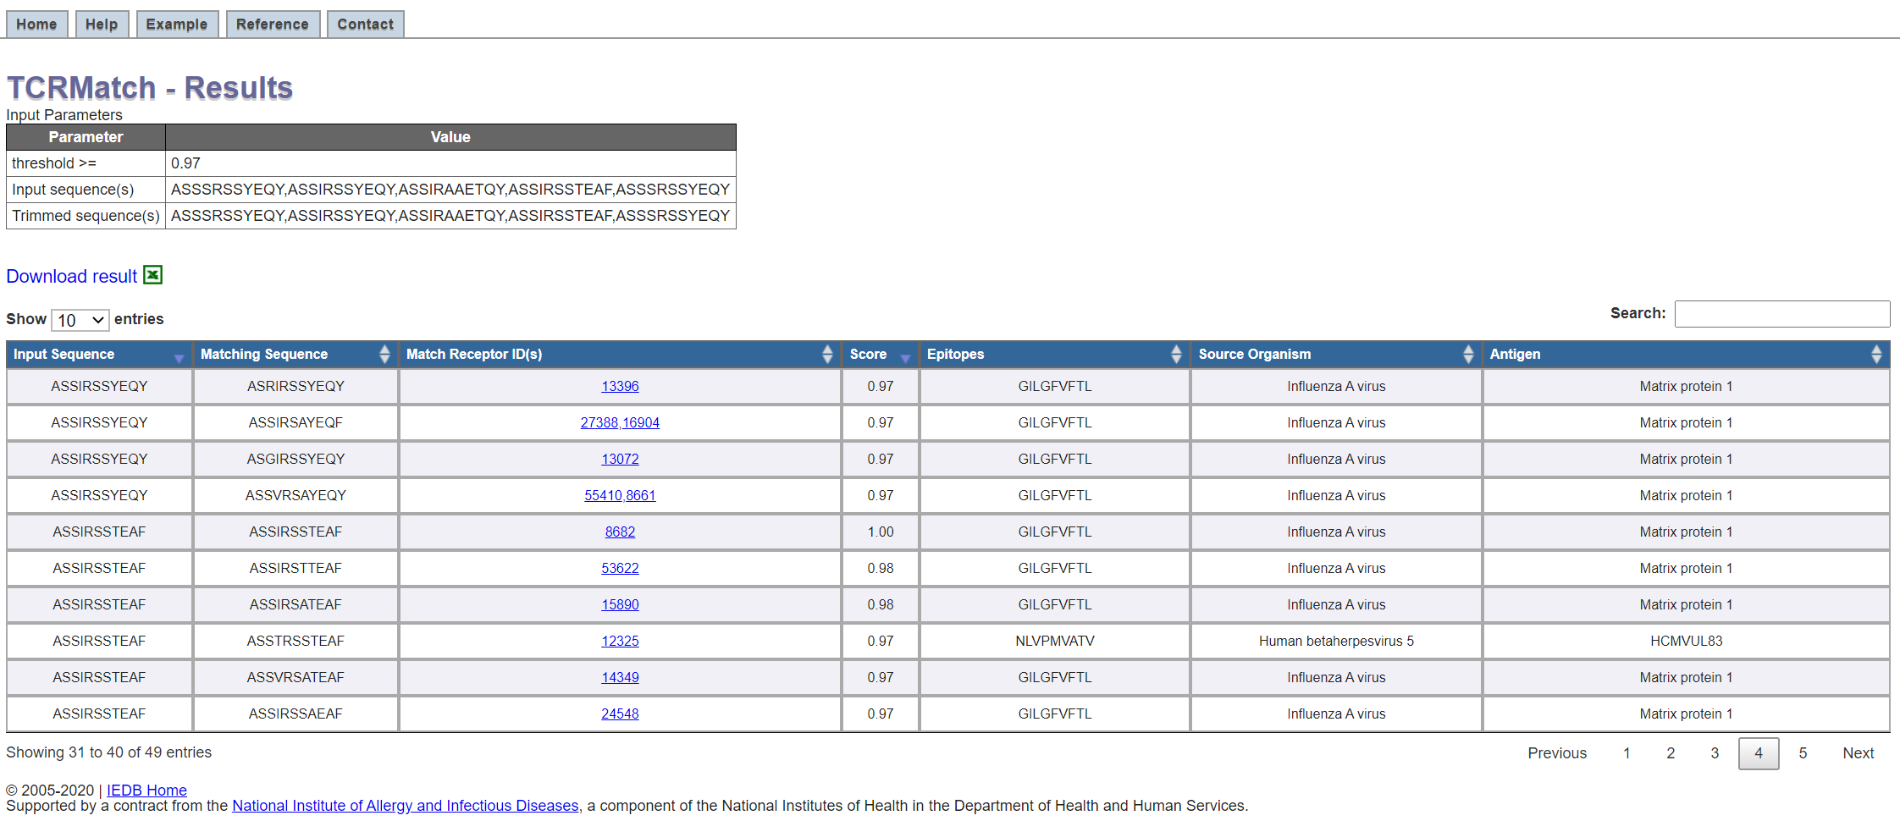
2020 IEDB User Workshop
42

Slide 43
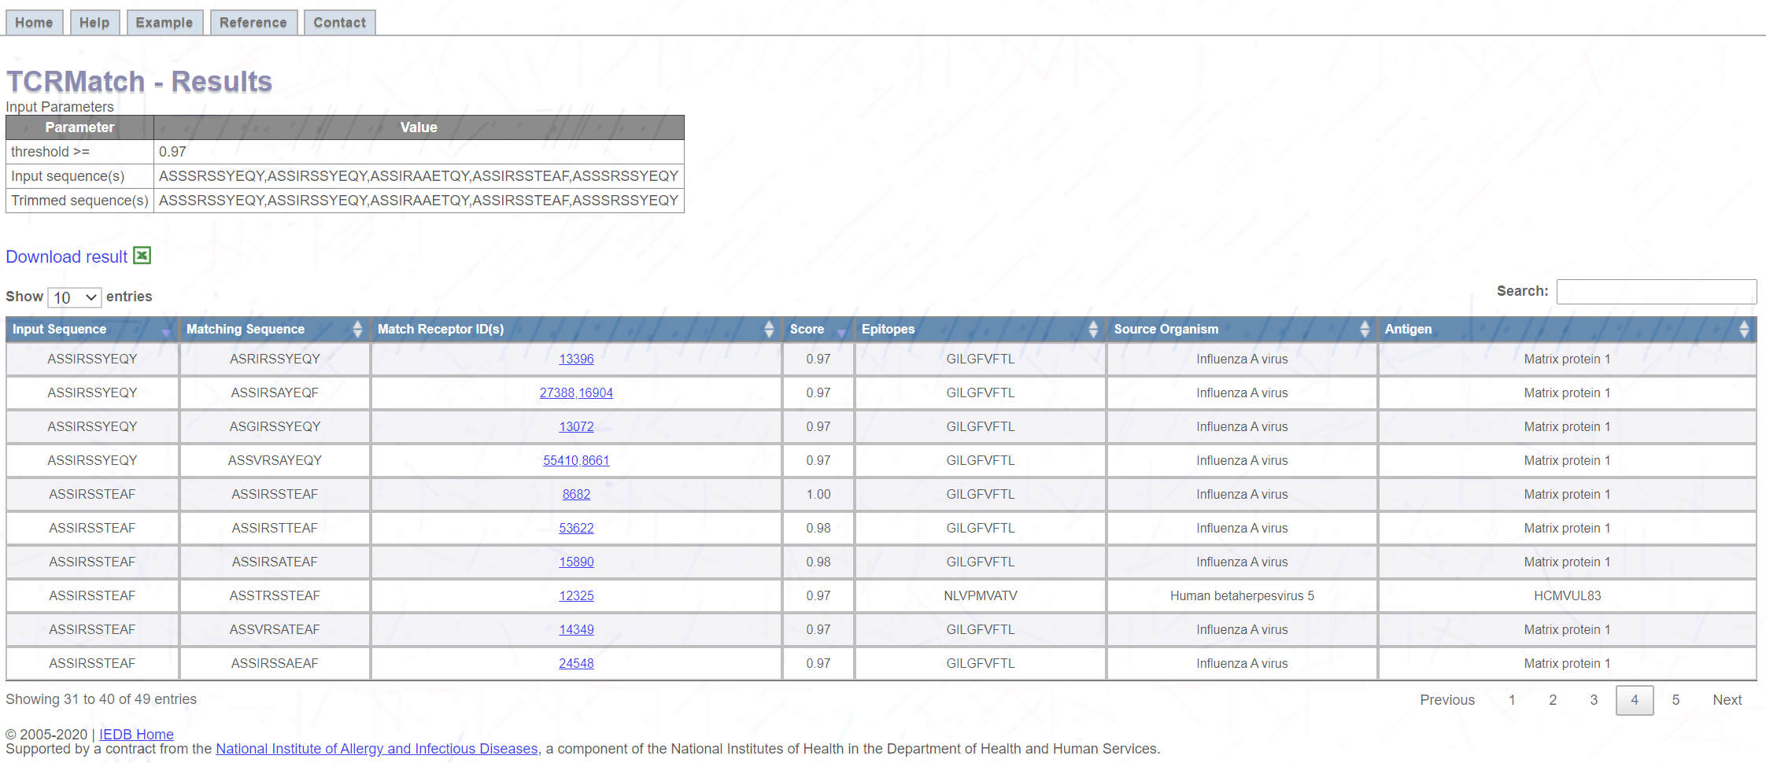
2020 IEDB User Workshop
43

Slide 44
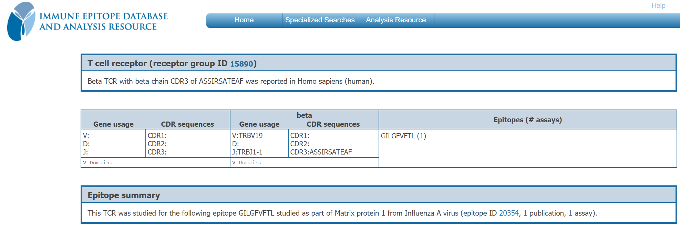
2020 IEDB User Workshop
44

