Slide 1
IEDB-AR 3.0: The Future of Tools
An integrated analysis platform
Presented by: J. Greenbaum

Slide 2
Outline
Motivations and vision
Lifecycle of a mhci prediction request
Live demo!
Tool integration (pipelines)
Plans and timeline

Slide 3
Motivations: Why a redesign?
Site navigation needs improvement
No linkage between/among current tools
Inconsistencies among tools
Outdated layout and aesthetics
We can do better!

Slide 4
What is the vision?
A complete re-thinking of the user experience
Users should feel at home and have immediate understanding
Power users should be able to perform complex workflows
Emphasis on:
Navigation
Simplicity
Consistency
Integration
Speed
Drawing upon familiar paradigms
REST APIs
JSON
Jupyter

Slide 5
Lifecycle of a mhci prediction request
/mhci
1 - prediction request
2 - request ID
3 - request ID
4 - status / results
/get_results

Slide 6
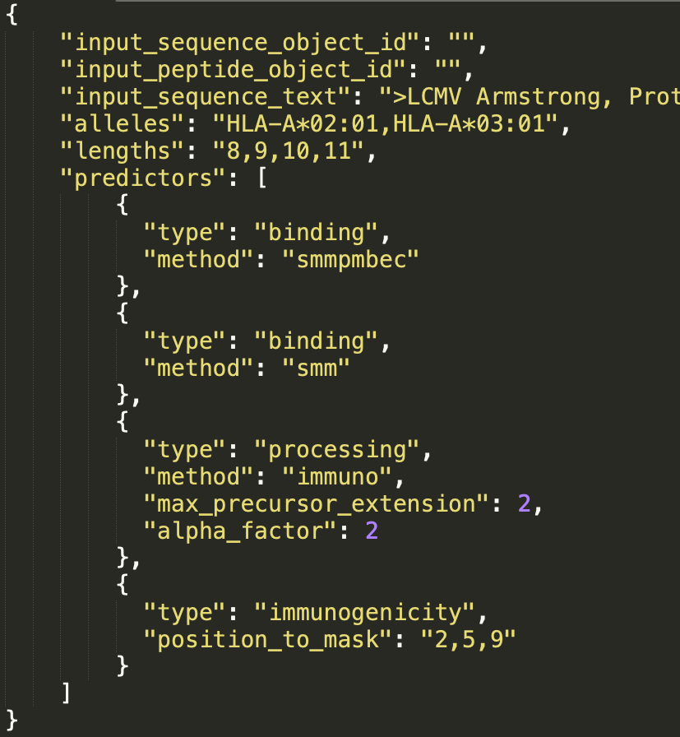
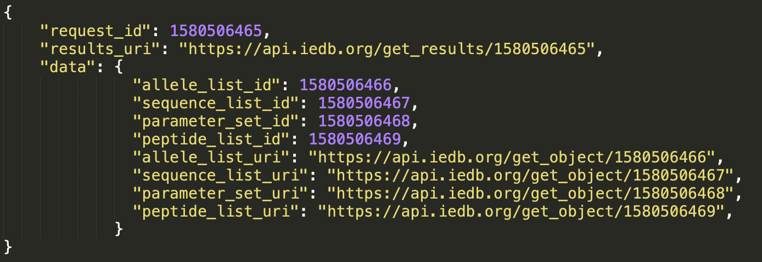
‘/mhci’ endpoint allows for multiple predictors and returns request ID
POST
Success! 🙌
Validation error 😢

Slide 7
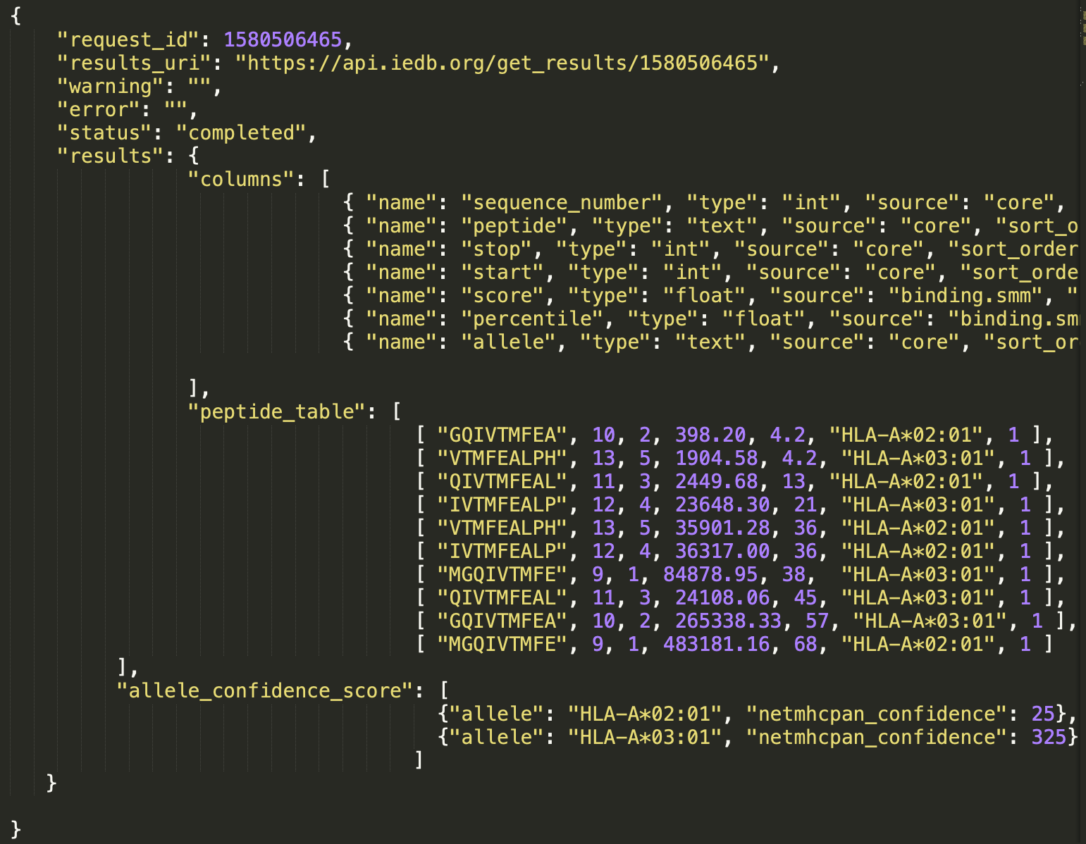
Request status and results retrieved through ‘get_results/’ endpoint
Nice! 😎
Waiting… 💤
Error 💣

Slide 8
Live demo!
Clean and consistent APIs with interactive documentation:
https://iedb-ar-prototype.lji.org/docs/api/
T cell tool prototype:
https://iedb-ar-prototype.lji.org/t-cell-prediction

Slide 9
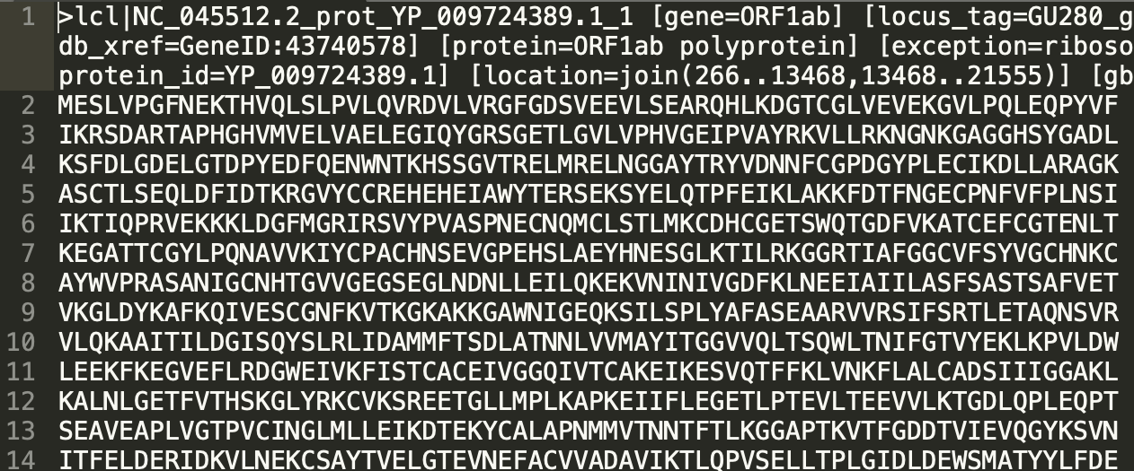
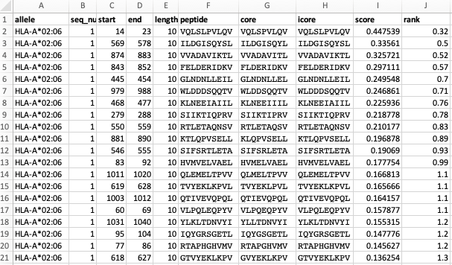
Pipelines will allow for tool integration
Immunome browser
fasta file with 12 proteins
1,500 top predicted binders
MHC I binding tool
Clustering tool
binding hotspots mapped to protein
14,053 peptide:MHC binding predictions
126 peptide clusters

Slide 10
Plans and timeline
Other planned features
API access packages
Customizable output formats
Data and pipeline shareability
Curated pipelines
High performance cluster backend and queuing system
Key dates
Expert committee review and feedback - December 2020
T cell tool alpha site availability - Early 2021
Remaining tools to follow

Slide 11
Backup Screenshots Below

Slide 12
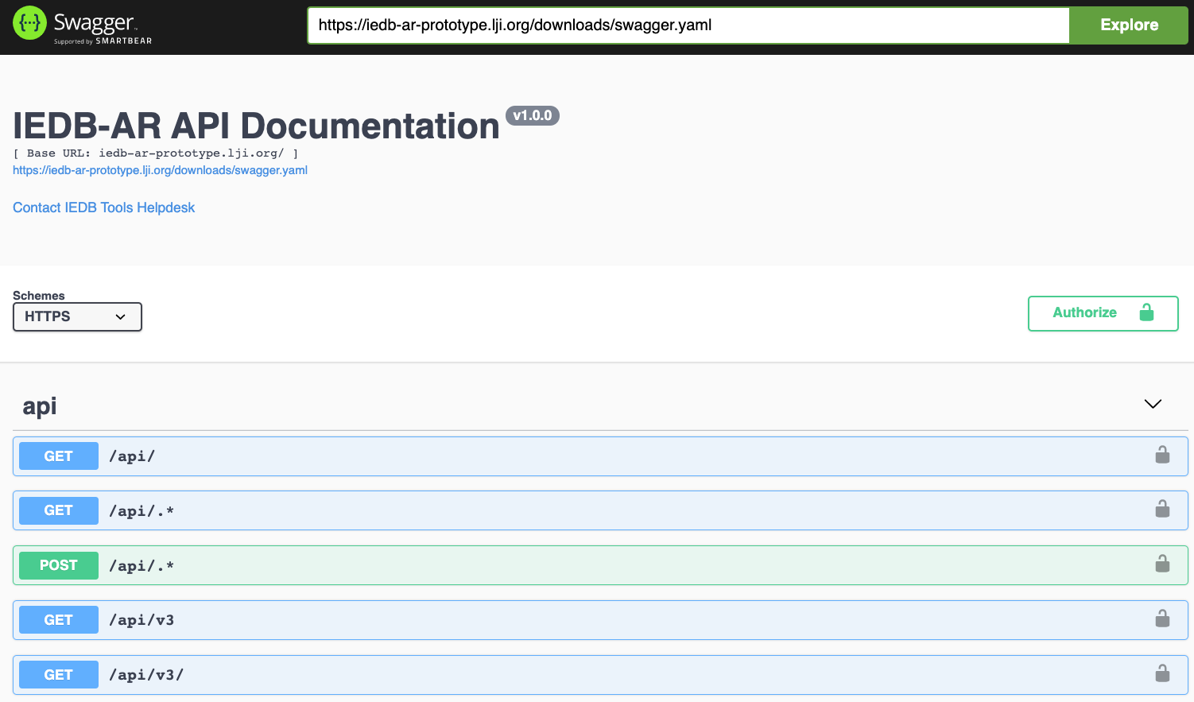

Slide 13
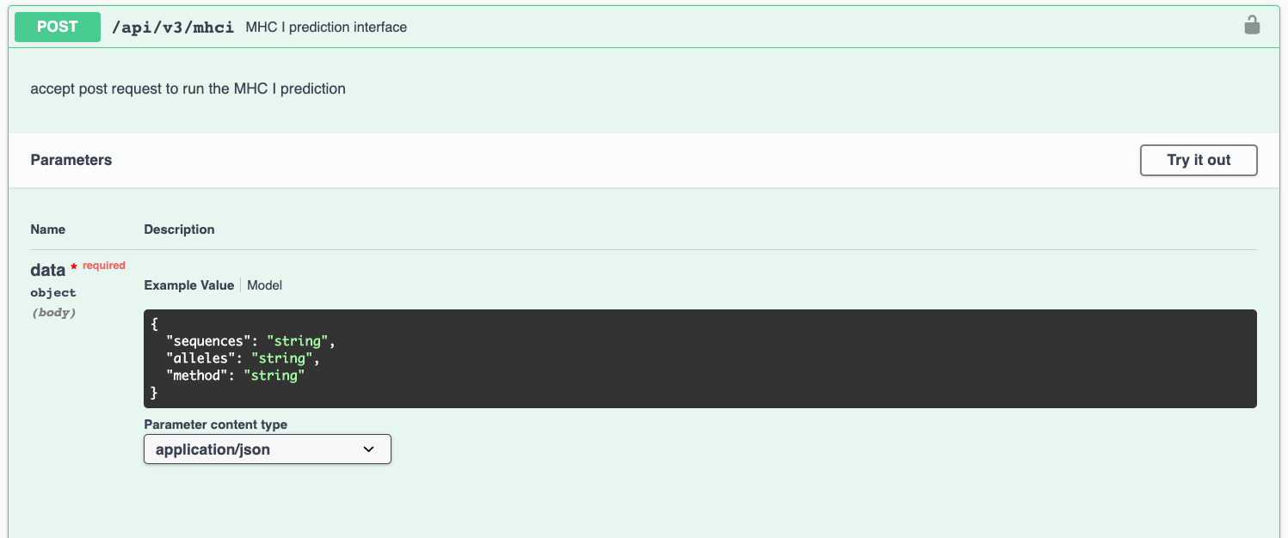

Slide 14
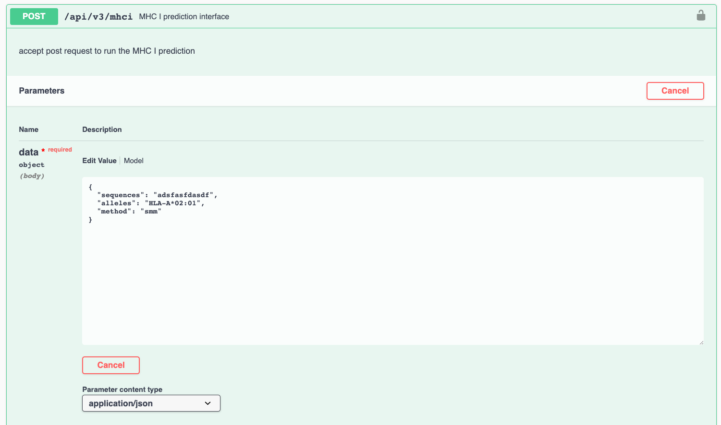

Slide 15
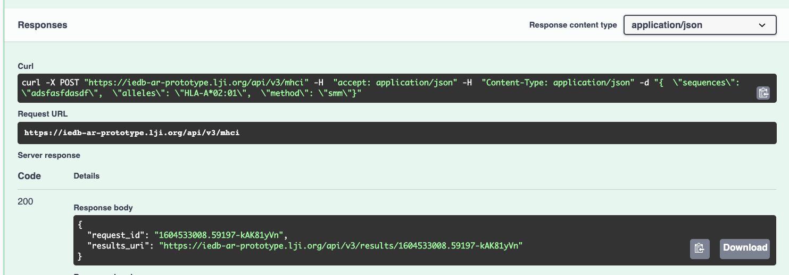

Slide 16
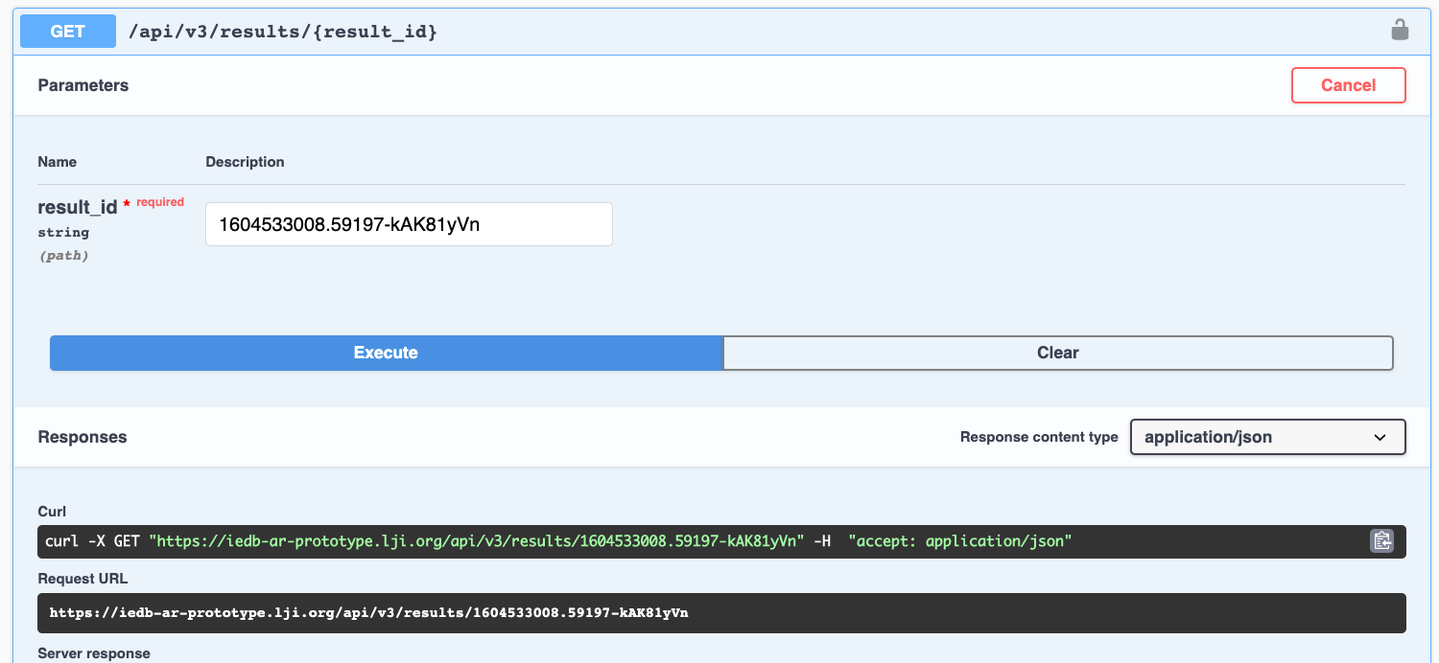

Slide 17
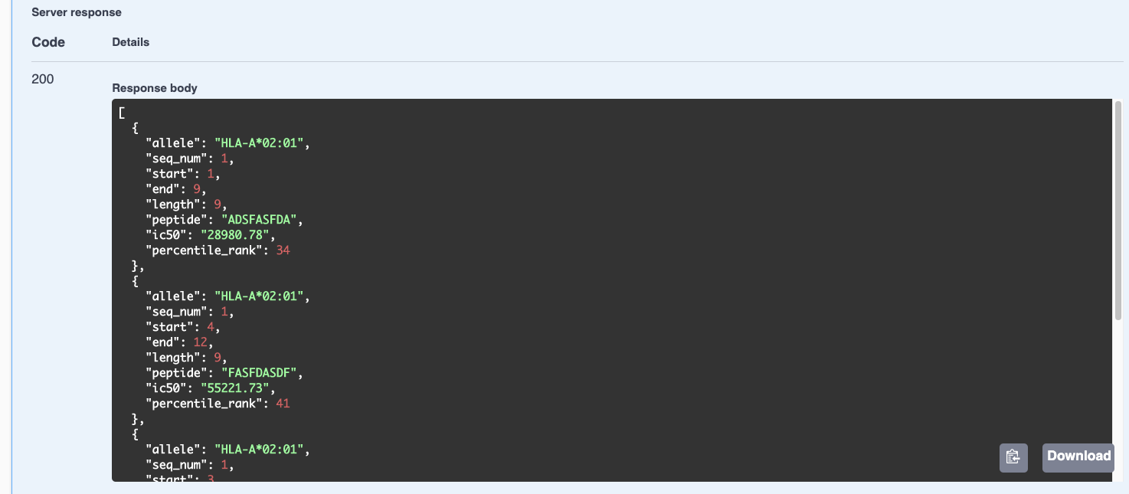

Slide 18
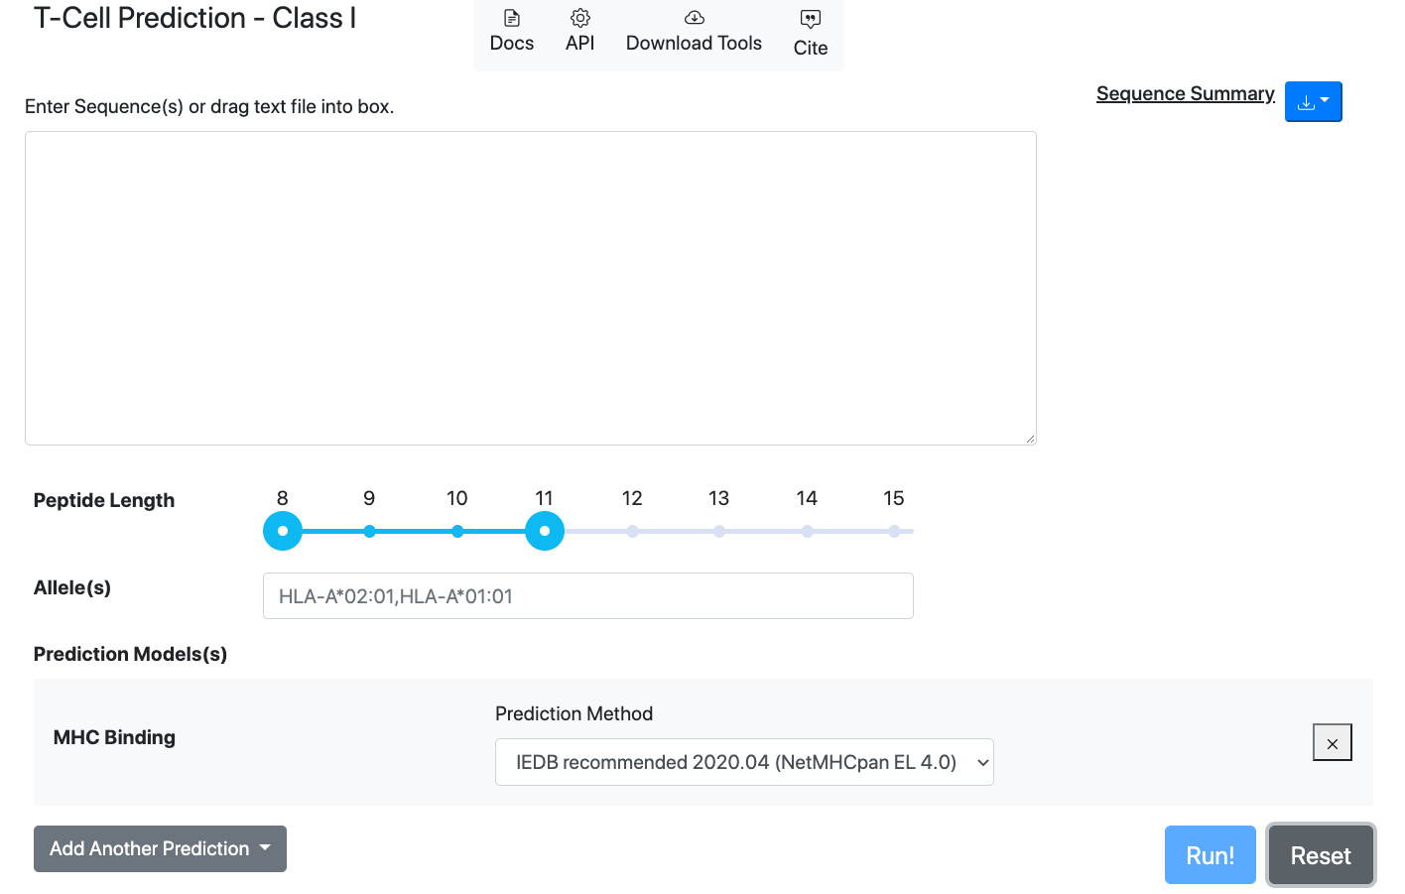

Slide 19
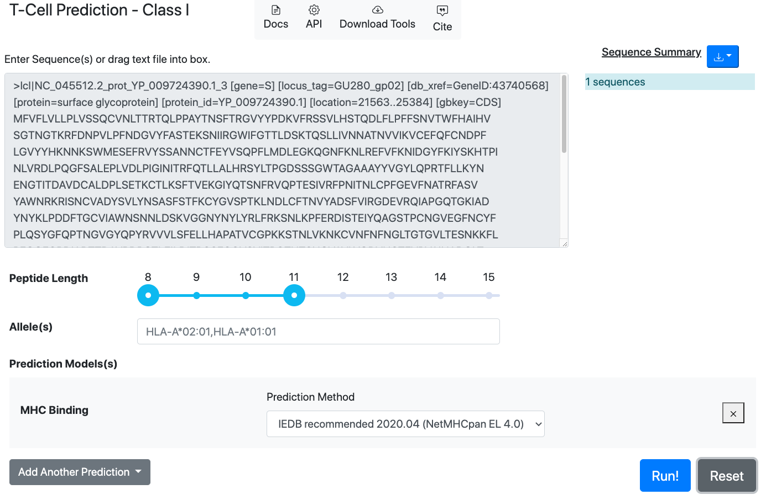

Slide 20
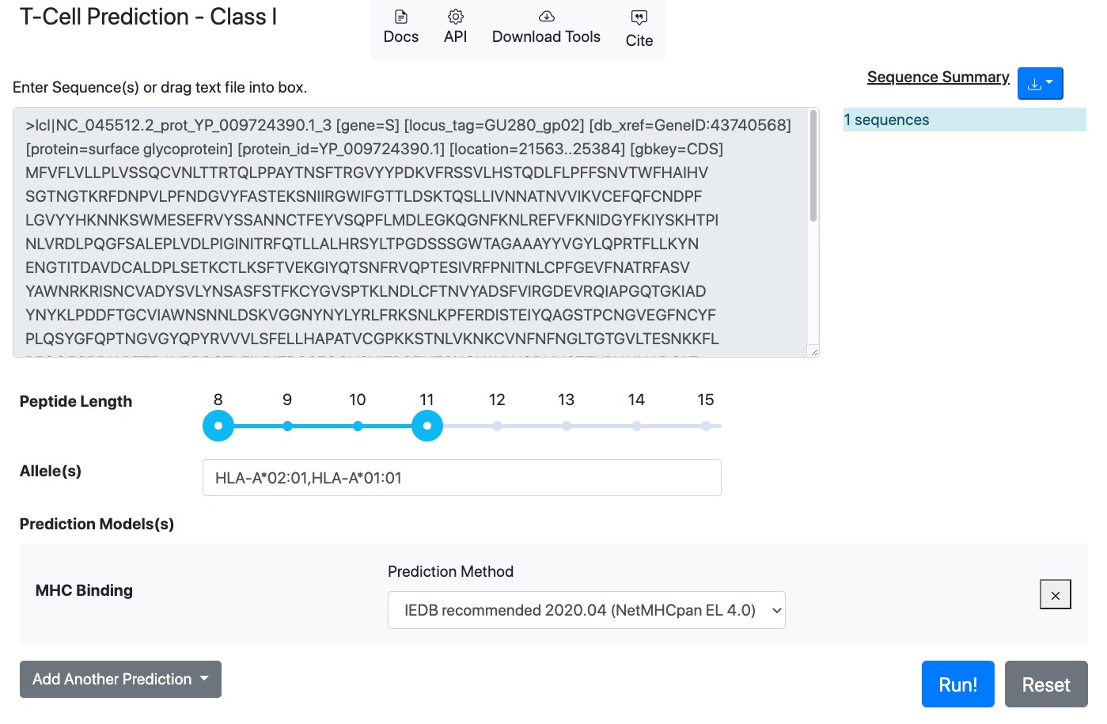

Slide 21
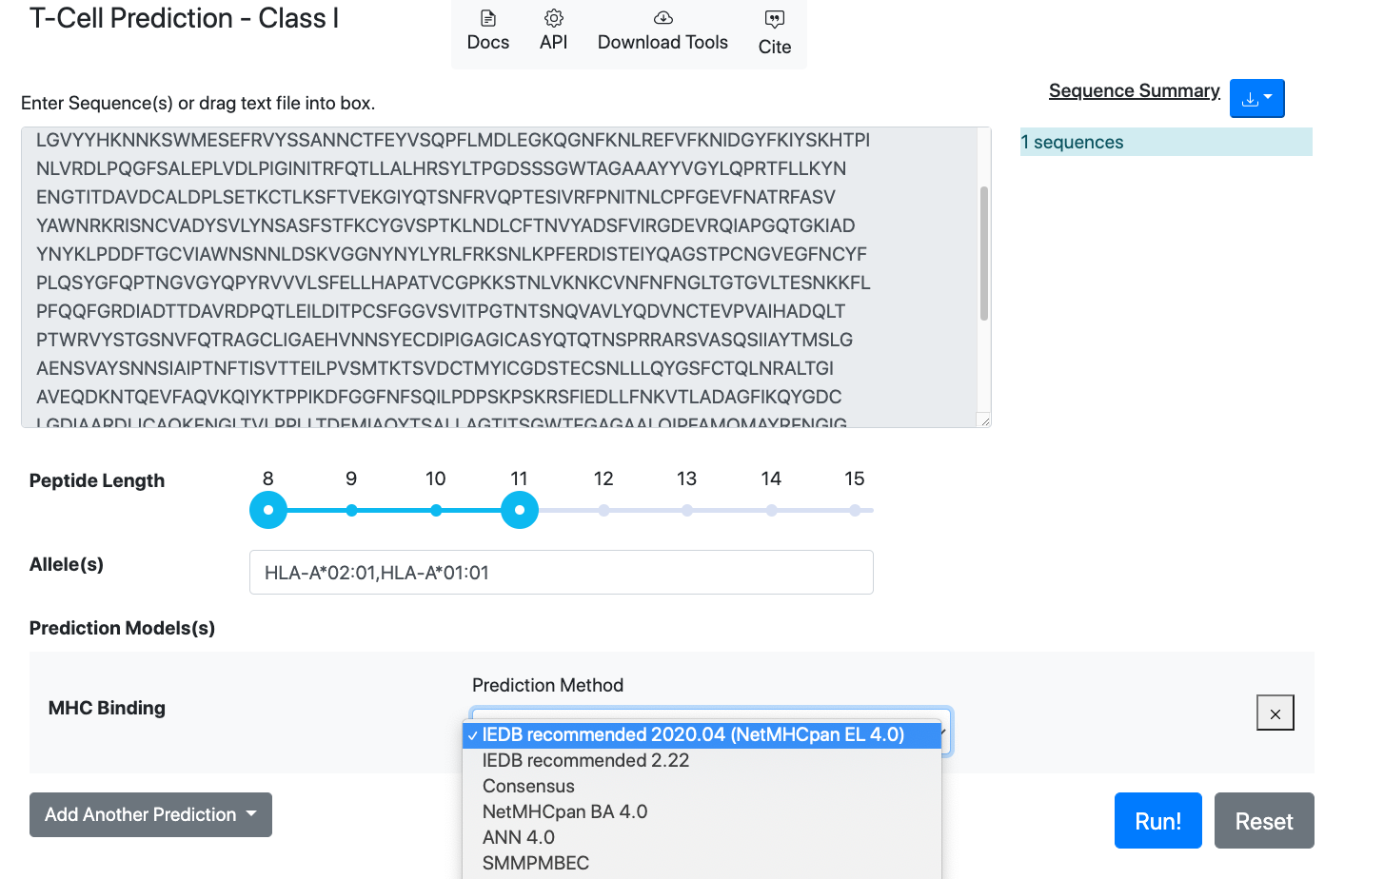

Slide 22
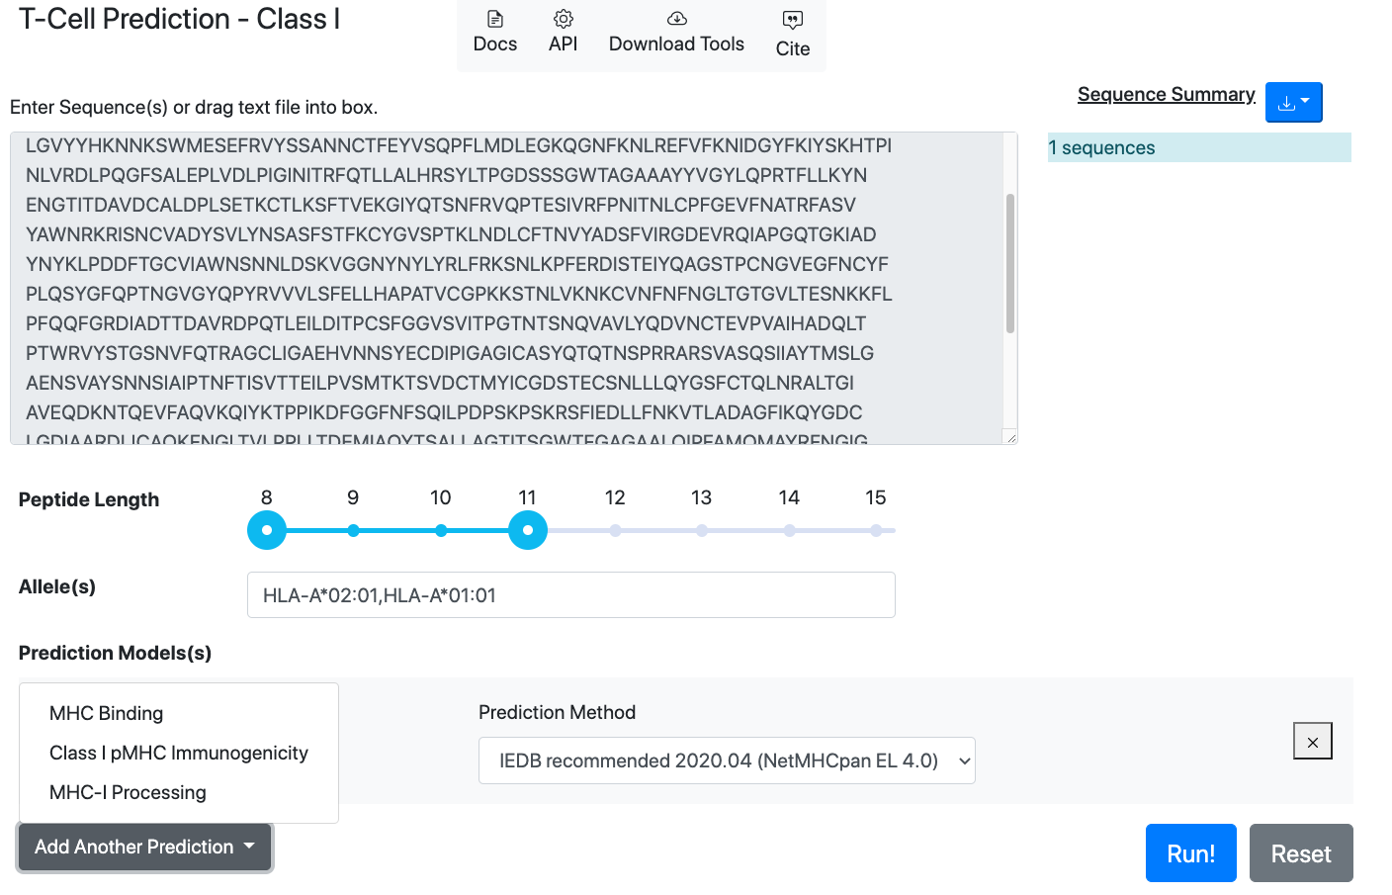

Slide 23
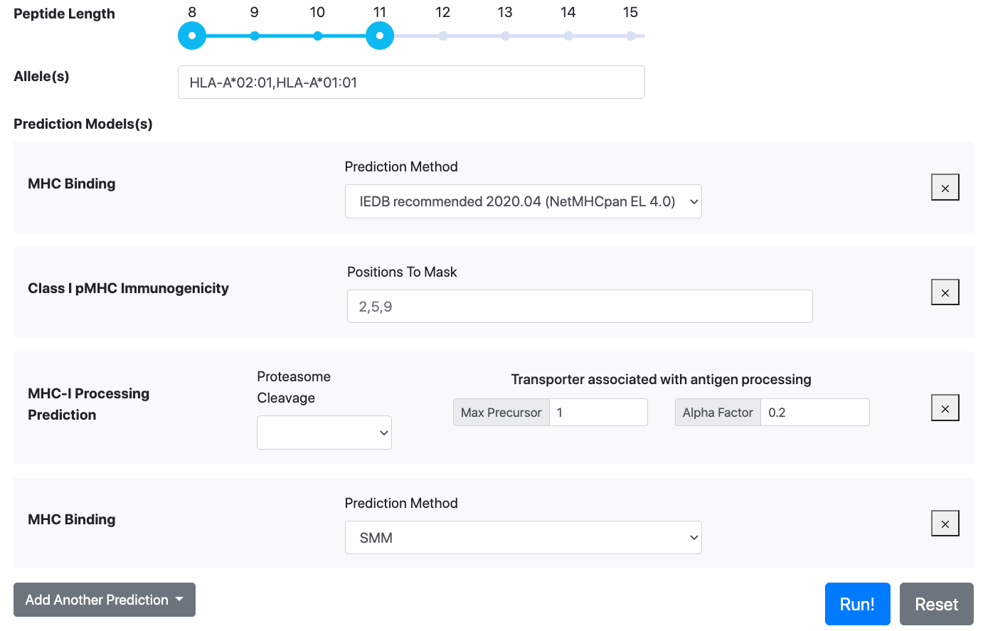

Slide 24
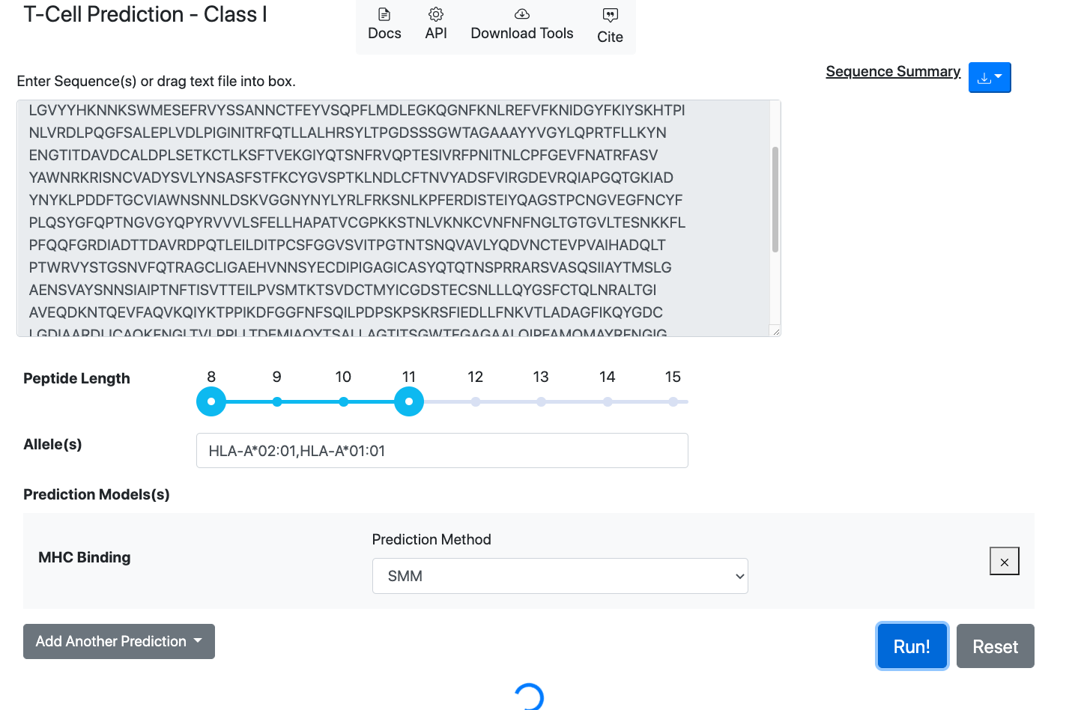

Slide 25
