Slide 1
MHC Binding Predictions
tools.iedb.org
Presented by: Bjoern Peters, Professor

Slide 2
Outline
MHC class I binding prediction
MHC class II binding prediction
TepiTool
Datasets availability
Benchmarking of class I tools
Contributing tools
How the tool works
Recommendations
Interpreting results
Exercises

Slide 3
MHC binding predictions
MHC molecules are highly polymorphic – thousands of different variants exist
MHC-peptide binding is promiscuous in nature
Experimental characterization of peptide–MHC interactions is highly cost-intensive
Prediction methods facilitate selection of potential epitopes from a pool of peptides
Peptide binding data
HLA-A*01:01
Machine learning algorithms
Peptide IC₅₀(nM)
ASFCGSPY 51.4
LTDFGLSK 739.3
FTSFFYRY 1285.0
KSVFNSLY 1466.0
RDWAHNSL 1804.6
FSSCPVAY 1939.4
RNWAHSSL 2201.7
LSCAASGF 2830.1
LASIDLKY 3464.0
+

Slide 4
MHC I Binding Prediction
tools.iedb.org/main/tcell/

Slide 5
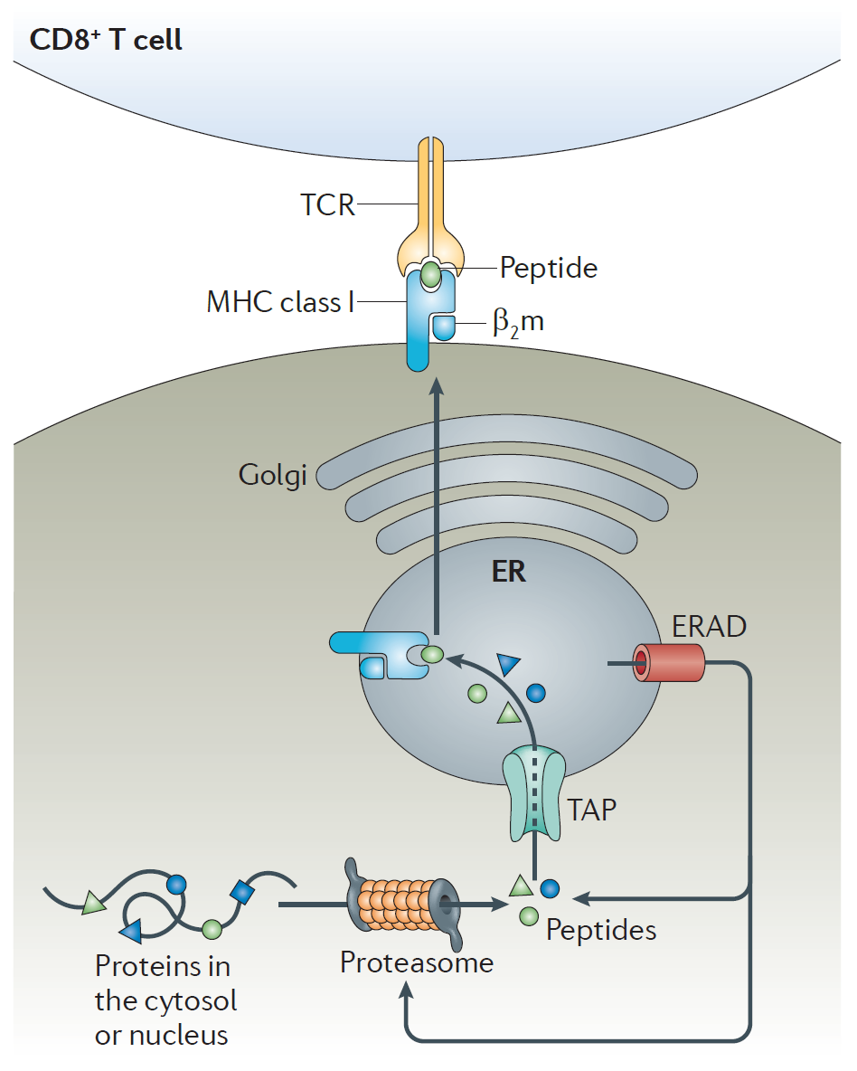
Endogenous antigen processing pathway (class I)
Antigens generated within the cell
Viral particles
Self proteins
DRiPs (Defective Ribosomal Particles)
Different factors influence peptide being “epitope”

Slide 6
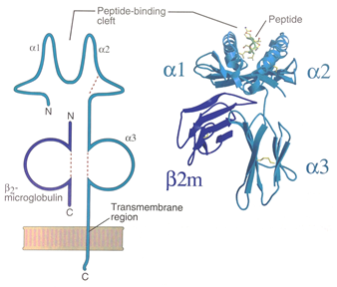
Class I MHC molecule
Expressed by almost all nucleated cells
Presents antigen to CD8+ T cells (Cytotoxic T cells)
One MHC encoded polymorphic chain (α) (2nd chain – β2-microglobulin)
The binding groove is closed at both ends and can accommodate peptides of 8-15 AA
Only α chain impacts binding
Figure Source
Cellular & Molecular Immunology, 5th Ed by Abbas and Lichtman

Slide 7
MHC-I binding prediction - example
tools.iedb.org/mhci/
>LCMV Armstrong, Protein GP
MGQIVTMFEALPHIIDEVINIVIIVLIVITGIKAVYNFATCGIFALISFLLLAGRSCGM
YGLKGPDIYKGVYQFKSVEFDMSHLNLTMPNACSANNSHHYISMGTSGLELTFTNDSII
SHNFCNLTSAFNKKTFDHTLMSIVSSLHLSIRGNSNYKAVSCDFNNGITIQYNLTFSDA
QSAQSQCRTFRGRVLDMFRTAFGGKYMRSGWGWTGSDGKTTWCSQTSYQYLIIQNRTWE
NHCTYAGPFGMSRILLSQEKTKFFTRRLAGTFTWTLSDSSGVENPGGYCLTKWMILAAE
LKCFGNTAVAKCNVNHDAEFCDMLRLIDYNKAALSKFKEDVESALHLFKTTVNSLISDQ
LLMRNHLRDLMGVPYCNYSKFWYLEHAKTGETSVPKCWLVTNGSYLNETHFSDQIEQEA
DNMITEMLRKDYIKRQGSTPLALMDLLMFSTSAYLVSIFLHLVKIPTHRHIKGGSCPKP
HRLTNKGICSCGAFKVPGVKTVWKRR
Epitope sequence
(copy or upload)

Slide 8
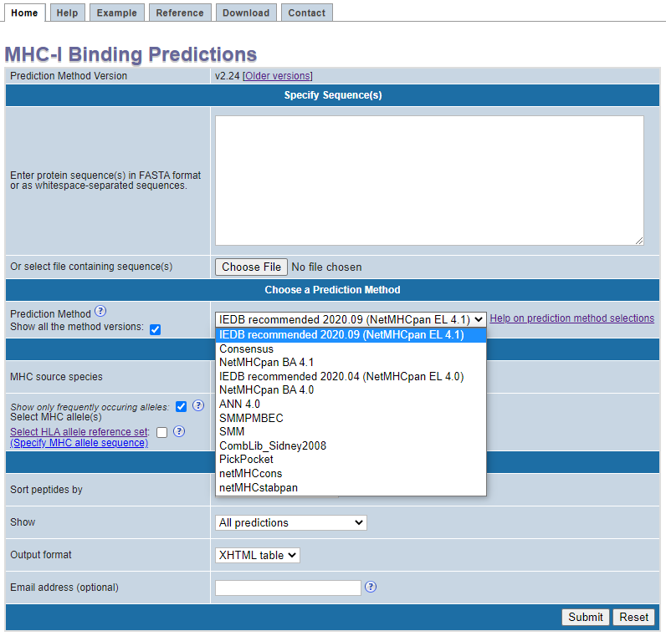
MHC-I binding prediction - example
tools.iedb.org/mhci/
>LCMV Armstrong, Protein GP
MGQIVTMFEALPHIIDEVINIVIIVLIVITGIKAVYNFATCGIFALISFLLLAGRSCGM
YGLKGPDIYKGVYQFKSVEFDMSHLNLTMPNACSANNSHHYISMGTSGLELTFTNDSII
SHNFCNLTSAFNKKTFDHTLMSIVSSLHLSIRGNSNYKAVSCDFNNGITIQYNLTFSDA
QSAQSQCRTFRGRVLDMFRTAFGGKYMRSGWGWTGSDGKTTWCSQTSYQYLIIQNRTWE
NHCTYAGPFGMSRILLSQEKTKFFTRRLAGTFTWTLSDSSGVENPGGYCLTKWMILAAE
LKCFGNTAVAKCNVNHDAEFCDMLRLIDYNKAALSKFKEDVESALHLFKTTVNSLISDQ
LLMRNHLRDLMGVPYCNYSKFWYLEHAKTGETSVPKCWLVTNGSYLNETHFSDQIEQEA
DNMITEMLRKDYIKRQGSTPLALMDLLMFSTSAYLVSIFLHLVKIPTHRHIKGGSCPKP
HRLTNKGICSCGAFKVPGVKTVWKRR
Prediction method

Slide 9
MHC class I binding prediction methods available
Method | Reference | Performance Reported
NetMHCpan EL - 4.1 | Reynisson et al., 2020 | 0.978 AUC (evaluated on EL data)
NetMHCpan EL - 4.0 | Paul et al., 2020 | 0.977 AUC (average)
NetMHCpan BA - 4.1 | Reynisson et al., 2020 | 0.893 AUC (evaluated on BA data)
NetMHCpan BA - 4.0 | Paul et al., 2020 | 0.975 AUC (average)
Consensus | Moutaftsi et al., 2006
ANN (NetMHC - 4.0) | Andreatta & Nielsen, 2016 | 0.887 AUC (average)
SMM with Peptide:MHC Binding Energy Covariance matrix (SMMPMBEC) | Kim et al., 2009 | 0.894 AUC (average)
Stabilized matrix method (SMM) | Peters & Sette, 2005 | 0.887 AUC (average) (Kim et. al., 2009)
Combinatorial library (CombLib) | Sidney et al., 2008 | 0.909 AUC (HLA-A*0201)
PickPocket - 1.1 | Zhang et al., 2009 | 0.895 AUC (average)
NetMHCcons - 1.1 | Karosiene et al., 2012 | 0.729 PCC (average)
NetMHCstabpan - 1.0 | Rasmussen et al., 2016 | 0.980 AUC (average)

Slide 10
Guidelines: Choosing the prediction method
Suggested method = “IEDB recommended”
Employs NetMHCpan EL 4.1 across all alleles
Provides binding affinity & percentile rank for each method separately as well
Recommendation will change with the new benchmark studies
IEDB Tools Version | Recommended Method
2020.09 (current) | NetMHCPan 4.1 EL
2020.04 | NetMHCPan 4.0 EL
2.22 and earlier | Consensus, if available; otherwise, NetMHCpan

Slide 11
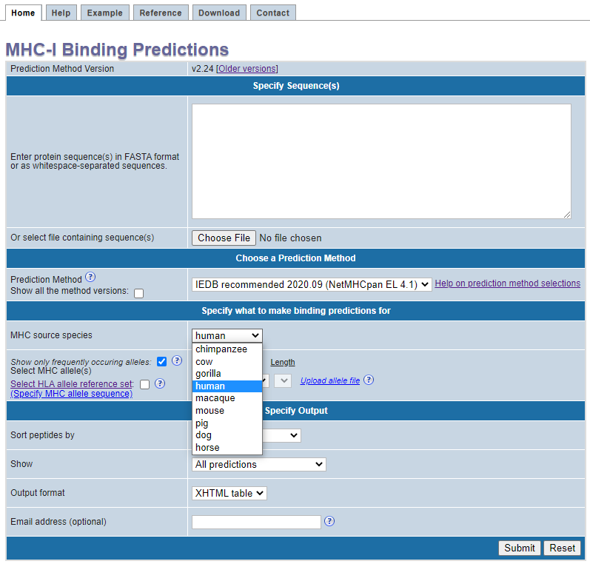
MHC-I binding prediction – example
tools.iedb.org/mhci/
>LCMV Armstrong, Protein GP
MGQIVTMFEALPHIIDEVINIVIIVLIVITGIKAVYNFATCGIFALISFLLLAGRSCGM
YGLKGPDIYKGVYQFKSVEFDMSHLNLTMPNACSANNSHHYISMGTSGLELTFTNDSII
SHNFCNLTSAFNKKTFDHTLMSIVSSLHLSIRGNSNYKAVSCDFNNGITIQYNLTFSDA
QSAQSQCRTFRGRVLDMFRTAFGGKYMRSGWGWTGSDGKTTWCSQTSYQYLIIQNRTWE
NHCTYAGPFGMSRILLSQEKTKFFTRRLAGTFTWTLSDSSGVENPGGYCLTKWMILAAE
LKCFGNTAVAKCNVNHDAEFCDMLRLIDYNKAALSKFKEDVESALHLFKTTVNSLISDQ
LLMRNHLRDLMGVPYCNYSKFWYLEHAKTGETSVPKCWLVTNGSYLNETHFSDQIEQEA
DNMITEMLRKDYIKRQGSTPLALMDLLMFSTSAYLVSIFLHLVKIPTHRHIKGGSCPKP
HRLTNKGICSCGAFKVPGVKTVWKRR
Choose species

Slide 12
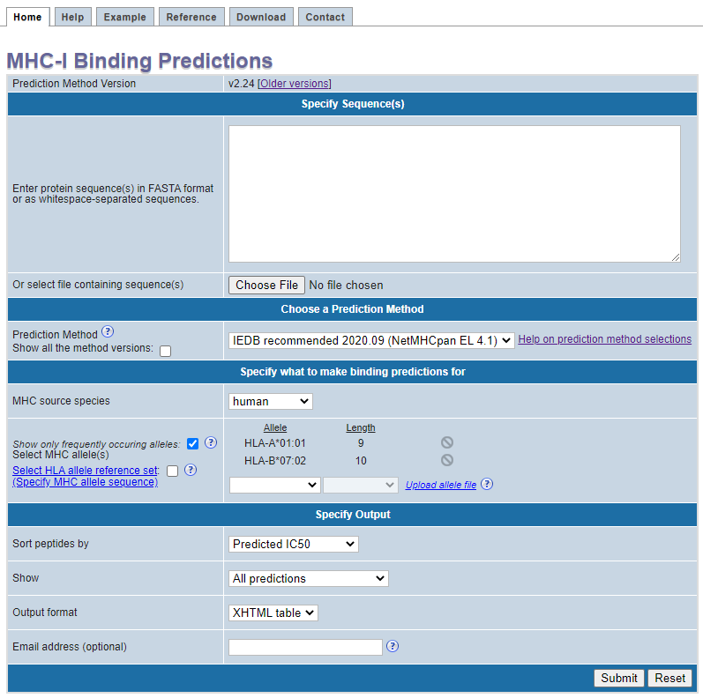
MHC-I binding prediction – example
tools.iedb.org/mhci/
>LCMV Armstrong, Protein GP
MGQIVTMFEALPHIIDEVINIVIIVLIVITGIKAVYNFATCGIFALISFLLLAGRSCGM
YGLKGPDIYKGVYQFKSVEFDMSHLNLTMPNACSANNSHHYISMGTSGLELTFTNDSII
SHNFCNLTSAFNKKTFDHTLMSIVSSLHLSIRGNSNYKAVSCDFNNGITIQYNLTFSDA
QSAQSQCRTFRGRVLDMFRTAFGGKYMRSGWGWTGSDGKTTWCSQTSYQYLIIQNRTWE
NHCTYAGPFGMSRILLSQEKTKFFTRRLAGTFTWTLSDSSGVENPGGYCLTKWMILAAE
LKCFGNTAVAKCNVNHDAEFCDMLRLIDYNKAALSKFKEDVESALHLFKTTVNSLISDQ
LLMRNHLRDLMGVPYCNYSKFWYLEHAKTGETSVPKCWLVTNGSYLNETHFSDQIEQEA
DNMITEMLRKDYIKRQGSTPLALMDLLMFSTSAYLVSIFLHLVKIPTHRHIKGGSCPKP
HRLTNKGICSCGAFKVPGVKTVWKRR
Complete set
Reference alleles
Specify allele(s) & peptide length
(select or upload)
Upload format:
HLA-A*01:01,9
HLA-B*07:02,10

Slide 13
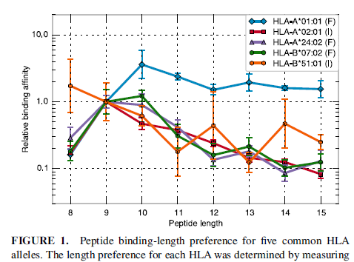
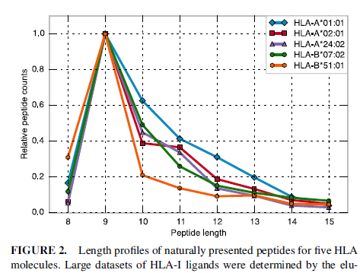
Natural length distribution in epitope prediction
Alleles differ in their preference for lengths on binding and presentation of peptides

Slide 14
Allele selection – Reference set for global coverage
Reference set of 27 alleles
Covers > 97% of population
HLA-A | Frequency | HLA-B | Frequency
A*01:01 | 16.2 | B*07:02 | 13.3
A*02:01 | 25.2 | B*08:01 | 11.5
A*02:03 | 3.3 | B*15:01 | 5.2
A*02:06 | 4.9 | B*35:01 | 6.5
A*03:01 | 15.4 | B*40:01 | 10.3
A*11:01 | 12.9 | B*44:02 | 9.2
A*23:01 | 6.4 | B*44:03 | 7.6
A*24:02 | 16.8 | B*51:01 | 5.5
A*26:01 | 4.7 | B*53:01 | 5.4
A*30:01 | 5.1 | B*57:01 | 3.2
A*30:02 | 5.0 | B*58:01 | 3.6
A*31:01 | 4.7
A*32:01 | 5.7
A*33:01 | 3.2
A*68:01 | 4.6
A*68:02 | 3.3
http://iedb.zendesk.com/entries/25054538-HLA-allele-frequencies

Slide 15
Prediction method dependent allele selection
NetMHCpan prediction methods allow FASTA sequence input
tools.iedb.org/mhci/
Select “Specify MHC allele sequence”

Slide 16
MHC-I binding prediction – example
tools.iedb.org/mhci/
>LCMV Armstrong, Protein GP
MGQIVTMFEALPHIIDEVINIVIIVLIVITGIKAVYNFATCGIFALISFLLLAGRSCGM
YGLKGPDIYKGVYQFKSVEFDMSHLNLTMPNACSANNSHHYISMGTSGLELTFTNDSII
SHNFCNLTSAFNKKTFDHTLMSIVSSLHLSIRGNSNYKAVSCDFNNGITIQYNLTFSDA
QSAQSQCRTFRGRVLDMFRTAFGGKYMRSGWGWTGSDGKTTWCSQTSYQYLIIQNRTWE
NHCTYAGPFGMSRILLSQEKTKFFTRRLAGTFTWTLSDSSGVENPGGYCLTKWMILAAE
LKCFGNTAVAKCNVNHDAEFCDMLRLIDYNKAALSKFKEDVESALHLFKTTVNSLISDQ
LLMRNHLRDLMGVPYCNYSKFWYLEHAKTGETSVPKCWLVTNGSYLNETHFSDQIEQEA
DNMITEMLRKDYIKRQGSTPLALMDLLMFSTSAYLVSIFLHLVKIPTHRHIKGGSCPKP
HRLTNKGICSCGAFKVPGVKTVWKRR
Input
Output
bpeters@lji.org

Slide 17
How the tool works
Breaks the sequence into all possible peptides (of chosen length).
Predicts the binding affinity for each peptide based on the method.
Compares the predicted affinity to that of a large set of randomly selected peptides.
Assigns a percentile rank depending on individual predicted affinity.
Consensus picks the median rank of the methods used.

Slide 18
MHC-I binding prediction – example
tools.iedb.org/mhci/
Input sequence
Output
(sorted low-to-high by percentile rank)
A percentile rank for a peptide is the percentage of randomly sampled peptides scoring better than the peptide.

Slide 19
MHC-I binding prediction – example
tools.iedb.org/mhci/
Individual scores for different methods

Slide 20
Downloaded prediction results

Slide 21
Emailed prediction results

Slide 22
Selection of “binders”
Pick peptides below percentile rank 1.0
Pick peptides below predicted binding affinity of 500 nM
IC50 < 50 nM - high affinity
IC50 < 500 nM - intermediate affinity
IC50 < 5000 nM - low affinity
Sette et al. 1994, J. Immunology (PMID: 7527444)
Ensures that all peptides have reasonable affinity
Pick top 1% of peptides for each allele/length combination to cover most of immune responses
Moutaftsi et al. 2006 (PMID: 16767078)
Kotturi et al. 2007 (PMID: 17329346)
Ensures equal number of peptides per allele
Select based on allele specific binding affinity threshold

Slide 23
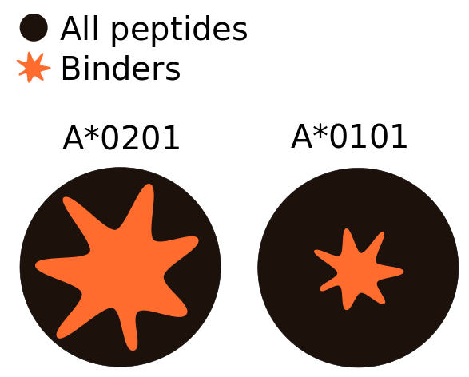
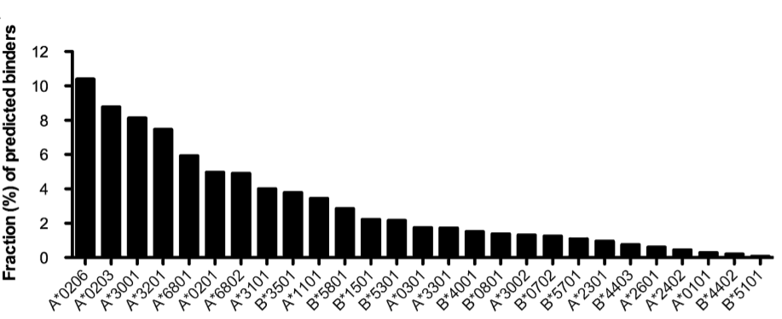
Different peptide-binding repertoires
The size of the peptide repertoire binding at a given affinity varies between alleles
HLA-A*02:01
HLA-A*01:01
Allele-specific affinity cutoffs

Slide 24
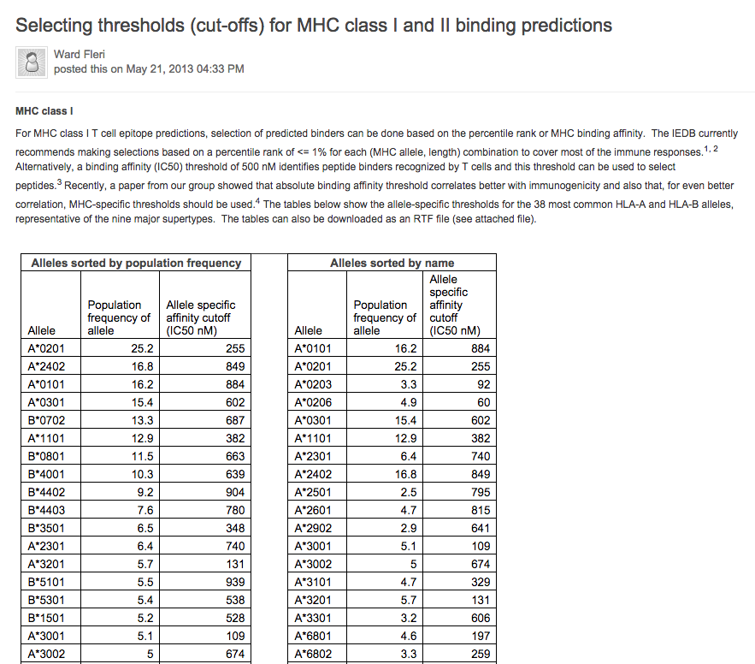
Allele-specific thresholds

Slide 25
Recommendations
Both approaches (affinity and ranking) are reasonable, and have been applied in numerous studies
Thresholds can be combined (peptides in top 1% and IC50 <500nM)
Current studies suggest that allele specific thresholds can be derived

Slide 26
Alternate approaches for selecting binders
Change threshold values depending on your need
e.g. in case you have too few or too many predicted binders.
Set a desired percentage within your peptide set (irrespective of IEDB percentile rank) in case you want to study a fixed number of best possible peptides.

Slide 27
Walk through exercise
tools.iedb.org/mhci/
Find the best epitope candidate of length 9 for HLA-A*02:01 from SARS spike glycoprotein (GenBank accession no: ABD72984.1)
Find the best epitope candidate of length 9 for HLA-A*02:01 from SARS spike glycoprotein (GenBank accession no: ABD72984.1)
Solution:
Copy sequence from GenBank (NCBI Protein) into the prediction tool
Select prediction method
Select species
Select the allele
Submit
Solution:
Copy sequence from GenBank (NCBI Protein) into the prediction tool
Select prediction method as “IEDB recommended”
Select species as “Human”
Select the allele as HLA-A*02:01 & length as 9
Submit

Slide 28
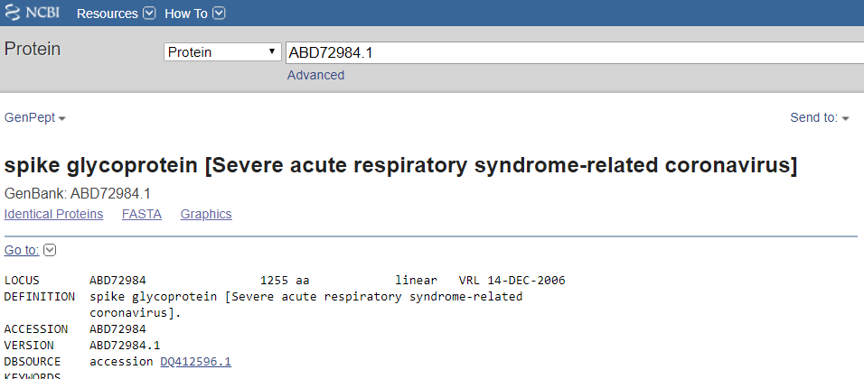
Walk through exercise
tools.iedb.org/mhci/
Find the best epitope candidate of length 9 for HLA-A*02:01 from SARS spike glycoprotein (GenBank accession no: ABD72984.1)
Solution:
Collect sequence from GenBank (NCBI Protein) - https://www.ncbi.nlm.nih.gov/protein/

Slide 29
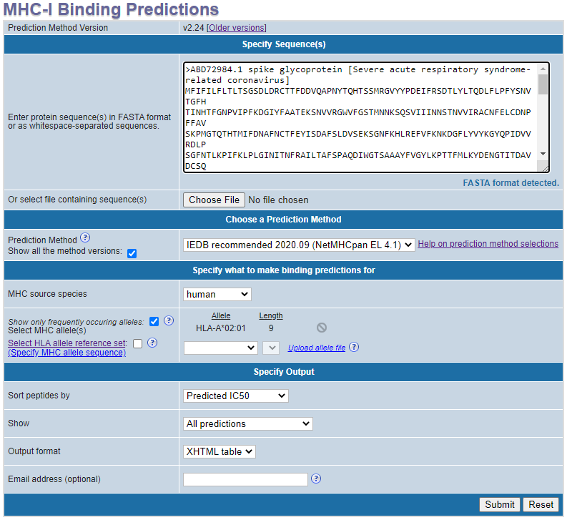
Practice Exercise
tools.iedb.org/mhci/
Insert protein sequence
Select prediction method
Select species
Select allele & length

Slide 30
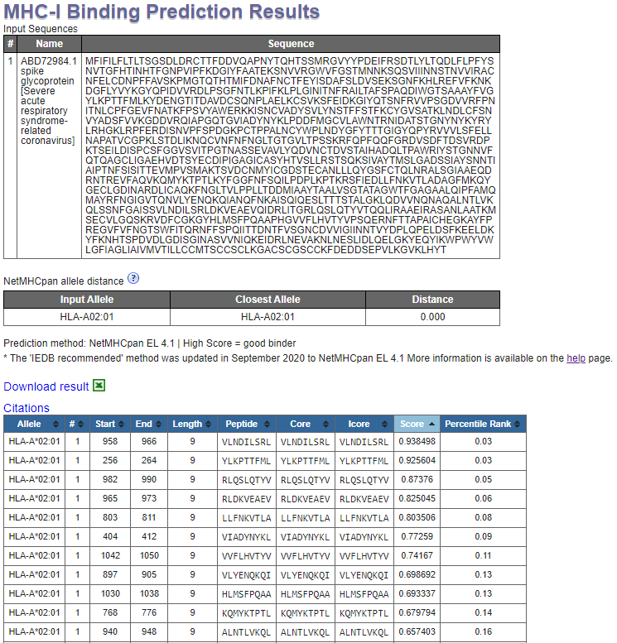
Practice Exercise

Slide 31
Self-practice: 5 min
Background
Apical membrane antigen-1 (AMA1) is a protein expressed in the membrane of P. falciparum sporozoite liver and blood stages. In clinical trials AMA1 gives both CD4+ & CD8+ responses and is considered a good malaria vaccine candidate.
Methods
Five volunteers were immunized with a vaccine containing full length of AMA1. A peptide pool of 15-mers overlapping by 11 amino acids in the AMA1 sequence was constructed. ELISpot responses of the peptides from the peptide pool were tested among the volunteers. HLA typing was done for each volunteer.
Problem statement
Use IEDB prediction tools to determine the minimal (length 9-10) epitope within the 15-mer LLSAFEFTYMINFGR. Volunteer’s HLA set: HLA-A*02:01, HLA-A*26:01, HLA-B*18:01, HLA-B*44:02.

Slide 32
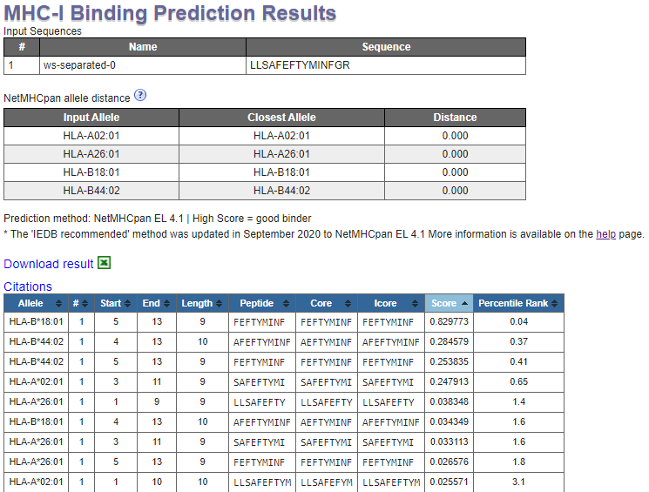
Self-practice results

Slide 33
Class II MHC Binding Prediction
Basic structure and principles same as class I binding prediction tool

Slide 34
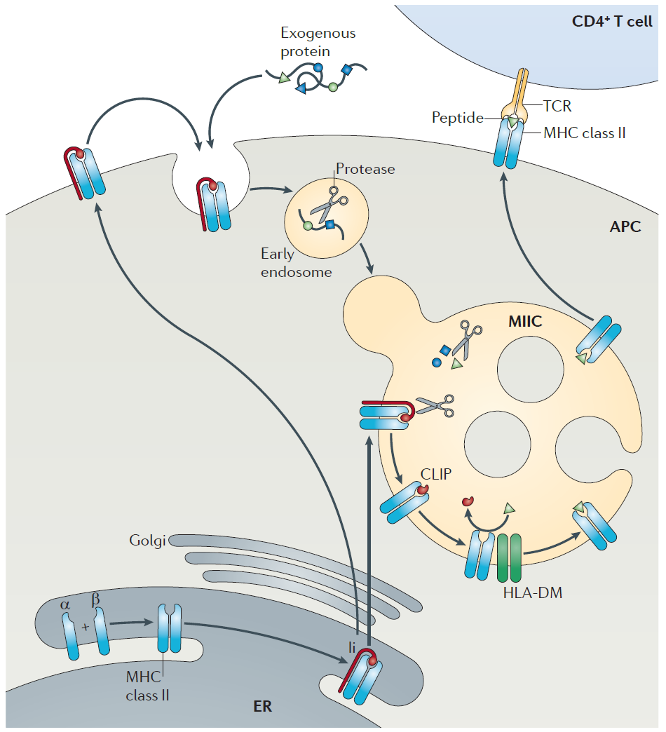
Exogenous antigen processing pathway (class II)
Antigens generated outside the cell
Entered through inhalation, ingestion, injection
Bacteria, Allergens, Parasites etc.

Slide 35
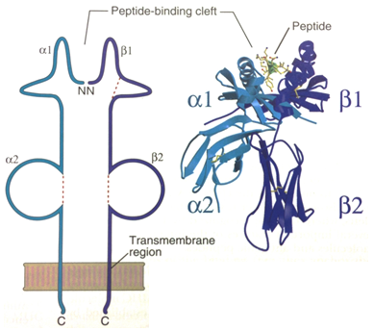
Class II MHC molecule
Only in antigen presenting cells
Two MHC encoded polymorphic chains (α, β)
Both α and β chains impact binding
Binding groove is open
Can bind longer peptides (13-25 AA)
Presents antigen to CD4+ T cells
Figure Source
Cellular & Molecular Immunology, 5th Ed by Abbas and Lichtman

Slide 36
HLA Nomenclature
Class I:
Only α chain is variable
HLA-B*07:02 (“B” is locus)
β2-microglobulin
Class II:
Both α and β chains are variable for DP & DQ loci
HLA-DPA1*01:03/DPB1*02:01
HLA-DQA1*01:01/DQB1*05:01
Only β chain is variable for DR locus
HLA-DRB1*01:01

Slide 37
Class II binding peptide “Binding core”
9 AA core within the peptide that interacts with the binding groove of MHC molecule
HLEFWEGVFTGLTHI
Challenge: Correct identification of the binding core
Needs proper alignment of the binding core with the binding groove
Binding Core

Slide 38
“Peptide flanking residues” (PFR)
Residues flanking the binding core - interacts with MHC molecule outside the groove.
HLEFWEGVFTGLTHI
Challenge: PFR length & composition influence binding.
Binding Core
Peptide flanking residues

Slide 39
Other differences between class I & II tools
Lesser accuracy compared to class-I tool
Less stringent threshold for selecting binders than class-I
Class I |  | Class II
Method | AUC* | Method | AUC*
NetMHCpan-4.0 | 0.960¹ | NetMHCIIpan-3.2 | 0.781²
SMM | 0.894³ | SMM-align | 0.763⁴
* The AUCs reported here are from different studies and obtained from different data sets
Jurtz et al., 2017, J of Immunology
Jensen et al. 2018, Immunology
Kim et al. 2009, BMC Bioinformatics
Wang et al. 2010, BMC Bioinformatics

Slide 40
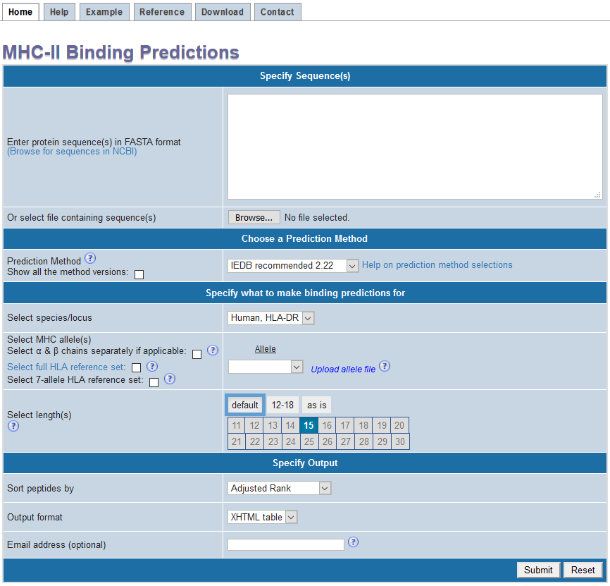
MHC-II binding prediction interface
Tool entry point layout similar to class I
tools.iedb.org/mhcii/
Insert protein sequence(s)
Select prediction method
Select species
Select allele(s) & length
Output options

Slide 41
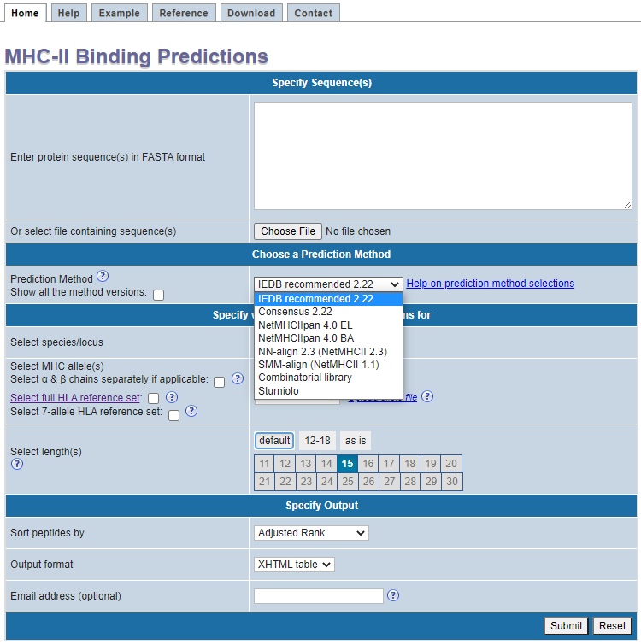
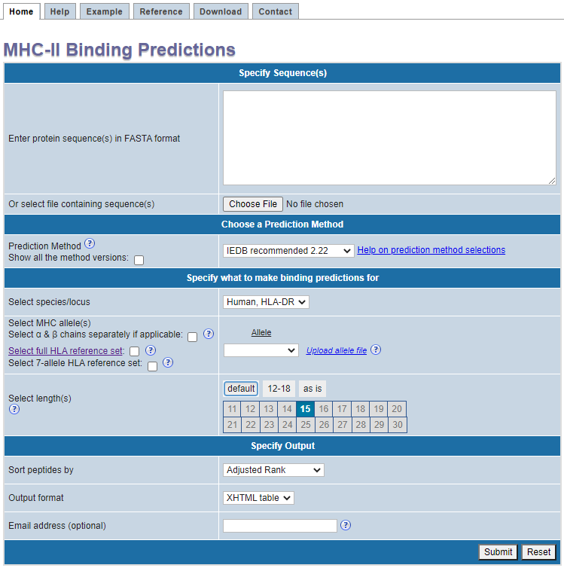
MHC-II binding prediction - example
tools.iedb.org/mhcii/
>West Nile virus envelope glycoprotein
FNCLGMSNRDFLEGVSGATWVDLVLEGDSCVTIMSKDKPTIDVKMMNMEAANLAEVRSYCYLATVSDLST
KAACPTMGEAHNDKRADPAFVCRQGVVDRGWGNGCGLFGKGSIDTCAKFACSTKAIGRTILKENIKYEVA
IFVHGPTTVESHGNYSTQVGATQAGRFSITPAAPSYTLKLGEYGEVTVDCEPRSGIDTNAYYVMTVGTKT
FLVHREWFMDLNLPWSSAGSTVWRNRETLMEFEEPHATKQSVIALGSQEGALHQALAGAIPVEFSSNTVK
LTSGHLKCRVKMEKLQLKGTTYGVCSKAFKFLGTPADTGHGTVVLELQYTGTDGPCKVPISSVASLNDLT
PVGRLVTVNPFVSVATANAKVLIELEPPFGDSYIVVGRGEQQINHHWHKSGSSIGKAFTTTLKGAQRLAA
LGDTAWDFGSVGGVFTSVGKAVHQVFGGAFRSLFGGMSWITQGLLGALLLWMGINARDRSIALTFLAVGG
VLLFLSVNVHA
Prediction method

Slide 42
Guidelines: Choosing the prediction method
Suggested method = “IEDB recommended”
Employs Consensus (Combination of NN-align, SMM-align & CombLib/Sturniolo) or NetMHCIIpan depending on the allele
Provides binding affinity & percentile rank for each method separately as well
Recommendation will change with the new benchmark studies

Slide 43
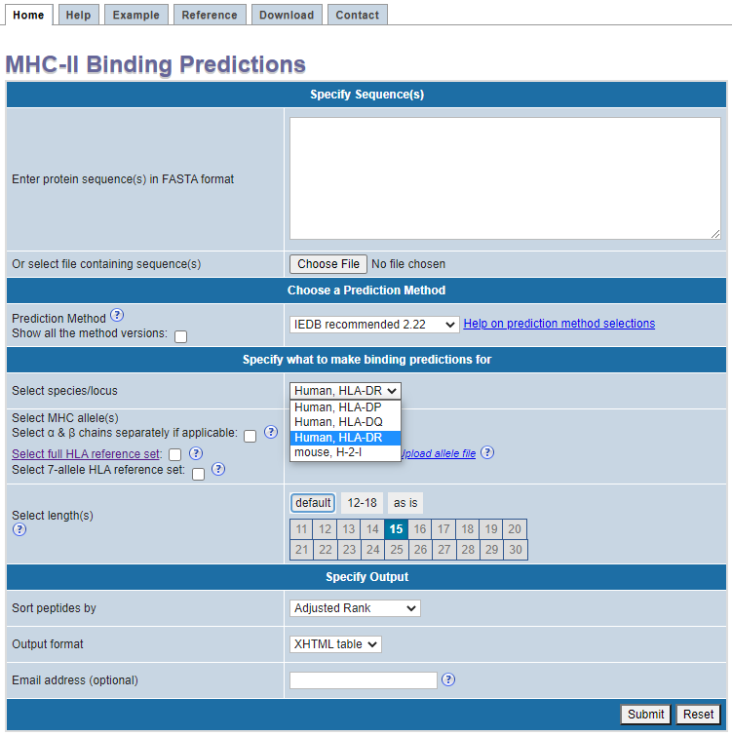
MHC-II binding prediction – example
tools.iedb.org/mhcii/
>West Nile virus envelope glycoprotein
FNCLGMSNRDFLEGVSGATWVDLVLEGDSCVTIMSKDKPTIDVKMMNMEAANLAEVRSYCYLATVSDLST
KAACPTMGEAHNDKRADPAFVCRQGVVDRGWGNGCGLFGKGSIDTCAKFACSTKAIGRTILKENIKYEVA
IFVHGPTTVESHGNYSTQVGATQAGRFSITPAAPSYTLKLGEYGEVTVDCEPRSGIDTNAYYVMTVGTKT
FLVHREWFMDLNLPWSSAGSTVWRNRETLMEFEEPHATKQSVIALGSQEGALHQALAGAIPVEFSSNTVK
LTSGHLKCRVKMEKLQLKGTTYGVCSKAFKFLGTPADTGHGTVVLELQYTGTDGPCKVPISSVASLNDLT
PVGRLVTVNPFVSVATANAKVLIELEPPFGDSYIVVGRGEQQINHHWHKSGSSIGKAFTTTLKGAQRLAA
LGDTAWDFGSVGGVFTSVGKAVHQVFGGAFRSLFGGMSWITQGLLGALLLWMGINARDRSIALTFLAVGG
VLLFLSVNVHA
Choose species & locus
Select or upload alleles
Upload format:
H2-IAb
HLA-DPA1*01/DPB1*04:01
HLA-DRB1*01:01

Slide 44
Allele selection - α and β chains separately
tools.iedb.org/mhcii/

Slide 45
Allele selection – 27 allele reference set
tools.iedb.org/mhcii/

Slide 46
Allele selection – 7 allele set
tools.iedb.org/mhcii/

Slide 47
MHC-II binding prediction – example
tools.iedb.org/mhcii/
Length selection
Output format
spaul@lji.org

Slide 48
How the tool works
Breaks sequence into all possible peptides of chosen lengths
Predicts the binding affinity for each peptide based on the method
Compares the predicted affinity to that of a large set of randomly selected peptides
Assigns a percentile rank depending on individual predicted affinity
Consensus picks median rank of the methods used – consensus percentile rank

Slide 49
MHC-II binding prediction – example
tools.iedb.org/mhcii/
Input sequence
Output
(sorted low-to-high by adjusted rank)
The adjusted rank is the percentile rank adjusted based on the frequency of peptide lengths.

Slide 50
MHC-II binding prediction – example
tools.iedb.org/mhcii/
Individual scores for different methods

Slide 51
Guidelines: Selecting binders
Based on Percentile rank or MHC binding affinity? Recommendation: IEDB Percentile rank
Threshold guidelines:
Percentile rank ≤ 10.0 (Percentile rank on linear scale (0-100), lower value = better binder)
MHC binding affinity IC50 ≤ 1000nM
Select all peptides with IEDB percentile rank ≤ 10.0

Slide 52
Alternate approaches for selecting binders
Change threshold values depending on your need
e.g. in case you have too few or too many predicted binders.
Set a desired percentage within your peptide set (irrespective of IEDB percentile rank) in case you want to study a fixed number of best possible peptides.

Slide 53
Issue of overlapping peptides
The tool breaks the sequence into all possible 15-mers - Peptides overlapping by 14 amino acid residues

Slide 54
Issue of overlapping peptides: Solution
Pre-processing:
Generate 15mers overlapping by 10 AA residues and do the prediction
APITAYAQQTRGLLGCIITSLTGRD
APITAYAQQTRGLLG----------
-----YAQQTRGLLGCIITS-----
----------RGLLGCIITSLTGRD
15 is mostly preferred length for class II
10 AA overlap captures minimal 15-mers with all possible 9-mer binding cores with at least 1 flanking residue
Python/Perl script or Excel

Slide 55
Issue of overlapping peptides: Solution
Post-processing:
Remove largely overlapping peptides after prediction (based on same binding core or position)

Slide 56
Promiscuous binders
Peptides that bind to more than one MHC molecule.
Significance:
Associated with stronger antigenicity & larger population coverage
Important in reducing immunogenicity of therapeutic proteins
Can be predicted based on binding affinity
Consensus percentile rank threshold ≤ 20.0

Slide 57
Promiscuous binders - Multiple alleles

Slide 58
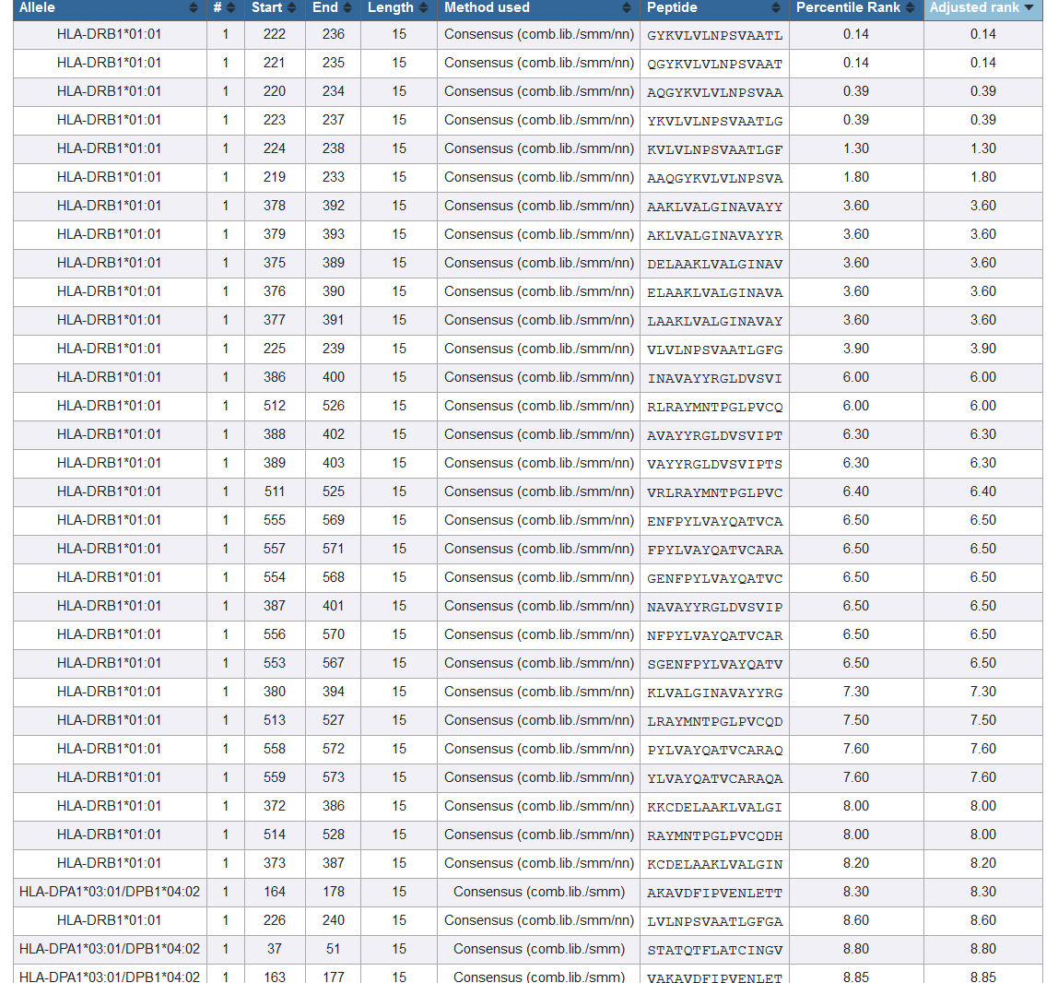
Multiple alleles - result

Slide 59
Panel of 27 class II alleles to allow for global coverage
Locus | Molecule | Phenotype frequency |  | Locus | Molecule | Phenotype frequency
DRB1 | DRB1*01:01 | 5.4 |  | DQA1/DQB1 | DQA1*05:01/DQB1*02:01 | 11.3
 | DRB1*03:01 | 13.7 |  |  | DQA1*05:01/DQB1*03:01 | 35.1
 | DRB1*04:01 | 4.6 |  |  | DQA1*03:01/DQB1*03:02 | 19.0
 | DRB1*04:05 | 6.2 |  |  | DQA1*04:01/DQB1*04:02 | 12.8
 | DRB1*07:01 | 13.5 |  |  | DQA1*01:01/DQB1*05:01 | 14.6
 | DRB1*08:02 | 4.9 |  |  | DQA1*01:02/DQB1*06:02 | 14.6
 | DRB1*09:01 | 6.2 |  |  | Combined | 81.6
 | DRB1*11:01 | 11.8 |  | DPA1/DPB1 | DPA1*02:01/DPB1*01:01 | 16.0
 | DRB1*12:01 | 3.9 |  |  | DPA1*01:03/DPB1*02:01 | 17.5
 | DRB1*13:02 | 7.7 |  |  | DPA1*01/DPB1*04:01 | 36.2
 | DRB1*15:01 | 12.2 |  |  | DPA1*03:01/DPB1*04:02 | 41.6
 | Combined | 71.1 |  |  | DPA1*02:01/DPB1*05:01 | 21.7
DRB3/4/5 | DRB3*01:01 | 26.1 |  |  | DPA1*02:01/DPB1*14:01 | 7.4
 | DRB3*02:02 | 34.3 |  |  | Combined | 94.5
 | DRB4*01:01 | 41.8
 | DRB5*01:01 | 16.0
 | Combined | 87.7

Slide 60
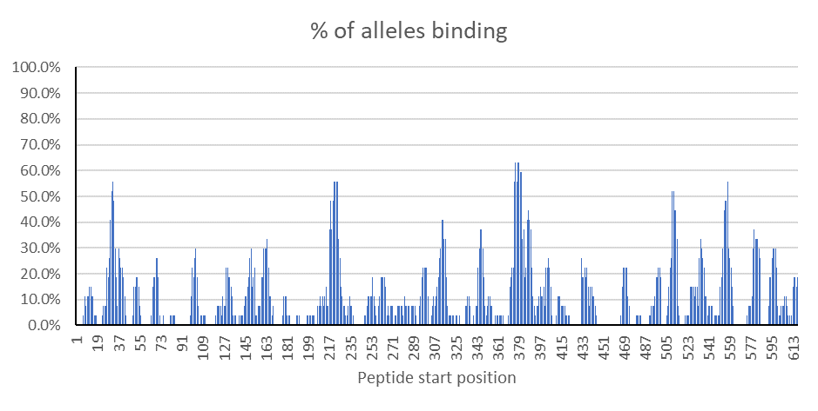
Promiscuous binders
Binders with ≥ 50% alleles binding (consensus percentile ≤ 20.0) considered promiscuous binders

Slide 61
“7-allele” method
Aim was to capture maximum immune response with minimum no. of peptides
6 peptide datasets with measured immune responses (SFCs/106 PBMCs)
15 or 16-mer peptide sets with 10 AA residues overlapping
Dataset | Purpose | No. of Antigens | Total peptides | No. of donors | Reference
Der p/f (House dust mite) | Training data | 4 | 156 | 20 | Hinz et al., 2015, CEA
Phl p (Timothy grass) | Training data | 10 | 425 | 25 | Oseroff et al., 2010, JI
TB-1 | Training data | 4 | 71 | 18 | Arlehamn et al., 2012, JI
TB-2 | Training data | 11 | 499 | 32 | Arlehamn et al., 2016, PLoS Path
Cockroach | Validation data | 6 | 463 | 19 | Dillon et al., 2015, CEA
Pertussis | Validation data | 9 | 785 | 23 | Bancroft et al., 2016, CEA
TOTAL |  | 44 | 2399 | 137

Slide 62
“7-allele” method
Optimal results obtained with a set of 7 alleles:
3 DRB1 alleles with frequency ≥ 12% (DRB1*03:01, DRB1*07:01, DRB1*15:01) and 4 DRB3/4/5 alleles (DRB3*01:01, DRB3*02:02, DRB4*01:01, DRB5*01:01)
Top 21.41% peptides ≈ 50% response
The median consensus percentile rank of the 7 alleles ≈ 20.0 - Universal prediction threshold

Slide 63
“7-allele” method
Generate 15-mers overlapping by 10 AA residues
Do binding prediction for the 7 selected alleles
Estimate the median consensus percentile rank (of the 7 alleles)
Select all peptides with median consensus percentile rank ≤ 20.0
This set of peptides can capture ≈ 50% of the response
These 7 alleles can be selected as a set
This is implemented in Tepitool

Slide 64
Self-practice (or mini-break): 10 min
Question:
The peptide VRLRAYMNTPGLPVC is recognized by CD4+ T cells in an individual that expresses the MHC class II alleles listed below. What is the most likely restricting allele?
Locus | Alleles
DPA1/DPB1 | DPA1*01/DPB1*04:01
 | DPA1*01:03/DPB1*02:01
DQA1/DQB1 | DQA1*05:01/DQB1*03:01
 | DQA1*03:01/DQB1*03:02
DRB1 | DRB1*03:01
 | DRB1*07:01

Slide 65
Self-practice
Steps:
Predict the binding affinity of the peptide for the given alleles
Peptide: VRLRAYMNTPGLPVC
Alleles:
Identify alleles with consensus percentile rank ≤ 10.0
Locus | Alleles
DPA1/DPB1 | DPA1*01/DPB1*04:01
 | DPA1*01:03/DPB1*02:01
DQA1/DQB1 | DQA1*05:01/DQB1*03:01
 | DQA1*03:01/DQB1*03:02
DRB1 | DRB1*03:01
 | DRB1*07:01

Slide 66
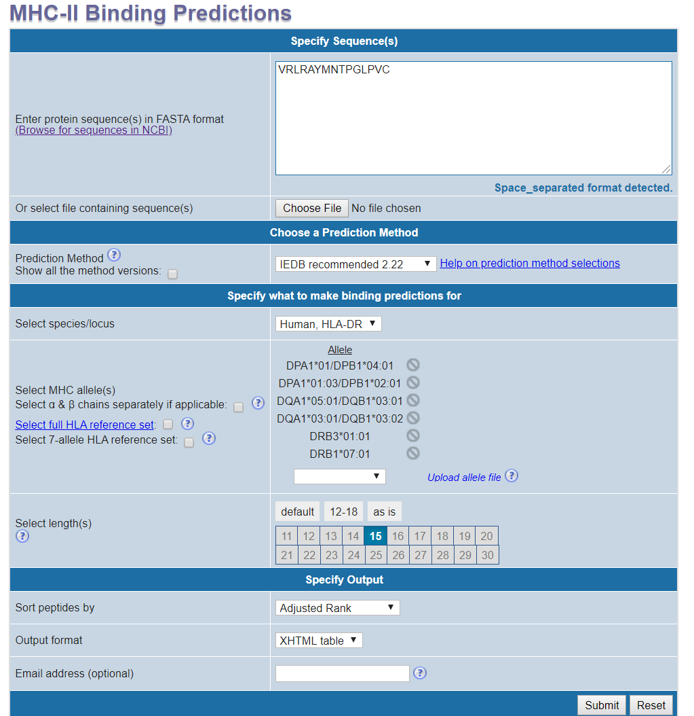
Self-practice: input

Slide 67
Self-practice: output

Slide 68
TepiTool
New interface to prediction of class I and class II epitope candidates
Motivation:
Make tools more user friendly
Provide recommendations as default
Provide a set of top peptides as concise results
In the form of a step-by-step wizard (6 steps)
Provides recommendations as default values
Input parameters can be adjusted as desired
New methods incorporated

Slide 69
Step 1: Sequence data
tools.iedb.org/tepitool/
>Seq_1
MKALIVLGLVLLSVTVQGKVFCELARTLKRLGMDGYRGISLANWMCLAKW
>Seq_2
MLLALVCLLSCLANSDF
>Seq_3
MKALIVLGLVLLSVTVQGKVFERCELAR

Slide 70
Step 2: Species & allele class
tools.iedb.org/tepitool/

Slide 71
Step 3: Alleles - Class I
tools.iedb.org/tepitool/

Slide 72
Step 4: Peptides - Class I
tools.iedb.org/tepitool/

Slide 73
Step 4: Peptides - Class I
tools.iedb.org/tepitool/

Slide 74
Step 4: Peptides - Class I
tools.iedb.org/tepitool/

Slide 75
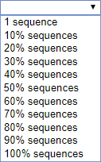
Step 4: Peptides - Class I
tools.iedb.org/tepitool/

Slide 76
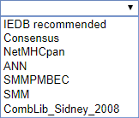
Step 5: Method - Class I
tools.iedb.org/tepitool/

Slide 77
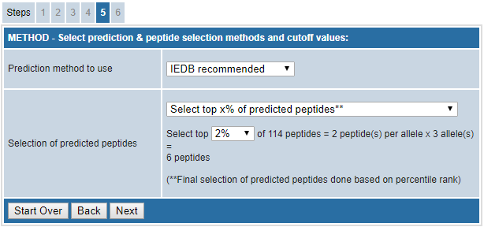
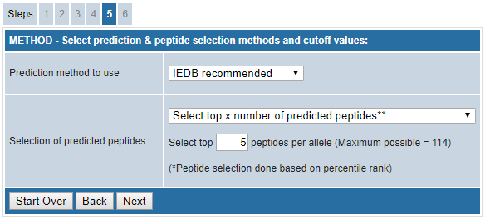
Step 5: Method - Class I
tools.iedb.org/tepitool/

Slide 78
Step 5: Method - Class I
tools.iedb.org/tepitool/

Slide 79
Step 5: Method - Class I
tools.iedb.org/tepitool/

Slide 80
Results: Class I
tools.iedb.org/tepitool/
Differences in TepiTool workflow if Class II?

Slide 81
Step 3: Alleles - Class II
tools.iedb.org/tepitool/

Slide 82
Step 4: Peptides - Class II
tools.iedb.org/tepitool/
 | Low | Moderate | High | Custom
Duplicates | removed | removed | not removed | user selects
Overlapping residues | 8 | 10 | 10 | user selects
Approx. # peptides | 10 | 12 | 14 | 12
settings
summary

Slide 83
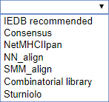
Step 5: Method - Class II
tools.iedb.org/tepitool/
exclusive to
class II

Slide 84
Results – Class II
Differences if 7 allele method or promiscuous?

Slide 85
Step 3-5: Class II -7 allele method
tools.iedb.org/tepitool/

Slide 86
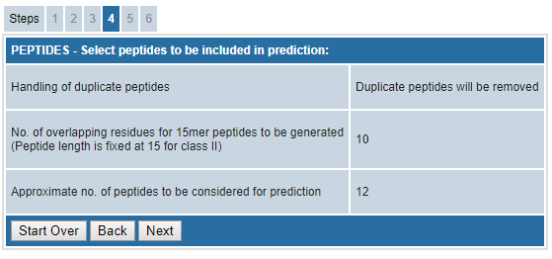
Step 3-5: Class II – promiscuous
tools.iedb.org/tepitool/

Slide 87
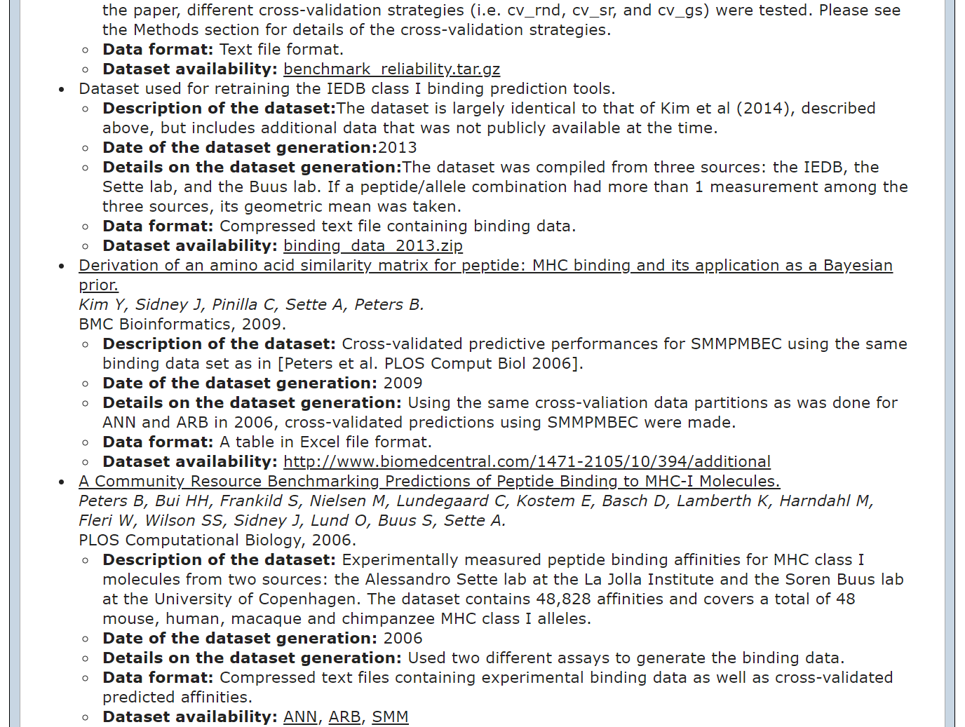
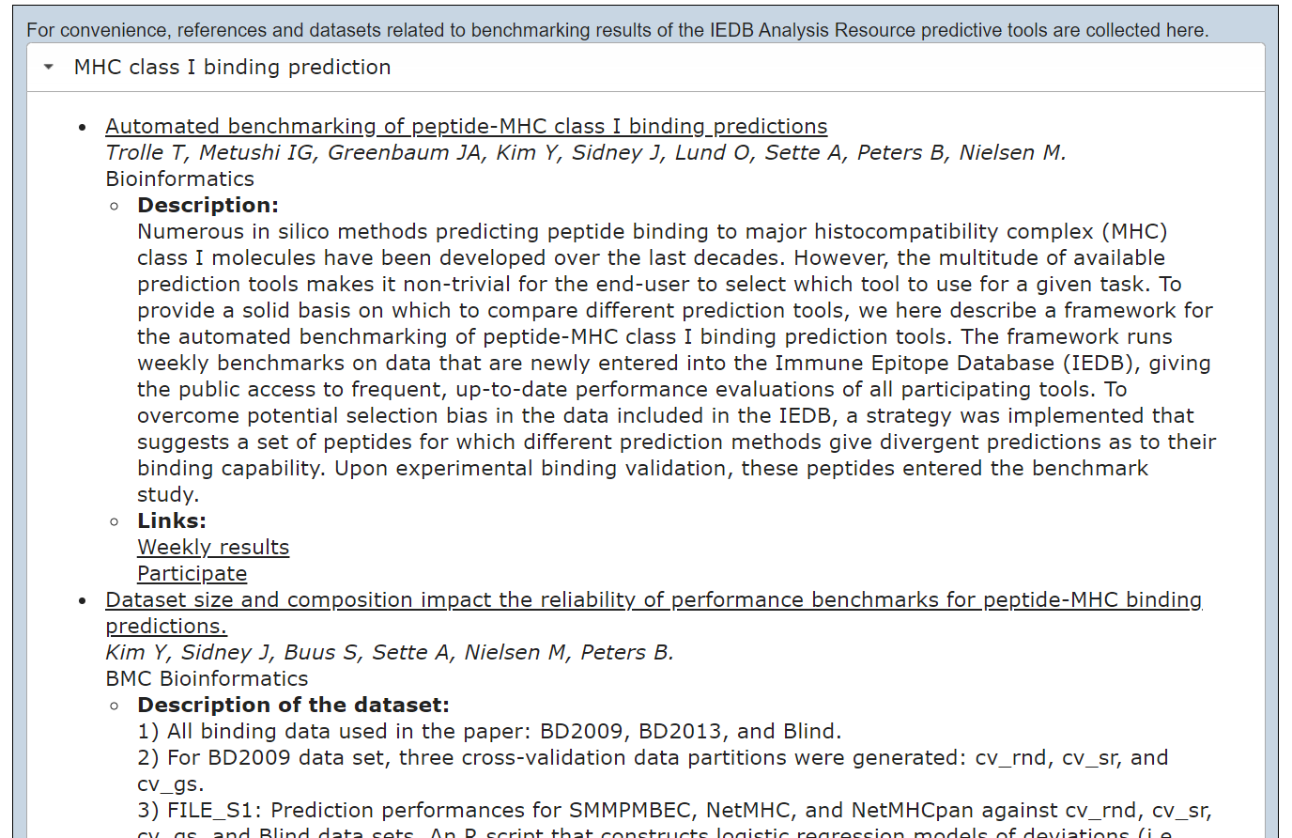
Datasets

Slide 88
Benchmarking of class I epitope prediction methods
List of 44 methods
Freely available
Selected 15 methods
Trained models for H-2D^{b} & H-2K^{b}
2 variants
NetMHCpan-4.0-B & L
MHCflurry-B & L
Total 17 methods

Slide 89
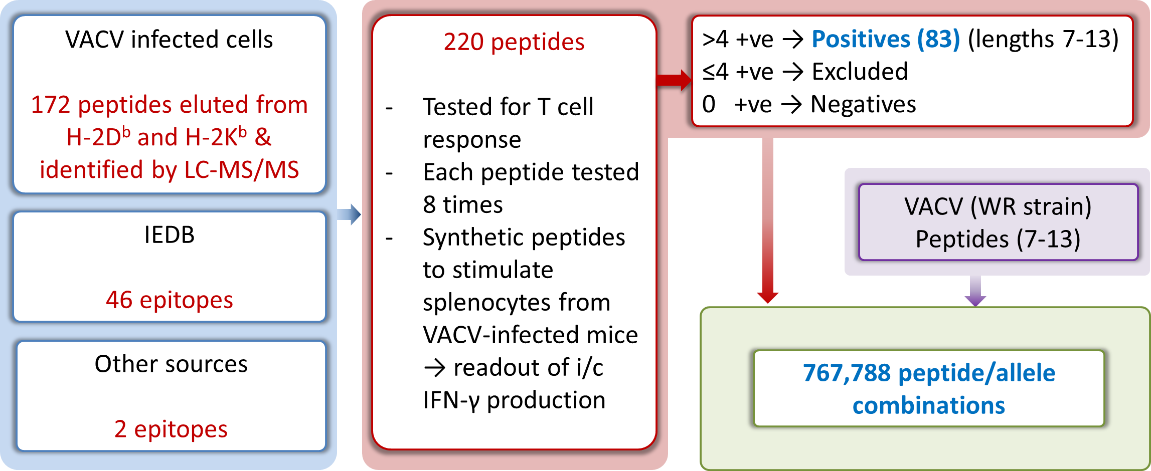
Dataset
Comprehensive epitope dataset from Vaccinia virus

Slide 90
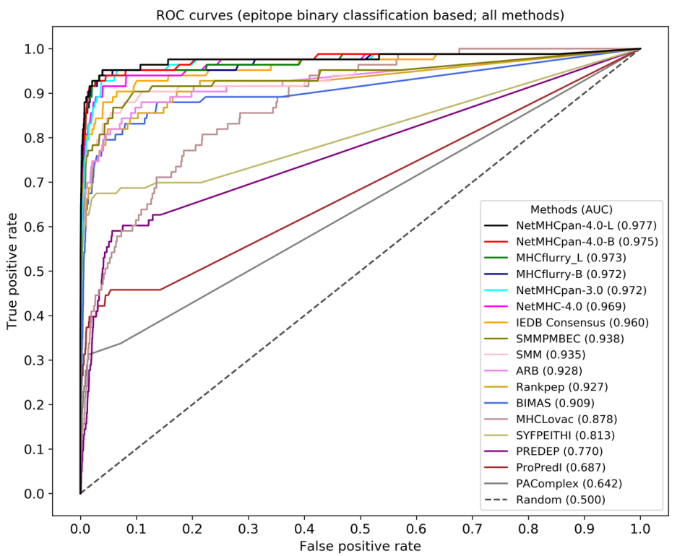
Results
Binary classification (epitope/non-epitope) & T cell response based
In terms of AUC (Area under curve of ROC curves)

Slide 91
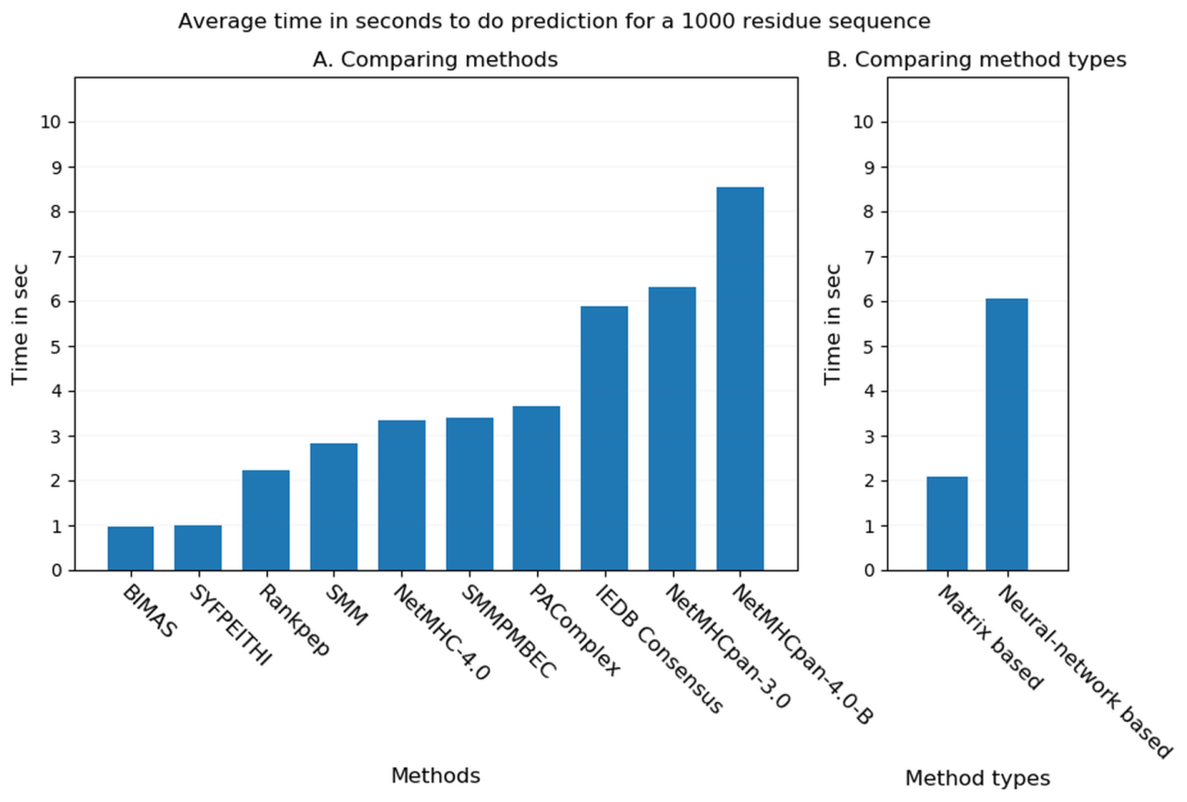
Prediction speed comparison
5 random sequences of 1000 residues each
Matrix-based methods faster compared to Neural network-based methods

Slide 92
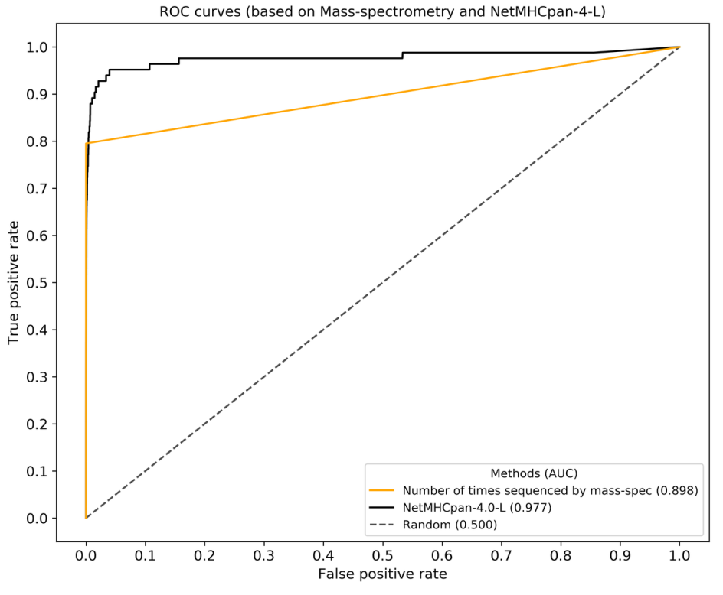
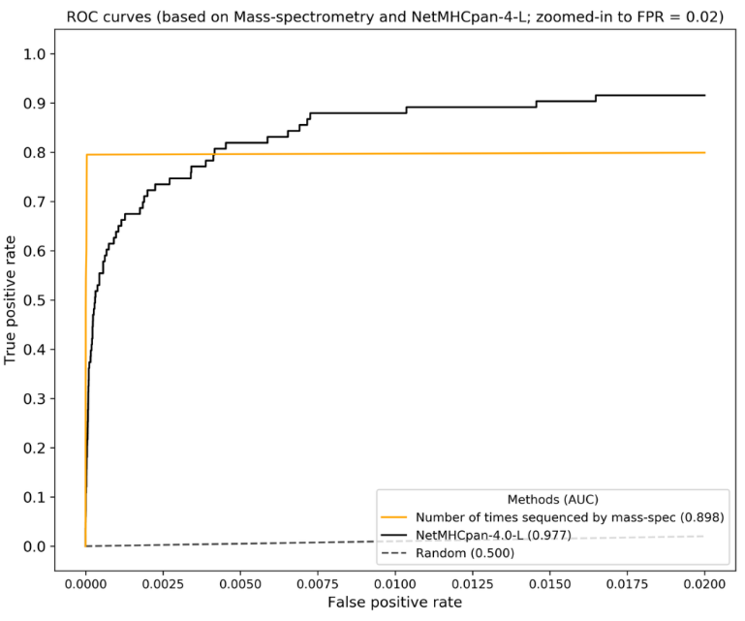
Results – peptide selection by MS vs. prediction
Number of times peptides were identified by MS used as “MS score”
Compared with NetMHCpan-4.0-L
MS needs much less peptides to capture 50% epitopes (0.01%, N=48 vs. 0.04%, N = 277 for NetMHCpan-4.0-L)
NetMHCpan-4.0-L better when considering all epitopes

Slide 93
Summary
MHC class I binding prediction
MHC class II binding prediction
TepiTool
Datasets
Benchmarking of class I epitope prediction tools
Contributing tools to IEDB

