Slide 1

B Cell Epitope Prediction
tools.iedb.org
Presented by: Bjoern Peters, PI

Slide 2
Outline of topics
B cell epitope biology recap
Prediction tools on IEDB
Linear sequence-based epitope prediction methods
Discontinuous 3D structure-based epitope prediction methods
Computational antibody design
  Antigen and Antibody structure modelling
  Antibody-protein docking

Slide 3
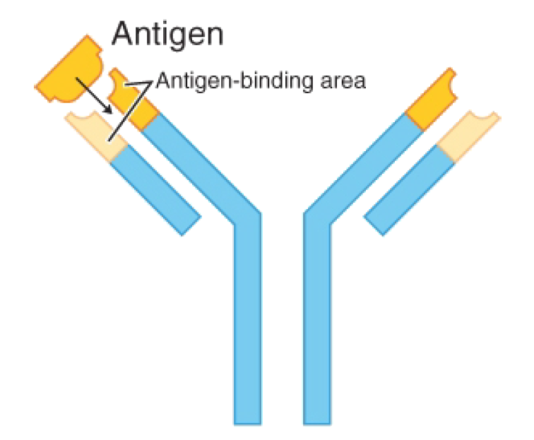
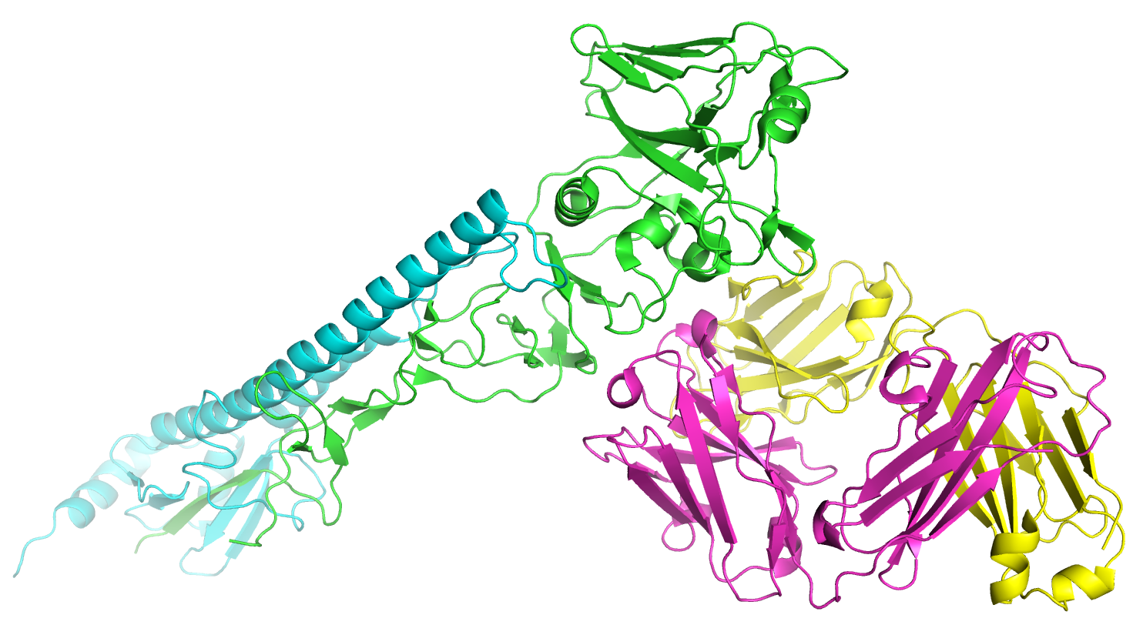
Example: Ab binding HA1
Antigen
Hemagglutinin HA1 Chain from Influenza A Virus
PDB ID: 1EO8
Antibody
Light Chain
Hemagglutinin HA2 Chain
Antibody
Heavy Chain

Slide 4
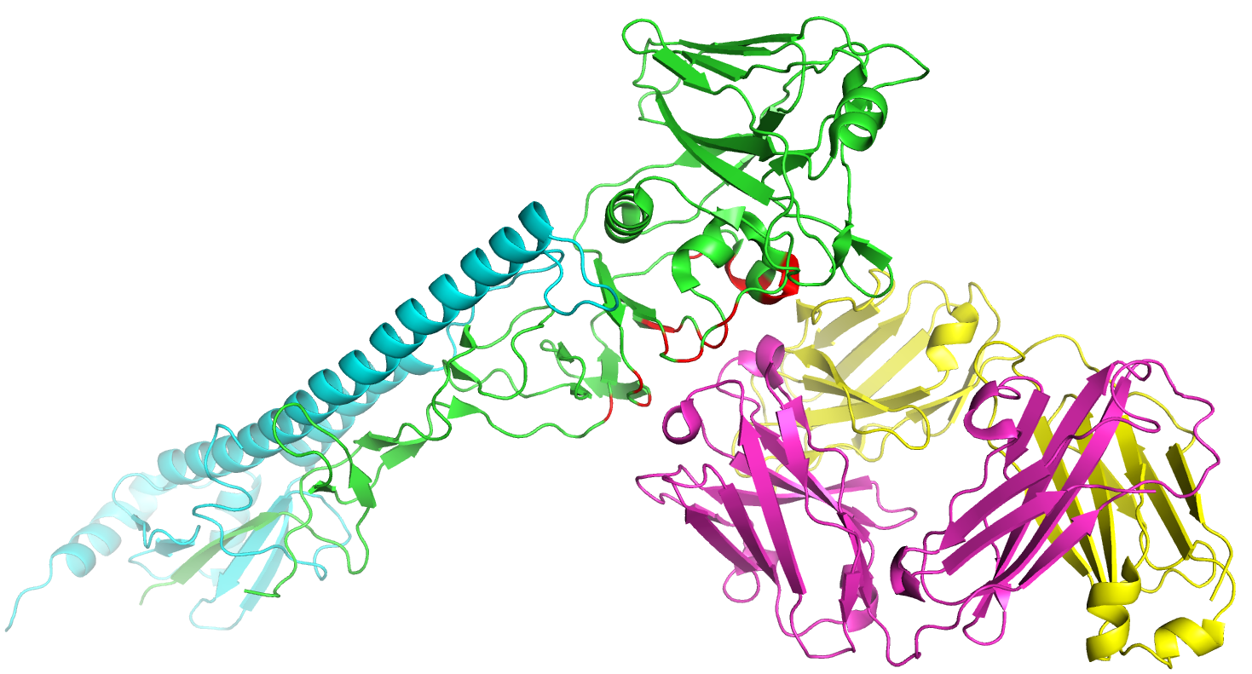
Discontinuous epitope
Antigen
Hemagglutinin HA1 Chain from Influenza A Virus
PDB ID: 1EO8
Epitope
Antibody
Light Chain
Antibody
Heavy Chain

Slide 5
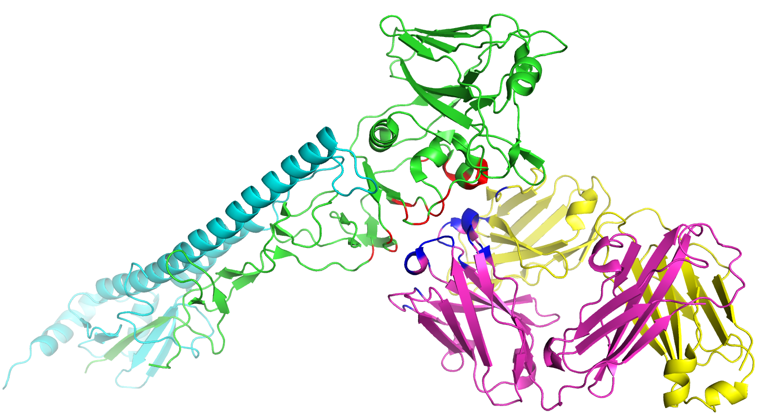
Discontinuous epitope
Antigen
Hemagglutinin HA1 Chain from Influenza A Virus
PDB ID: 1EO8
Paratope
Antibody
Light Chain
Antibody
Heavy Chain

Slide 6
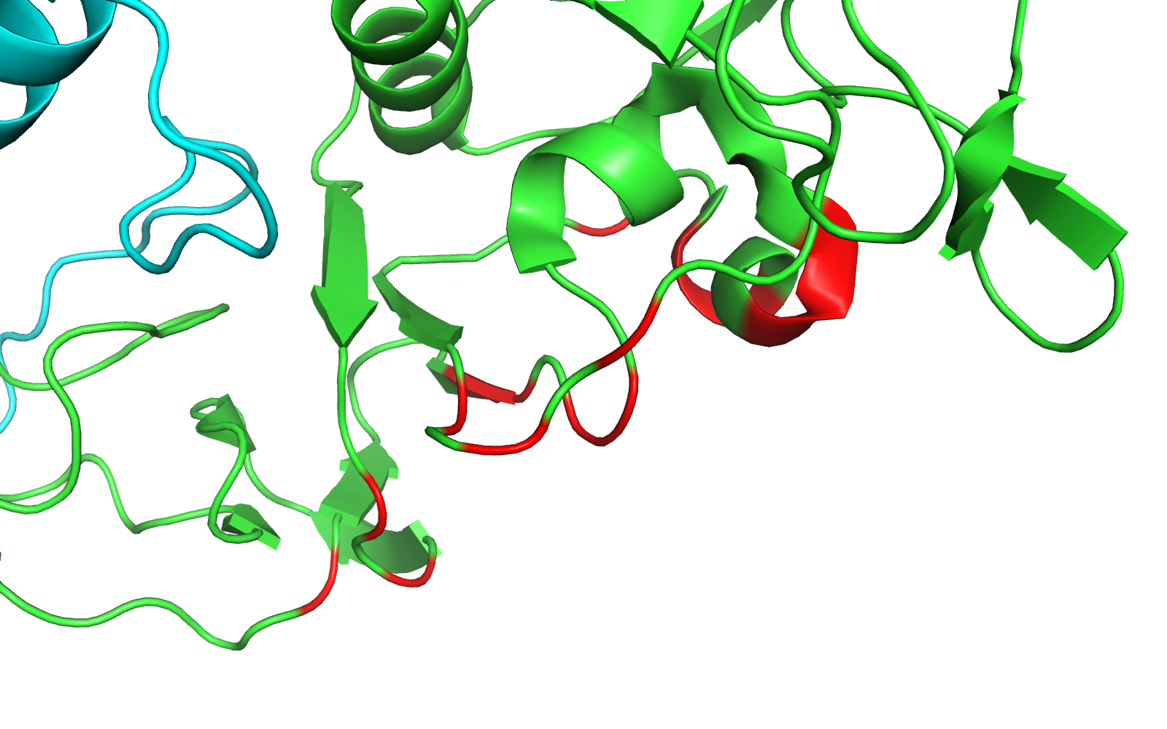
Discontinuous epitope
PDB ID: 1EO8
Discontinuous
Epitope

Slide 7
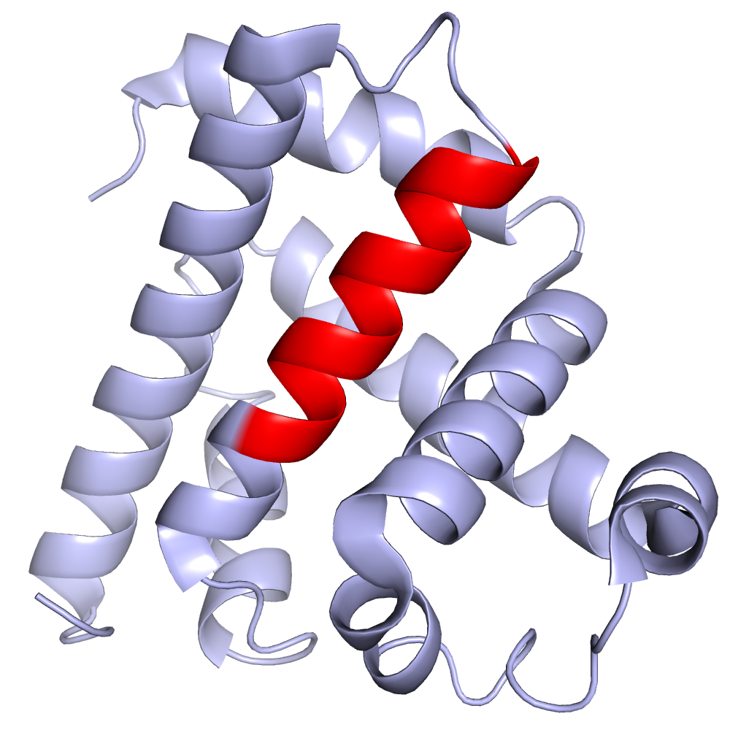
B cell epitopes
PDB ID: 1VXG
Antigen
Sperm whale myoglobin
Protein antigens usually contain both linear & discontinuous epitopes
  “Linear” aka sequential or continuous
  “Discontinuous” aka non-sequential or conformational epitopes
More than 90% of the B cell epitopes are estimated to be discontinuous*
Epitope
*Barlow et al, Nature. 1986.
*Van Regenmortel, Methods. 1996.

Slide 8
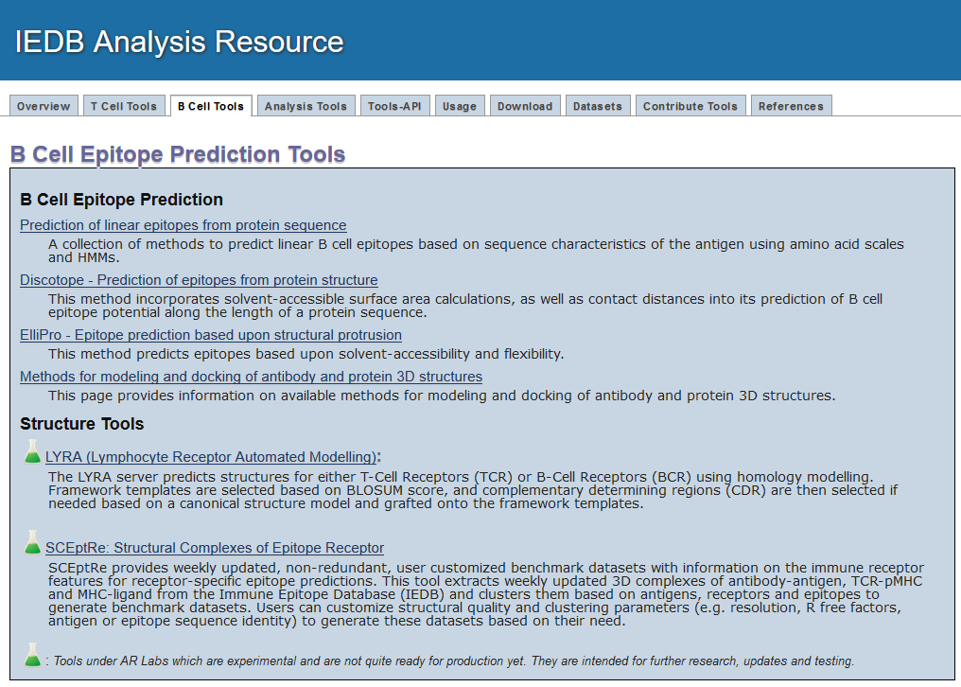
B cell prediction tools on IEDB
http://tools.iedb.org/main/bcell/

Slide 9
Epitope prediction
When to use epitope prediction methods?
You have verified thoroughly that no information is available in the IEDB on the antigen of your interest
You want to know all the candidate antigenic determinants in an antigen of your interest other than epitopes provided in the IEDB

Slide 10
Sequence-based epitope prediction
Linear epitope prediction:
Amino acid physicochemical properties-based methods
  Features which have been correlated with the location of continuous epitopes
  𝛃-Turns (Chou & Fasman)
  Surface Accessibility (Emini)
  Flexibility (Karplus & Schulz)
  Antigenic propensity: occurrence of residues in epitopes (Kolaskar & Tongaonkar)
  Hydrophilicity (Parker)
Only provide information on protein regions which are likely to be accessible for antibody binding

Slide 11
Linear epitope prediction
Linear epitope prediction methods:
Machine learning algorithms
  Positive and negative training datasets are used
  Combination of one or more amino acid scales are used as an input to one of the machine learning algorithms
    Random Forest (BepiPred-2.0)
    ANN: Artificial Neural Network (ABCpred)
    SVM: Support Vector Machine (BCpred, FBCpred)
  Prediction accuracy is optimized

Slide 12
B cell prediction tools on IEDB
http://tools.iedb.org/main/bcell/

Slide 13
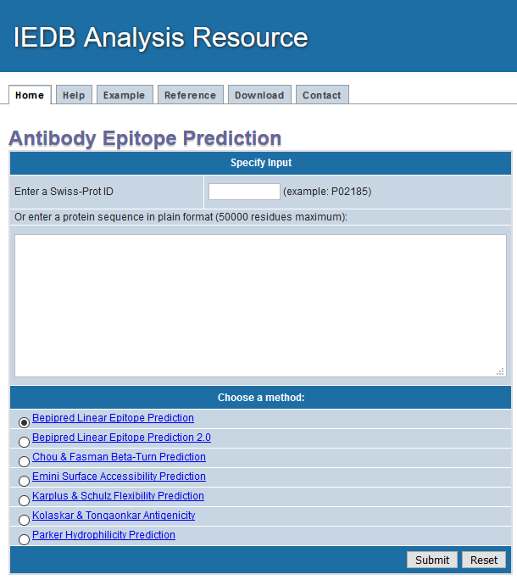
Linear B cell prediction
http://tools.iedb.org/bcell/
1. Input protein sequence
Entry allowed via Swiss-Prot ID or plain format
Links to help tab
2. Select prediction method
BepiPred is the default & recommended method

Slide 14
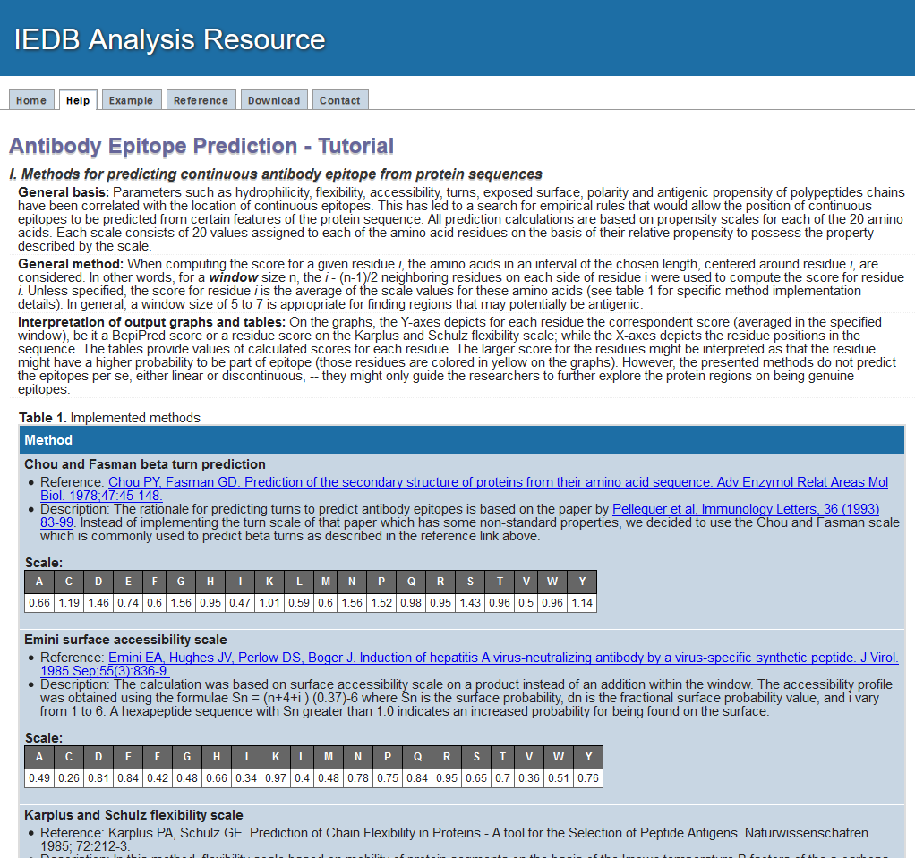
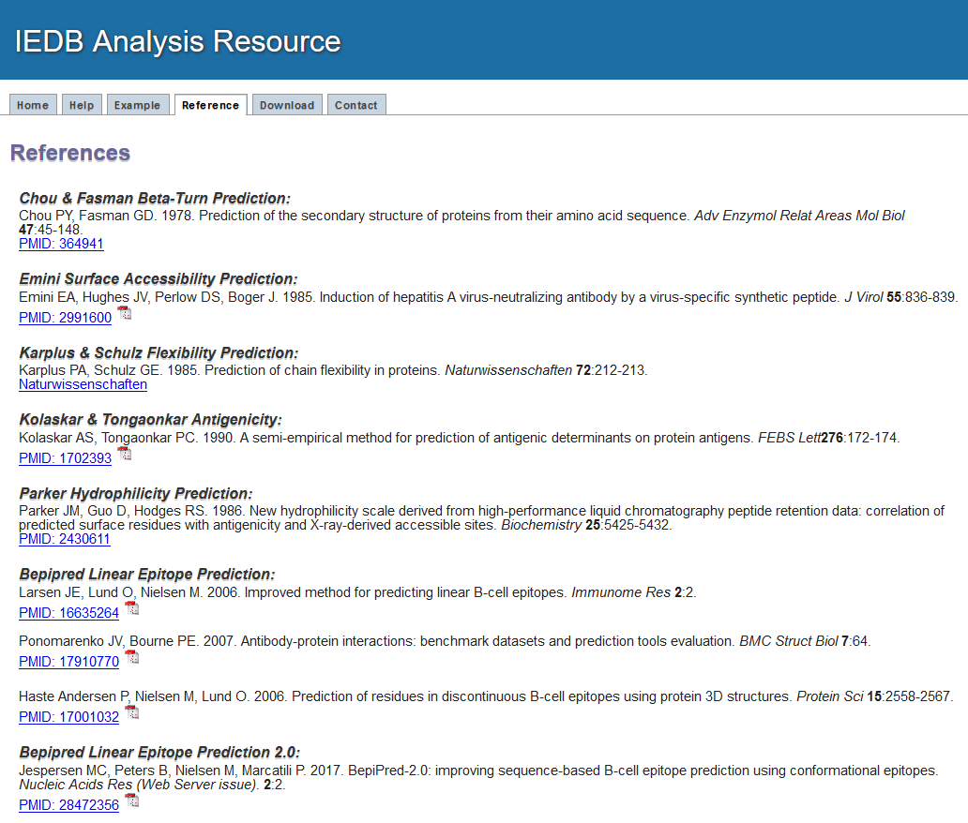
Visit Help & Reference tabs to learn about a prediction method
http://tools.iedb.org/bcell/

Slide 15
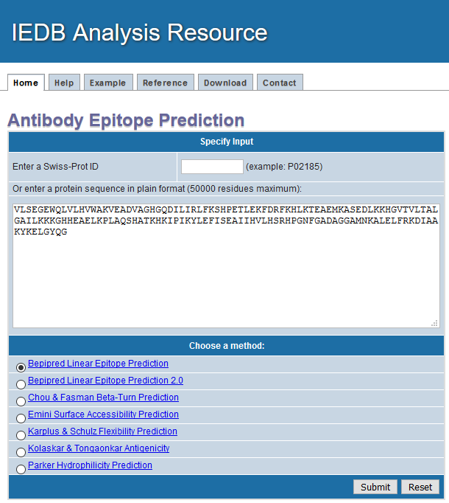
Linear B cell prediction -example
http://tools.iedb.org/bcell/
Example Sequence
Sperm Whale Myoglobin
Swiss-Prot ID P02185
VLSEGEWQLVLHVWAKVEADVAGHGQDILIRLFKSHPETLEKFDRFKHLKTEAEMKASEDLKKHGVTVLTALGAILKKKGHHEAELKPLAQSHATKHKIPIKYLEFISEAIIHVLHSRHPGNFGADAGGAMNKALELFRKDIAAKYKELGYQG

Slide 16
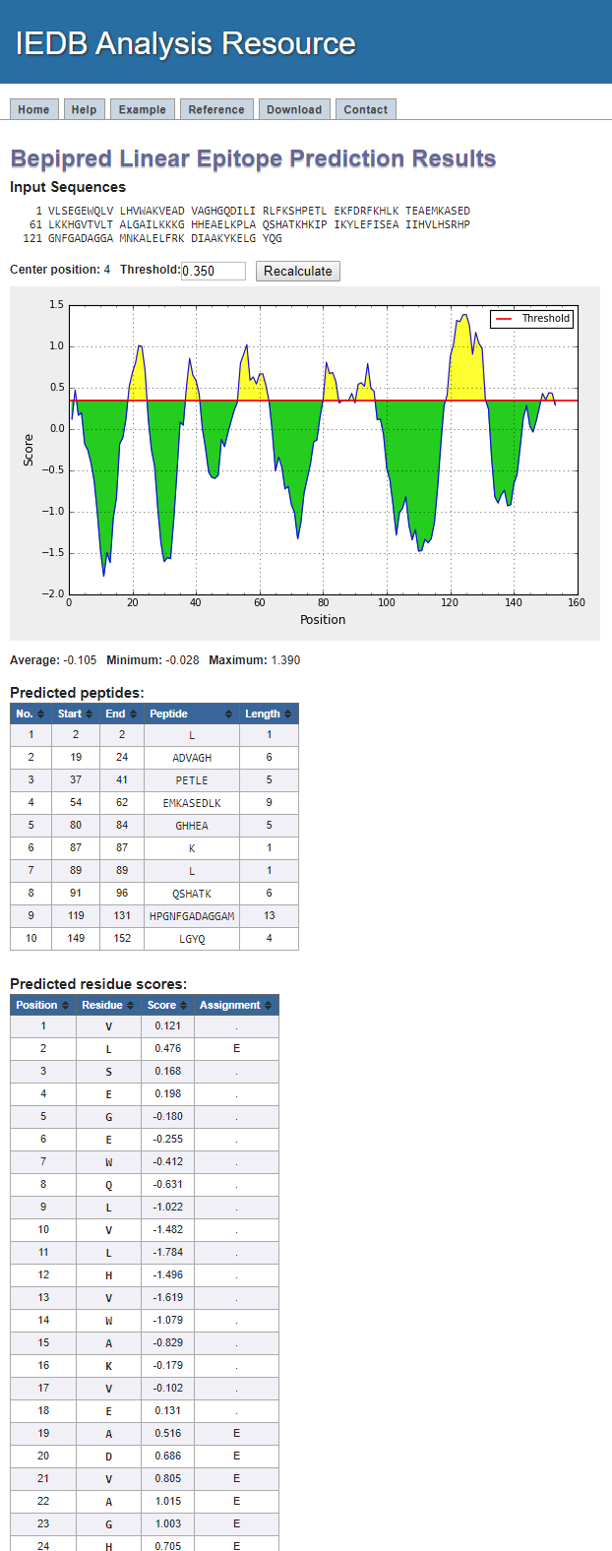
Linear B cell prediction -example
http://tools.iedb.org/bcell/
Adjustable threshold
Average score of a protein chosen as a threshold by default

Slide 17
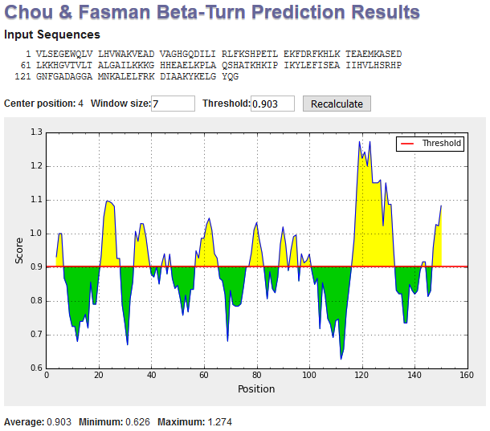
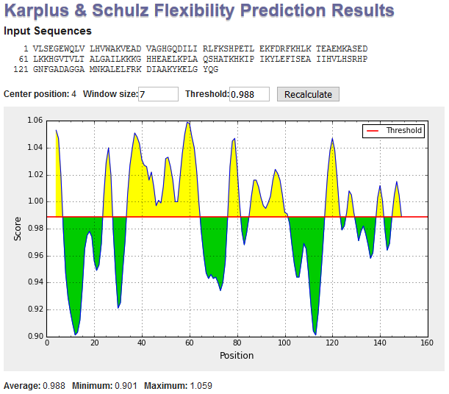
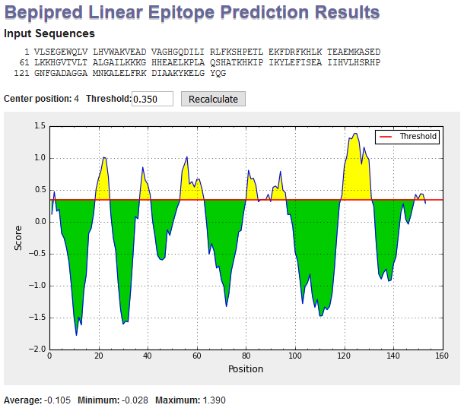
Method comparisons
http://tools.iedb.org/bcell/
It is better to use consensus of different methods rather than relying on a single method

Slide 18
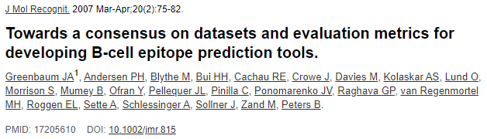
Sequence-based epitope prediction
Evaluation of amino acid scales: no method gave AUC above 0.60

Slide 19
3D Structures of Ab-Ag complexes
Methods for 3D structure determination:
X-ray crystallography (provides the most accurate identification of epitopes)
Nuclear magnetic resonance (NMR)
Electron microscopy (EM)
Where to get 3D Ab-Ag complexes??
IEDB 3D export (1790 3D BCR assays)
🡪SCEptRe (for annotation and redundancy removal)
Where to get 3D coordinates of proteins?
Biomolecular 3D structural data is deposited into PDB (Protein Data Bank)

Slide 20
3D Structure-based epitope prediction
Discontinuous epitope prediction
Structure-based epitope prediction using:
  Geometrical properties combined with amino acid scales (DiscoTope, ElliPro, CEP)
  Geometrical properties and amino acid scales used as input to machine learning approaches (EPSVR)
  Protein-protein docking algorithms

Slide 21
B cell prediction tools on IEDB
http://tools.iedb.org/main/bcell/

Slide 22
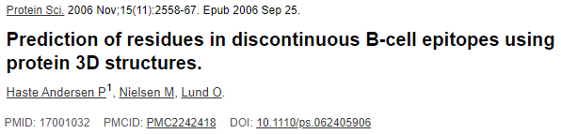
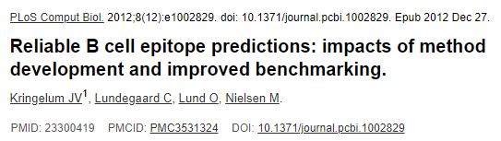
DiscoTope
Trained on 75 X-ray structures of antibody-protein complexes
DiscoTope 2 took into account multiple epitopes in an antigen
Assigns each residue a score value calculated as a linear combination of normalized values
  Parker’s hydrophilicity scale
  Amino acid occurrence
  Number of contacts within 10Å
  Area of relative solvent accessibility
AUC 0.71 for DiscoTope 1 and 0.73 for DiscoTope 2
DiscoTope 2
DiscoTope 1

Slide 23
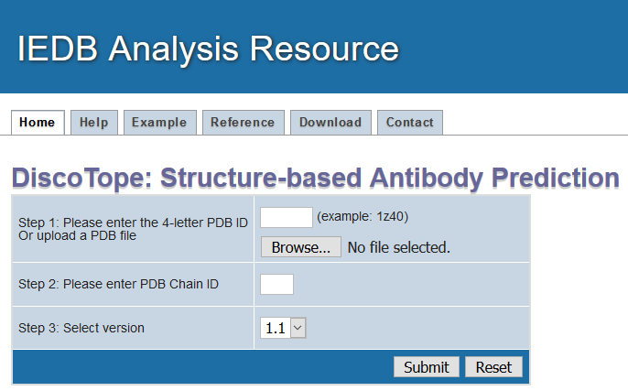
DiscoTope
http://tools.iedb.org/discotope/
Identify structure
Input PDB id or upload file
Specific to the protein chain of interest

Slide 24
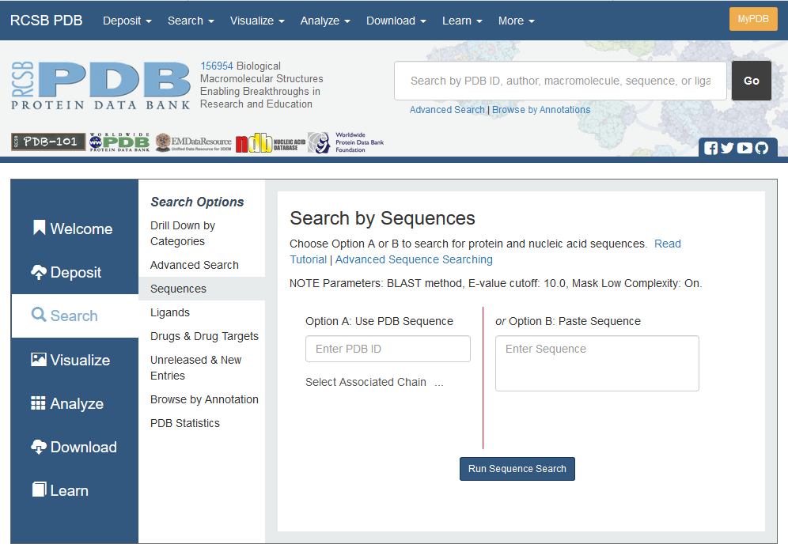
Search in PDB to identify inputs
http://www.rcsb.org/

Slide 25
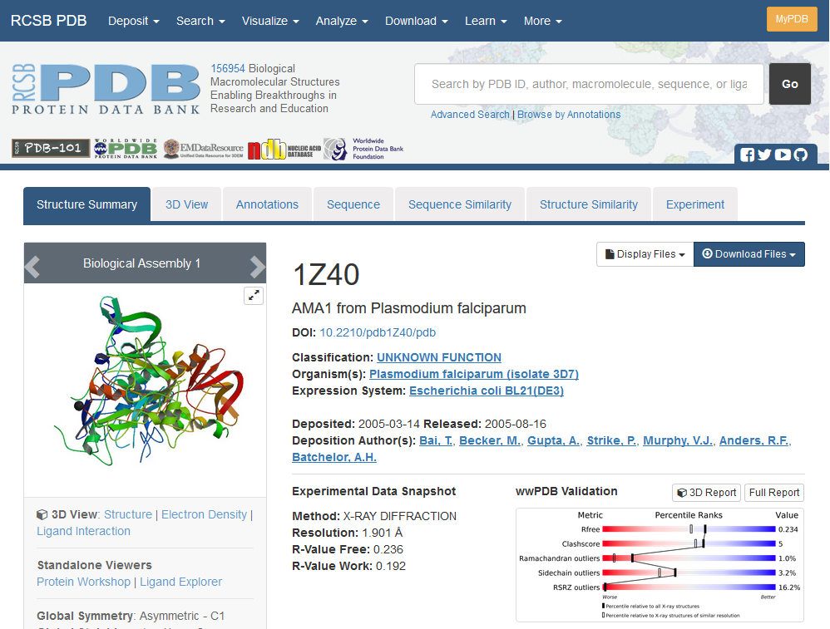
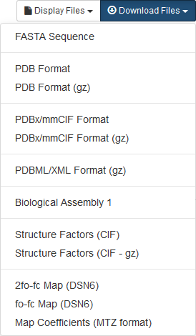
Search in PDB to identify inputs
http://www.rcsb.org/

Slide 26
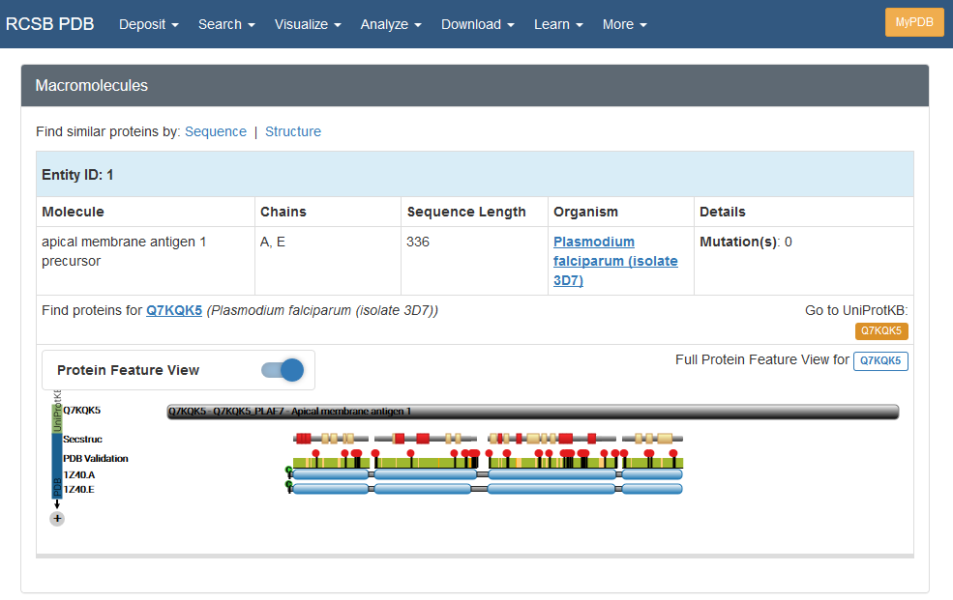
Search in PDB to identify inputs
http://www.rcsb.org/
What if the 3D structure of a protein of your interest is not available in PDB?
> Homology or comparative modeling methods, servers and databases

Slide 27
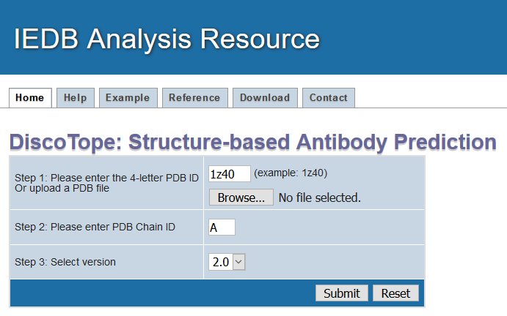
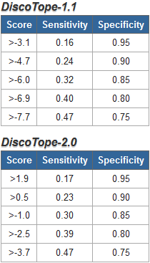

DiscoTope -example
http://tools.iedb.org/discotope/
Default
Default

Slide 28
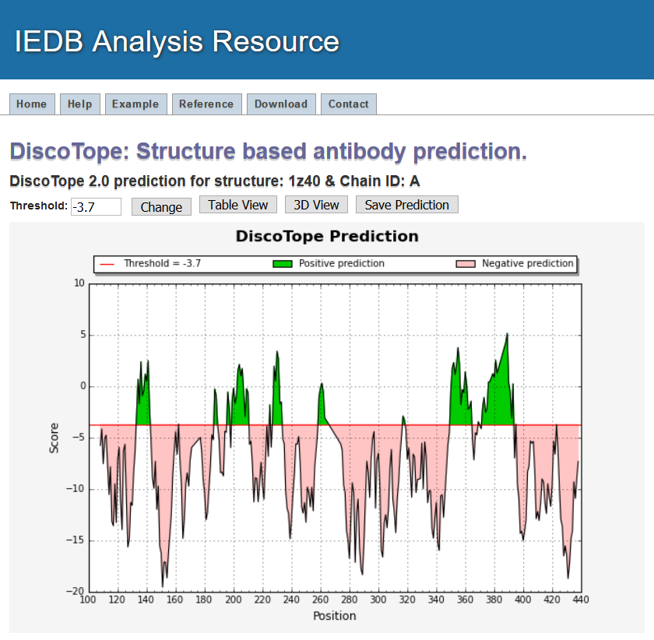
DiscoTope -example
http://tools.iedb.org/discotope/
Downloads as csv
Adjustable threshold

Slide 29
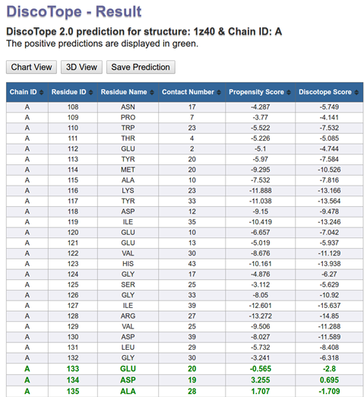
DiscoTope -example
http://tools.iedb.org/discotope/

Slide 30
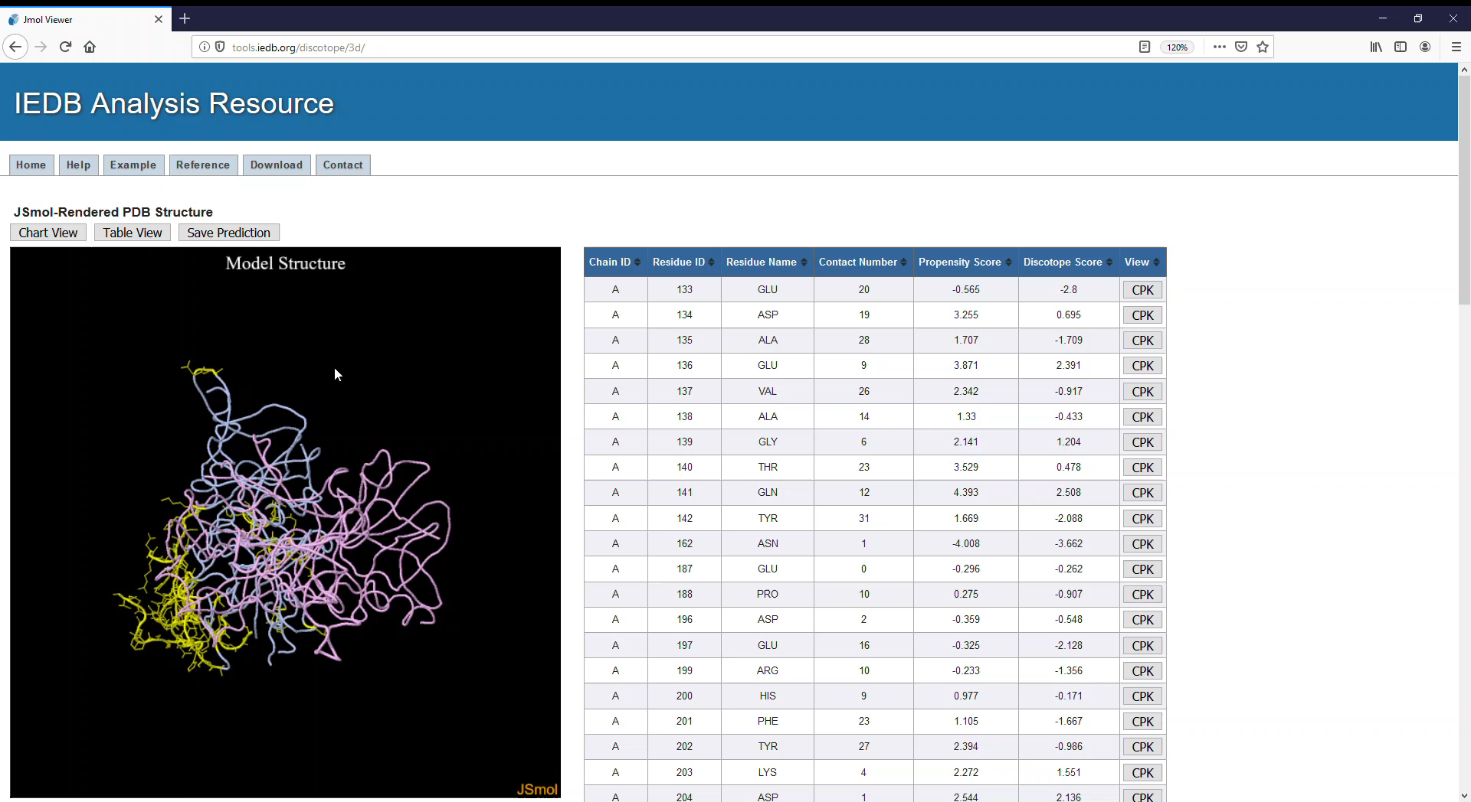
DiscoTope -example
http://tools.iedb.org/discotope/

Slide 31
B cell prediction tools on IEDB
http://tools.iedb.org/main/bcell/

Slide 32
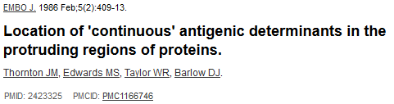
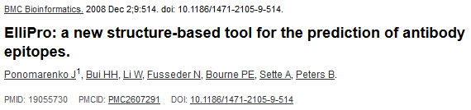
ElliPro
Predicts linear and discontinuous antibody epitopes based on the geometrical properties of protein structure
Uses Thornton’s Method
Implements three algorithms:
  Approximation of the protein shape as an ellipsoid
  Calculation of the residue protrusion index (PI)
  Clustering of neighboring residues based on PI values

Slide 33
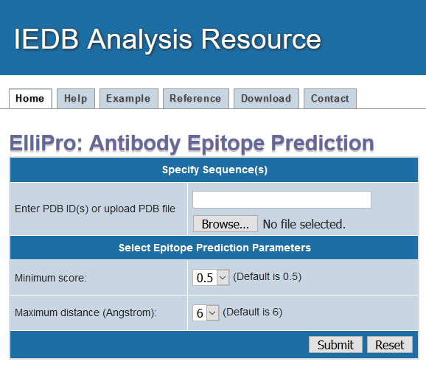
ElliPro
http://tools.iedb.org/ellipro/
Identify structure
Input PDB id or upload file
Select min. PI value
- Averaged over epitope residues
- Higher scores predict fewer epitopes
Specify max distance for predicting (grouping) discontinous epitopes
Longer distances predict discontinuous epitopes spanning larger regions

Slide 34

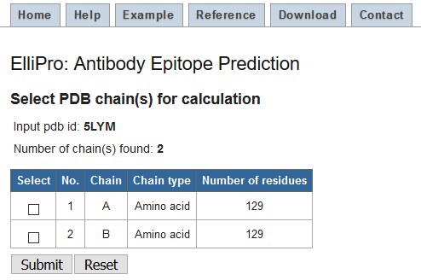
ElliPro -example
http://tools.iedb.org/ellipro/
Select chain(s) of interest

Slide 35
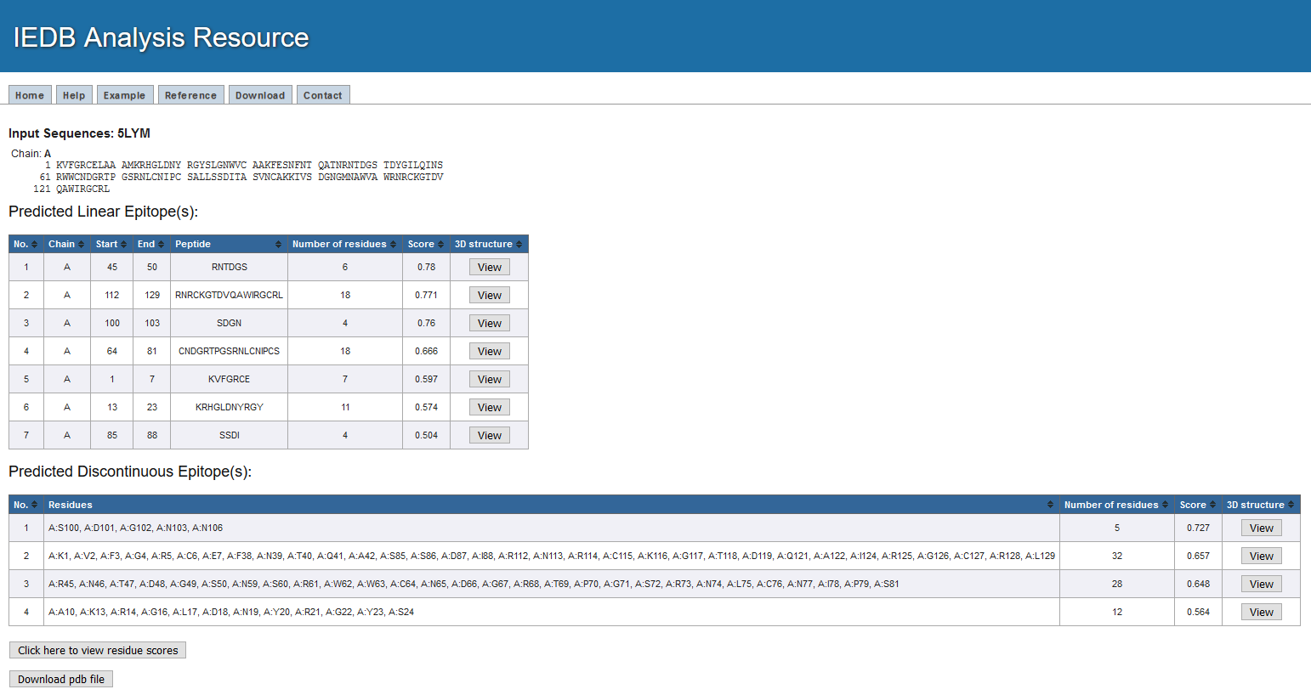
ElliPro -example
http://tools.iedb.org/ellipro/
View 3D structure

Slide 36
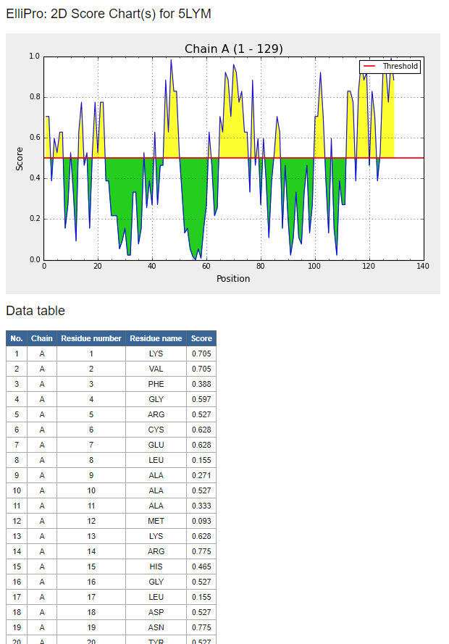
ElliPro -example
http://tools.iedb.org/ellipro/

Slide 37
Summary – B cell epitope predictions
Linear and discontinuous (conformational) epitopes can be overlapping and depending on method of discovery
Traditional B cell epitope prediction methods largely predict surface accessibility
If a 3D structure of the antigen is available (or a reliable model thereof), predictions can be further improved.

Slide 38
Practice Exercise
Use BepiPred and DiscoTope to predict B cell epitopes of dengue 2 virus envelope glycoprotein
Download crystal structure and sequence of dengue 2 virus envelope glycoprotein from PDB (PDB ID: 4UTC)

Slide 39
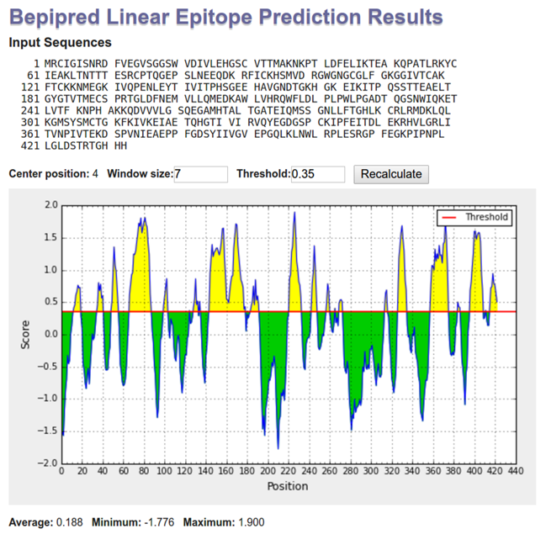
Practice Exercise
Too many epitope candidates?

Slide 40
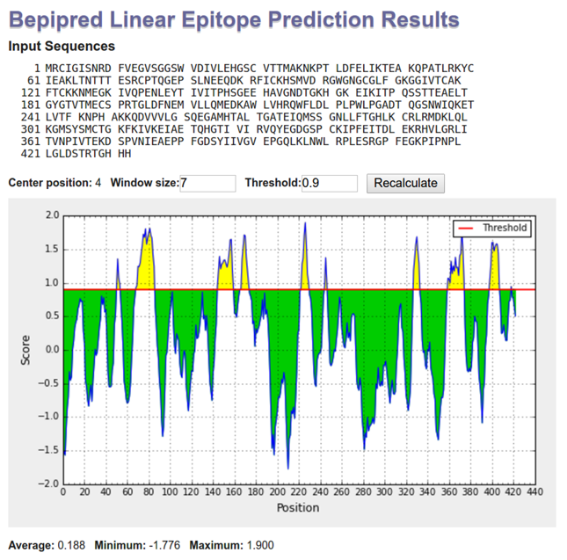
Practice Exercise
Score threshold of 0.9 corresponds to 90% specificity

Slide 41
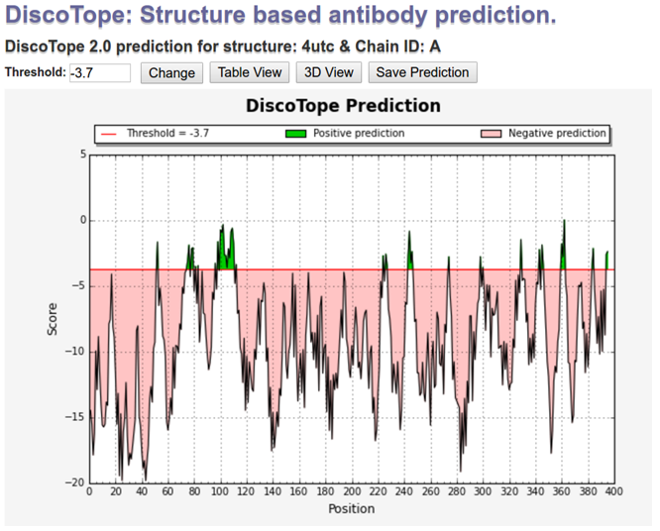
Practice Exercise
Did you notice the length difference between BepiPred (length 422) and DiscoTope (length 391) outputs?

Slide 42
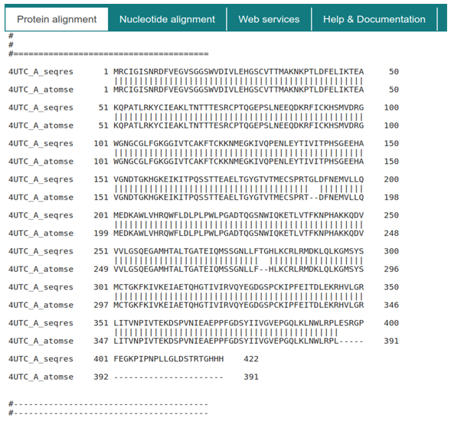
Practice Exercise
There might be missing residues in PDB coordinate file compared to the sequence file provided by PDB
These missing residues are not resolved properly in the structure
  e.g. flexible loops

Slide 43
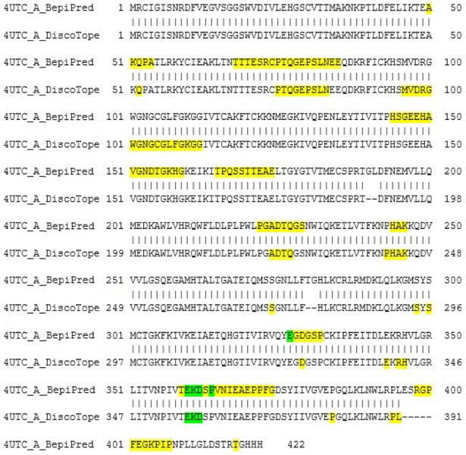
Practice Exercise
Predicted
Correctly predicted
Epitope residues from 3D B cell assay 3319631 (PDB ID: 2R69) were mapped on Dengue envelope glycoprotein

Slide 44
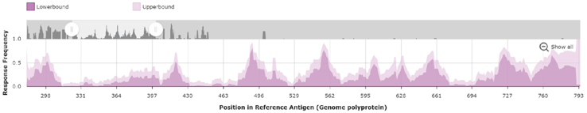
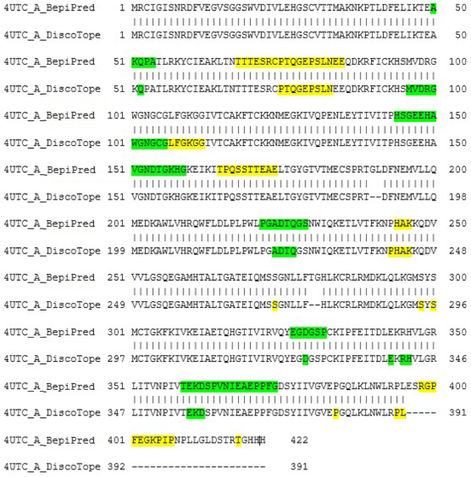
Practice Exercise
Epitope residues from the IEDB in Dengue envelope glycoprotein
Predicted
Correctly predicted

Slide 45
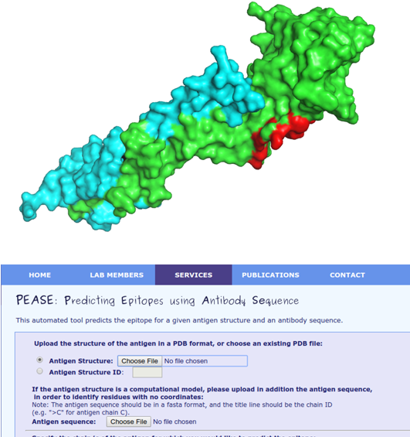
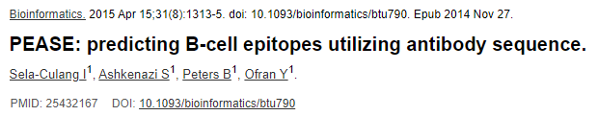
3D Structure-based epitope prediction
Theoretically, the whole exposed surface of an antigen can be targeted by different antibodies
Antibody sequence based B cell epitope prediction method called PEASE was developed
  Users must provide antigen structure and antibody sequence
http://www.ofranlab.org/PEASE

Slide 46
Benchmark on 42 X-ray structures of Ab-protein complexes (Ponomarenko & Bourne, 2008)
Average AUC values
  0.73 ElliPro (Ponomarenko et al., 2008)
  0.65 Epitopia (Rubinstein et al., 2008)
  0.63 PEPITO (Sweredoski & Baldi, 2008)
  0.60 DiscoTope 1 (Andersen et al, 2006)
  0.59 DOT (1st model, bound Ab-protein docking)
  0.58 PatchDock (1st model, bound Ab-protein docking)

Slide 47
Benchmark on 52 X-ray structures of Ab-protein complexes (Kringelum et al., 2012, PLoS Comp. Biol.)
Average AUC values
( * means p-value < 0.05 in comparison with DiscoTope 2)
  0.73 DiscoTope 2 (Kringelum et al., 2012)
  0.73 PEPITO (Sweredoski & Baldi, 2008)
  0.73 Epitopia (Rubinstein et al., 2008)
  0.72 SEPPA (Sun et al., 2009)
  0.71 DiscoTope 1 (Andersen et al, 2006)
  0.69* ElliPro (Ponomarenko et al., 2008)
  0.65* EPCES (Liang et al., 2009)
  0.59* EPSVR (Liang et al., 2010)

Slide 48
3D Structure-based epitope prediction
The reason for the relatively poor performance is in the quality of the benchmark datasets
  Structural information on the entire ‘‘biological unit‘‘ is often not available
  Existence of well characterized epitopes from very few antigens

